Slide 1
California Cadet Corps
Curriculum on Leadership
“Learn from Leaders who have forged the way before us.”
L6/A: Historical Leader Profiles

Slide 2
Historical Leadership Profiles Agenda
A1. Nelson Mandela
A2. Martin Luther King, Jr.
A3. Abraham Lincoln
A4. Lee Kuan Yew
A5. George Washington
A6. Eleanor Roosevelt
A7. Napoleon Bonaparte
A8. Genghis Khan
A9. Winston Churchill
A10. Alexander the Great
A11. Dwight D. Eisenhower
A12. George S. Patton
A13. Colin Powell
A14. Sun Tzu
A15. Steve Jobs
A16. Ray Kroc
A17. Walt Disney
A18. Henry Ford
A19. James Doolittle
A20. Chester Nimitz
A21. Douglas MacArthur
A22. Chesty Puller
A23. Frederick Douglass
A24. Mohandes Gandhi

Slide 3
Historical Leadership Profiles Unit Objectives
The desired outcome of this unit is for cadets to learn about successful historical leaders, the reasons for their success, and what their experience added to the study of leadership.
Plan of Action:
Identify historical leaders, the basics of who they were and what they did.
Explain the leadership lessons we learned from each of the historical leaders.
Compare the leadership of historical leaders to your own leadership skills, styles, and dynamics.

Slide 4
Nelson mandela
OBJECTIVES
DESIRED OUTCOME (Self-Mastery)
Cadets learn about Nelson Mandela, the reasons for his success, and what his experience added to the study of leadership.
Plan of Action:
A1. Identify the basic facts about Nelson Mandela, and what he accomplished.
A2. Explain what leadership lessons we can learn from familiarity with Nelson Mandela’s story.
A3. Compare the leadership of Nelson Mandela with your own leadership skills, styles, and dynamics.
Essential Question: What can we learn about our own leadership, how to build our traits and skills, based on the leadership of Nelson Mandela?

Slide 5
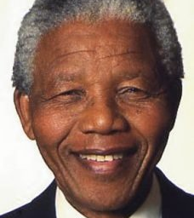
Nelson Mandela
1918-2013
Social activist
Believed in non-violence
First Black President of South Africa
Instrumental in ending apartheid
Imprisoned for 27 years
Never gave up his vision for equal rights in South Africa
Nobel Peace Prize in 1993

Slide 6
Nelson Mandela

Slide 7
Leadership Lessons
Have a vision that is for the greater good
It may be a long shot
Vision = Dream. Dream big
You need to fight for your vision
Be willing to give everything to reach your vision
Leadership is not tied to a position
Leadership can thrive without formal authority
Be a peer leader

Slide 8
Quotes
It is better to lead from behind and to put others in front, especially when you celebrate victory when nice things occur. You take the front line when there is danger. Then people will appreciate your leadership.
There is no passion to be found playing small – in settling for a life that is less than the one you are capable of living.
We must use time wisely and forever realize that the time is always ripe to do right.
After climbing a great hill, one only finds that there are many more hills to climb.

Slide 9
Check on Learning . . .
What did Nelson Mandela accomplish?
What leadership lessons can we take away?
What traits did he exhibit?
What do you admire about him?
Is there anything about Mandela that you dislike and don’t want to emulate?
What did you learn that you can use to improve your own leadership?

Slide 10
Martin Luther King, Jr.
OBJECTIVES
DESIRED OUTCOME (Self-Mastery)
Cadets learn about Martin Luther King, Jr., the reasons for his success, and what his experience added to the study of leadership.
Plan of Action:
A1. Identify the basic facts about Martin Luther King, Jr. and what he accomplished.
A2. Explain what leadership lessons we can learn from familiarity with Martin Luther King Jr.’s story.
A3. Compare the leadership of Martin Luther King, Jr. your own leadership skills, styles, and dynamics.
Essential Question: What can we learn about our own leadership, how to build our traits and skills, based on the leadership of Martin Luther King, Jr.?

Slide 11
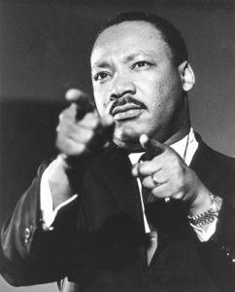
Martin Luther King, Jr.
1929-1968
Baptist Preacher
American civil rights activist
Believed in nonviolence
Led marches, protests, & advocated for equal rights
Nobel Peace Prize in 1964
Assassinated in 1968

Slide 12
Martin Luther King, Jr.

Slide 13
Leadership Lessons
Be a proactive leader
Speak up for what’s right
Have the courage to take a stand
Creative leadership is necessary for change
Embrace your values, but challenge the status quo
Stick to your priorities
Stay focused
Don’t abandon your values

Slide 14
Quotes
A genuine leader is not a searcher for consensus but a molder of consensus.
Never succumb to the temptation of bitterness.
We must learn to live together as brothers or perish together as fools.
A man who won’t die for something is not fit to live.
The time is always right to do what is right.
An individual has not started living until he can rise above the narrow confines of his individualistic concerns to the broader concerns of all humanity.
Faith is taking the first step even when you don’t see the whole staircase.
The ultimate measure of a man is not where he stands in moments of comfort and convenience, but where he stands at times of challenge and controversy.
I have a dream that one day on the red hills of Georgia, the sons of former slaves and the sons of former slave owners will be able to sit together at the table of brotherhood.
The hottest place in Hell is reserved for those who remain neutral in times of great moral conflict.
In the End, we will remember not the words of our enemies, but the silence of our friends.

Slide 15
Check on Learning . . .
What did MLK accomplish?
What leadership lessons can we take away?
What traits did he exhibit?
What do you admire about him?
Is there anything about MLK that you dislike and don’t want to emulate?
What did you learn that you can use to improve your own leadership?

Slide 16
Abraham Lincoln
OBJECTIVES
DESIRED OUTCOME (Self-Mastery)
Cadets learn about Abraham Lincoln, the reasons for his success, and what his experience added to the study of leadership.
Plan of Action:
A1. Identify the basic facts about Abraham Lincoln, and what he accomplished.
A2. Explain what leadership lessons we can learn from familiarity with Abraham Lincoln’s story.
A3. Compare the leadership of Abraham Lincoln with your own leadership skills, styles, and dynamics.
Essential Question: What can we learn about our own leadership, how to build our traits and skills, based on the leadership of Abraham Lincoln?

Slide 17
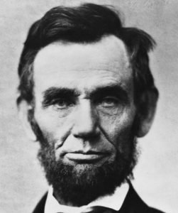
Abraham Lincoln
1809-1865
16th President of the US
Protested against slavery, against the war w/Mexico
Confederate states seceded rather than see him President
Led the Union during the Civil War
Emancipated the slaves
Assassinated in 1865

Slide 18
Abraham Lincoln The Gettysburg Address

Slide 19
Leadership Lessons
Allow room for strong opinions on your team
Get input from diverse sources
Give all stakeholders a voice and a place within the organization
Have the desire to learn
Be a lifelong learner
Having character is important
Values are important
Persistence, courage, integrity

Slide 20
Quotes
Always bear in mind that your own resolution to succeed is more important than any other.
Am I not destroying my enemies when I make friends of them?
America will never be destroyed from the outside. If we falter and lose our freedoms, it will be because we destroyed ourselves.
As I would not be a slave, so I would not be a master. This expresses my idea of democracy.
Character is like a tree and reputation like a shadow. The shadow is what we think of it; the tree is the real thing.
Give me six hours to chop down a tree and I will spend the first four sharpening the axe.
I care not much for a man’s religion whose dog and cat are not the better for it.
I have always found that mercy bears richer fruits than strict justice.
I walk slowly, but I never walk backward.
Important principles may, and must, be inflexible.
That some achieve great success, is proof to all that others can achieve it as well.
Whatever you are, be a good one.

Slide 21
Check on Learning . . .
What did Lincoln accomplish?
What leadership lessons can we take away?
What traits did he exhibit?
What do you admire about him?
Is there anything about Lincoln that you dislike and don’t want to emulate?
What did you learn that you can use to improve your own leadership?

Slide 22
Lee Kuan Yew
OBJECTIVES
DESIRED OUTCOME (Self-Mastery)
Cadets learn about Lee Kuan Yew, the reasons for his success, and what his experience added to the study of leadership.
Plan of Action:
A1. Identify the basic facts about Lee Kuan Yew, and what he accomplished.
A2. Explain what leadership lessons we can learn from familiarity with Lee Kuan Yew’s story.
A3. Compare the leadership of Lee Kuan Yew with your own leadership skills, styles, and dynamics.
Essential Question: What can we learn about our own leadership, how to build our traits and skills, based on the leadership of Lee Kuan Yew?

Slide 23
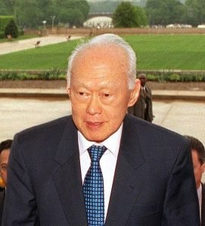
Lee Kuan Yew
1923-2015
First, longest serving Prime Minister of Singapore
Fought against British colonial rule and for an independent Singapore
Wanted union with Malaysia but failed
Built a thriving Singapore
Autocratic leadership style still pervades Singapore’s culture

Slide 24
Lee Kuan Yew

Slide 25
Leadership Lessons
Say it as it is
He was straightforward and blunt
He was honest, and could be trusted
Plan your leadership succession
The organization must transcend you
Stay tenacious
Never give up
Keep your resolve, keep focused

Slide 26
Quotes
Between being loved and being feared, I have always believed Machiavelli was right. If nobody is afraid of me, I’m meaningless.
I always tried to be correct, not politically correct.
When you’re Singapore and your existence depends on performance – extraordinary performance, better than your competitors – when that performance disappears because the system on which it’s been based becomes eroded, then you’ve lost everything… I try to tell the younger generation that and they say the old man is playing the same record, we’ve heard it all before. I happen to know how we got here, and I know how we can unscramble it.
If you can’t force or are unwilling to force your people to follow you, with or without threats, you are not a leader.
What I fear is complacency. When things always become better, people tend to want more for less work.

Slide 27
Check on Learning . . .
What did Lee Kuan Yew accomplish?
What leadership lessons can we take away?
What traits did he exhibit?
What do you admire about him?
Is there anything about Lee Kuan Yew that you dislike and don’t want to emulate?
What did you learn that you can use to improve your own leadership?

Slide 28
George Washington
OBJECTIVES
DESIRED OUTCOME (Self-Mastery)
Cadets learn about George Washington, the reasons for his success, and what his experience added to the study of leadership.
Plan of Action:
A1. Identify the basic facts about George Washington, and what he accomplished.
A2. Explain what leadership lessons we can learn from familiarity with George Washington’s story.
A3. Compare the leadership of George Washington with your own leadership skills, styles, and dynamics.
Essential Question: What can we learn about our own leadership, how to build our traits and skills, based on the leadership of George Washington?

Slide 29
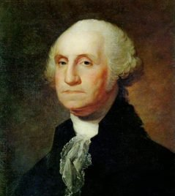
George Washington
1732-1799
Father of his country
Military leader
Reluctant to serve as president
Brought unity among diverse opinions of politicians
Slaveholder
Committed to his soldiers’ welfare and discipline

Slide 30
George Washington

Slide 31
Leadership Lessons
Character builds credibility like nothing else
Integrity builds trust
People follow leaders they trust – even to places they don’t want to go
Take care of your people
If you take care of them, they’ll take care of you
Model the behavior you wish to see
Lead by example

Slide 32
Quotes
Associate with men of good quality if you esteem your own reputation; for it is better to be alone than in bad company.
Laws made by common consent must not be trampled on by individuals.
I hope I shall possess firmness and virtue enough to maintain what I consider the most enviable of all titles, the character of an honest man.
My first wish is to see this plague of mankind
If we desire to avoid insult, we must be able to repel it; if we desire to secure peace, one of the most powerful instruments of our rising prosperity, it must be known, that we are at all times ready for War.
Discipline is the soul of an army. It makes small numbers formidable; procures success to the weak, and esteem to all.
When we assumed the Soldier, we did not lay aside the Citizen.
If the freedom of speech is taken away then dumb and silent we may be led, like sheep to the slaughter.
It is better to offer no excuse than a bad one.
We should not look back unless it is to derive useful lessons from past errors, and for the purpose of profiting by dearly bought experience.

Slide 33
Check on Learning . . .
What did George Washington accomplish?
What leadership lessons can we take away?
What traits did he exhibit?
What do you admire about him?
Is there anything about Washington that you dislike and don’t want to emulate?
What did you learn that you can use to improve your own leadership?

Slide 34
Eleanor Roosevelt
OBJECTIVES
DESIRED OUTCOME (Self-Mastery)
Cadets learn about Eleanor Roosevelt, the reasons for her success, and what her experience added to the study of leadership.
Plan of Action:
A1. Identify the basic facts about Eleanor Roosevelt, and what she accomplished.
A2. Explain what leadership lessons we can learn from familiarity with Eleanor Roosevelt’s story.
A3. Compare the leadership of Eleanor Roosevelt with your own leadership skills, styles, and dynamics.
Essential Question: What can we learn about our own leadership, how to build our traits and skills, based on the leadership of Eleanor Roosevelt?

Slide 35
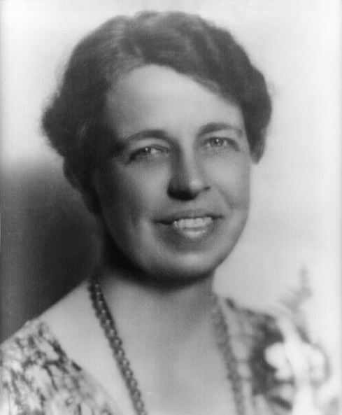
Eleanor Roosevelt
1884-1962
First Lady 1933-1945
Redefined the role of First Lady, involved in political & civil life
Diplomat, social activist, and humanitarian
Public speaker, author, acted for the President
Supported Civil Rights Movement
Supported women’s causes

Slide 36
Eleanor Roosevelt

Slide 37
Leadership Lessons
Define your own role as a leader
Be true to yourself
Fit the needs of your situation, not just what your predecessors have done
Use your position to advance your goals
Fight for what you believe in
Use your position as a positive way to bring about change
Mentors are important to your growth
Learn from your mentors, & let them guide you

Slide 38
Quotes
No one can make you feel inferior without your consent.
You must do the things you think you cannot do.
The future belongs to those who believe in the beauty of their dreams.
Great minds discuss ideas; average minds discuss events; small minds discuss people.
You gain strength, courage, and confidence by every experience in which you really stop to look fear in the face. You are able to say to yourself, ‘I lived through this horror. I can take the next thing that comes along.’
In the long run, we shape our lives, and we shape ourselves. The process never ends until we die. And the choices we make are ultimately our own responsibility.
It is not fair to ask of others what you are not willing to do yourself.
Do what you feel in your heart to be right- for you’ll be criticized anyway. You’ll be damned if you do, and damned if you don’t.
Life must be lived and curiosity kept alive. One must never, for any reason, turn his back on life.
You can often change your circumstances by changing your attitude.
Happiness is not a goal; it is a by-product.

Slide 39
Check on Learning . . .
What did Eleanor Roosevelt accomplish?
What leadership lessons can we take away?
What traits did she exhibit?
What do you admire about her?
Is there anything about Eleanor Roosevelt that you dislike and don’t want to emulate?
What did you learn that you can use to improve your own leadership?

Slide 40
Napoleon Bonaparte
OBJECTIVES
DESIRED OUTCOME (Self-Mastery)
Cadets learn about Napoleon Bonaparte, the reasons for his success, and what his experience added to the study of leadership.
Plan of Action:
A1. Identify the basic facts about Napoleon Bonaparte, and what he accomplished.
A2. Explain what leadership lessons we can learn from familiarity with Napoleon Bonaparte’s story.
A3. Compare the leadership of Napoleon Bonaparte with your own leadership skills, styles, and dynamics.
Essential Question: What can we learn about our own leadership, how to build our traits and skills, based on the leadership of Napoleon Bonaparte?

Slide 41
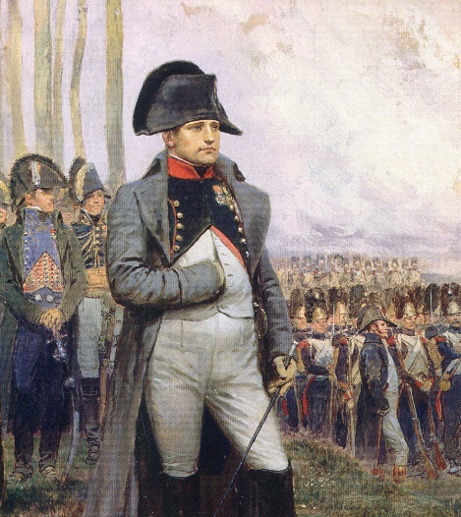
Napoleon Bonaparte
1769-1821
Conquered most of Europe, Egypt, & Syria
Military genius, made France a superpower
Stopped by Russian ability to survive defeats and the Russian winter
European countries banded together to fight against France
Lost to Britain and Prussia at Waterloo (Belgium)
Exiled to an island in 1815, where he died in 1821

Slide 42
Napoleon Bonaparte

Slide 43
Leadership Lessons
Vision and Imagination
Napoleon had a great vision for France
He was able to inspire people to follow him
He was able to attain much of what he envisioned
Know your people
Napoleon knew and inspired his soldiers
He would mingle with them and they looked to him as their leader
Persistence is key for your success
Even when he failed, he regrouped and approached his goals another way
He never gave up

Slide 44
Quotes
The word impossible is not in my dictionary.
There are only two forces in the world, the sword and the spirit. In the long run the sword will always be conquered by the spirit.
A picture is worth a thousand words.
Nothing is more difficult, and therefore more precious, than to be able to decide.
A leader is a dealer in hope
Victory belongs to the most persevering.
It requires more courage to suffer than to die.
Take time to deliberate, but when the time for action has arrived, stop thinking and go in.
With audacity one can undertake anything, but not do everything.
Four hostile newspapers are more to be feared than a thousand bayonets.
Impossible is a word to be found only in the dictionary of fools.
A true man hates no one.
Courage is like love; it must have hope for nourishment.
Ten people who speak make more noise than ten thousand who are silent.

Slide 45
Check on Learning . . .
What did Napoleon Bonaparte accomplish?
What leadership lessons can we take away?
What traits did he exhibit?
What do you admire about him?
Is there anything about Napoleon Bonaparte that you dislike and don’t want to emulate?
What did you learn that you can use to improve your own leadership?

Slide 46
Genghis Khan
OBJECTIVES
DESIRED OUTCOME (Self-Mastery)
Cadets learn about Genghis Khan, the reasons for his success, and what his experience added to the study of leadership.
Plan of Action:
A1. Identify the basic facts about Genghis Khan, and what he accomplished.
A2. Explain what leadership lessons we can learn from familiarity with Genghis Khan’s story.
A3. Compare the leadership of Genghis Khan with your own leadership skills, styles, and dynamics.
Essential Question: What can we learn about our own leadership, how to build our traits and skills, based on the leadership of Genghis Khan?

Slide 47
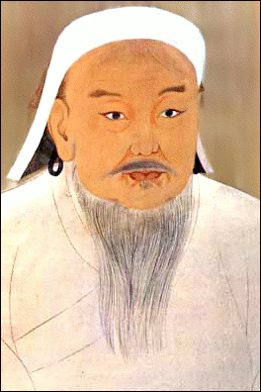
Genghis Khan (Temujin)
1162-1227
Son of a Mongolian tribal leader
A rival tribe stole his wife; he attacked them and saved her, and became a war leader
Once he defeated an enemy, he adopted them
Conquered China, Persia, and headed toward Europe, but had to return to Mongolia, so Europe was spared
Formed the largest empire in history

Slide 48
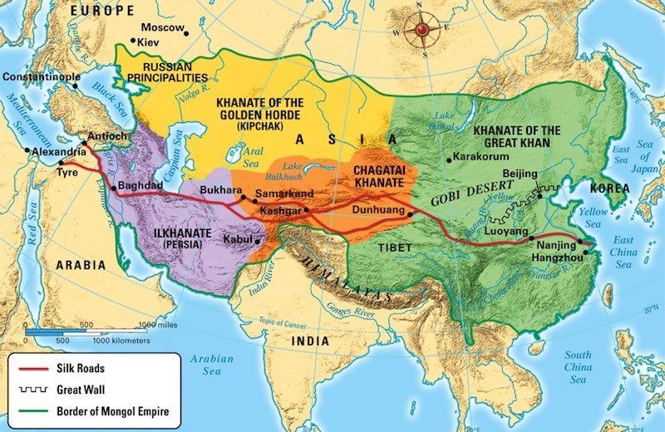
Mongol Empire

Slide 49
Genghis Khan

Slide 50
Leadership Lessons
Be a great student
Genghis Khan was open to new cultures
Adopted the better technologies, practices of people he conquered
Never stopped learning
Cultivate discipline in your team
Keeps people focused on goals
Preparation is key
If you come prepared, you will succeed

Slide 51
Quotes
With Heaven’s aid I have conquered for you a huge empire. But my life was too short to achieve the conquest of the world. That task is left for you.
A leader can never be happy until his people are happy.
An action committed in anger is an action doomed to failure.
Be of one mind and one faith, that you may conquer your enemies and lead long and happy lives.
The strength of a wall is neither greater nor less than the courage of the men who defend it.
It is not sufficient that I succeed – all others must fail.
Conquering the world on horseback is easy; it is dismounting and governing that is hard.
There is no good in anything until it is finished.
One arrow alone can easily be broken but many arrows are indestructible.
If my body dies, let my body die, but do not let my country die.

Slide 52
Check on Learning . . .
What did Genghis Khan accomplish?
What leadership lessons can we take away?
What traits did he exhibit?
What do you admire about him?
Is there anything about Genghis Khan that you dislike and don’t want to emulate?
What did you learn that you can use to improve your own leadership?

Slide 53
Winston Churchill
OBJECTIVES
DESIRED OUTCOME (Self-Mastery)
Cadets learn about Winston Churchill, the reasons for his success, and what his experience added to the study of leadership.
Plan of Action:
A1. Identify the basic facts about Winston Churchill, and what he accomplished.
A2. Explain what leadership lessons we can learn from familiarity with Winston Churchill’s story.
A3. Compare the leadership of Winston Churchill with your own leadership skills, styles, and dynamics.
Essential Question: What can we learn about our own leadership, how to build our traits and skills, based on the leadership of Winston Churchill?

Slide 54
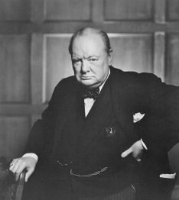
Winston Churchill
1874-1965
Prime Minister of Great Britain during World War II
Inspirational speaker (though he grew up with a stutter!) and writer
1st Lord of the Admiralty in WWI – responsible for the debacle at Gallipoli
Inspired Britons not to give up in WWII
Nobel Prize in Literature in 1953

Slide 55
Winston Churchill

Slide 56
Leadership Lessons
Strengthen your weaknesses
Overcame a stutter to become a great speaker
Never gave up, always worked to improve
Your words can have a great impact
Able to inspire others to carry on the fight
Leaders are primarily responsible for morale
Attitudes are contagious
Great leaders never stop learning
Churchill always worked on his goals, his skills
Self-development and learning from others

Slide 57
Quotes
All the great things are simple, and many can be expressed in a single word: freedom, justice, honor, duty, mercy, hope.
Never, never, never give up.
Attitude is a little thing that makes a big difference.
Courage is rightly esteemed the first of human qualities… because it is the quality which guarantees all others.
I am easily satisfied with the very best.
I have nothing to offer but blood, toil, tears and sweat.
If you are going through hell, keep going.
It is no use saying, ‘We are doing our best.’ You have got to succeed in doing what is necessary.
Success is going from failure to failure without a loss of enthusiasm.
Success is not final, failure is not fatal: it is the courage to continue that counts.
The pessimist sees difficulty in every opportunity. The optimist sees the opportunity in every difficulty.
The price of greatness is responsibility.
We are masters of the unsaid words, but slaves of those we let slip out.
We make a living by what we get, but we make a life by what we give.
You have enemies? Good. That means you’ve stood up for something, sometime in your life.

Slide 58
Check on Learning . . .
What did Winston Churchill accomplish?
What leadership lessons can we take away?
What traits did he exhibit?
What do you admire about him?
Is there anything about Churchill that you dislike and don’t want to emulate?
What did you learn that you can use to improve your own leadership?

Slide 59
Alexander the Great
OBJECTIVES
DESIRED OUTCOME (Self-Mastery)
Cadets learn about Alexander the Great, the reasons for his success, and what his experience added to the study of leadership.
Plan of Action:
A1. Identify the basic facts about Alexander the Great, and what he accomplished.
A2. Explain what leadership lessons we can learn from familiarity with Alexander the Great’s story.
A3. Compare the leadership of Alexander the Great with your own leadership skills, styles, and dynamics.
Essential Question: What can we learn about our own leadership, how to build our traits and skills, based on the leadership of Alexander the Great?

Slide 60
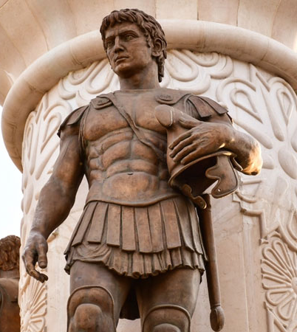
Alexander the Great
356-323 BCE
One of history’s greatest conquerors
Empire reached from Italy to the Himalayas
Brilliant general – undefeated in battle
Founded new cities that spread the Greek culture throughout his empire
Agreed to stop when his soldiers grew weary of war and wanted to go home
May have been gay
May have died from being poisoned

Slide 61
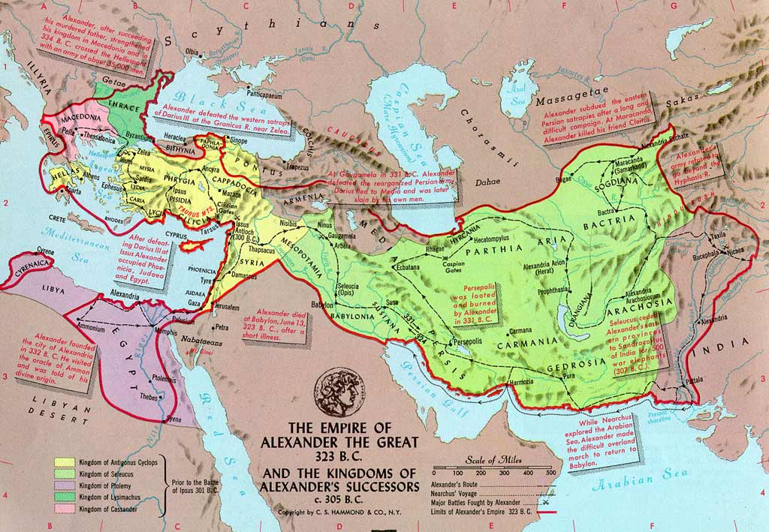
Alexander the Great’s Empire

Slide 62
Alexander the Great

Slide 63
Leadership Lessons
Believe in yourself
Confidence is a critical requirement of leadership
Leverage your team’s strengths
Alexander used brilliant tactics in battle
His army’s techniques beat the enemy every time
He understood his strengths and weaknesses
Make yourself an unnecessary part of the team
Alexander failed in this
His empire fell after he died
It’s not about you – it’s about the organization!

Slide 64
Quotes
A tomb now suffices him for whom the whole world was not sufficient.
I had rather excel others in the knowledge of what is excellent, than in the extent of my power and dominion.
Remember upon the conduct of each depends the fate of all.
I am indebted to my father for living, but to my teacher for living well.
There is nothing impossible to him who will try.
Heaven cannot brook two suns, nor earth two masters.
I am not afraid of an army of lions led by a sheep; I am afraid of an army of sheep led by a lion.
How great are the dangers I face to win a good name in Athens.
I am dying with the help of too many physicians.

Slide 65
Check on Learning . . .
What did Alexander the Great accomplish?
What leadership lessons can we take away?
What traits did he exhibit?
What do you admire about him?
Is there anything about Alexander that you dislike and don’t want to emulate?
What did you learn that you can use to improve your own leadership?

Slide 66
Dwight D. Eisenhower
OBJECTIVES
DESIRED OUTCOME (Self-Mastery)
Cadets learn about Dwight Eisenhower, the reasons for his success, and what his experience added to the study of leadership.
Plan of Action:
A1. Identify the basic facts about Dwight Eisenhower, and what he accomplished.
A2. Explain what leadership lessons we can learn from familiarity with Dwight Eisenhower’s story.
A3. Compare the leadership of Dwight Eisenhower with your own leadership skills, styles, and dynamics.
Essential Question: What can we learn about our own leadership, how to build our traits and skills, based on the leadership of Dwight Eisenhower?

Slide 67
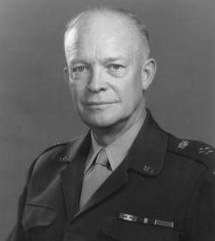
Dwight D. Eisenhower
1890-1969
Able officer who moved up the ranks from 1915, through WW1
Outstanding administrative & organizational abilities
Supreme Commander of Allied Forces in Europe during World War 2: 5-star General of the Army
Respected by a variety of stakeholders
Conceived & executed D-Day invasion
Supreme Commander of NATO after WW2
President of the US 1953-1961
Built the national highway system
Ended the Korean War

Slide 68
Dwight D. Eisenhower

Slide 69
Eisenhower Decision-Making

Slide 70
Leadership Lessons
Planning is part of success
Prepared for many eventualities
Planning process brings a staff together, makes them more able to deal with change
Lead by persuasion
Eisenhower worked successfully with many differing personalities, egos, ranks
Don’t let anger cloud your judgement
Anger clouds your judgement
Eisenhower had an easy-going disposition, and didn’t allow anger to enter into his decisions

Slide 71
Quotes
A people that values its privileges above its principles soon loses both.
History does not long entrust the care of freedom to the weak or the timid.
Humility must always be the portion of any man who receives acclaim earned in the blood of his followers and the sacrifices of his friends.
I would rather try to persuade a man to go along, because once I have persuaded him, he will stick. If I scare him, he will stay just as long as he is scared, and then he is gone.
In preparing for battle I have always found that plans are useless, but planning is indispensable.
Pessimism never won any battle.
The supreme quality for leadership is unquestionably integrity. Without it, no real success is possible, no matter whether it is on a section gang, a football field, in an army, or in an office.
What counts is not necessarily the size of the dog in the fight – it’s the size of the fight in the dog.
You don’t lead by hitting people over the head – that’s assault, not leadership.

Slide 72
Check on Learning . . .
What did Dwight D. Eisenhower accomplish?
What leadership lessons can we take away?
What traits did he exhibit?
What do you admire about him?
Is there anything about Eisenhower that you dislike and don’t want to emulate?
What did you learn that you can use to improve your own leadership?

Slide 73
George S. Patton
OBJECTIVES
DESIRED OUTCOME (Self-Mastery)
Cadets learn about George S. Patton, the reasons for his success, and what his experience added to the study of leadership.
Plan of Action:
A1. Identify the basic facts about George S. Patton, and what he accomplished.
A2. Explain what leadership lessons we can learn from familiarity with George S. Patton’s story.
A3. Compare the leadership of George S. Patton with your own leadership skills, styles, and dynamics.
Essential Question: What can we learn about our own leadership, how to build our traits and skills, based on the leadership of George S. Patton?

Slide 74
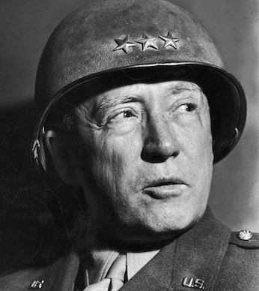
George S. Patton
1885-1945
West Point Class of 1908
Pentathlon in 1912 Olympics
Armor (tanks) Officer in WW1
Commanded II Corps in North Africa
Trouble over Slapping Incident, press reports
Commanded 3rd Army – France to Germany
Led counterattack in Battle of the Bulge
Relieved besieged forces at Bastogne

Slide 75
George S. Patton

Slide 76
Leadership Lessons
Courage
Patton was decisive and aggressive as a leader, and courageous
Make a decision and go with it!
Discipline
Patton believed in discipline
Training hard – and meeting standards - so you’ll do the right thing when in a real situation
Persistence
Patton never gave up, and pushed his units to lean forward, push ahead, and drive until they reached victory – then keep going

Slide 77
Quotes
Always do everything you ask of those you command.
You need to overcome the tug of people against you as you reach for high goals.
A good plan violently executed now is better than a perfect plan executed next week.
Success is how high you bounce when you hit bottom.
There is a time to take counsel of your fears, and there is a time to never listen to any fear.
A pint of sweat, saves a gallon of blood.
If a man does his best, what else is there?
If everyone is thinking alike, then somebody isn’t thinking.
Accept the challenges so that you can feel the exhilaration of victory.
Prepare for the unknown by studying how others in the past have coped with the unforeseeable and the unpredictable.
There is only one sort of discipline, perfect discipline.
Better to fight for something than live for nothing.
Wars may be fought with weapons, but they are won by men. It is the spirit of men who follow and of the man who leads that gains the victory.
Take calculated risks. That is quite different from being rash.

Slide 78
Check on Learning . . .
What did George Patton accomplish?
What leadership lessons can we take away?
What traits did he exhibit?
What do you admire about him?
Is there anything about Patton that you dislike and don’t want to emulate?
What did you learn that you can use to improve your own leadership?

Slide 79
Colin Powell
OBJECTIVES
DESIRED OUTCOME (Self-Mastery)
Cadets learn about Colin Powell, the reasons for his success, and what his experience added to the study of leadership.
Plan of Action:
A1. Identify the basic facts about Colin Powell, and what he accomplished.
A2. Explain what leadership lessons we can learn from familiarity with Colin Powell’s story.
A3. Compare the leadership of Colin Powell with your own leadership skills, styles, and dynamics.
Essential Question: What can we learn about our own leadership, how to build our traits and skills, based on the leadership of Colin Powell?

Slide 80
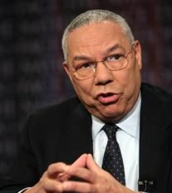
Colin Powell
1937-Present
Served 2 tours in Vietnam War
4-star Army General
Chairman, Joint Chiefs of Staff during Desert Storm
Secretary of State 2001-2005

Slide 81
Colin Powell

Slide 82
Leadership Lessons
Leadership by experience
Leaders who have experience in the field they’re leading are trusted by their followers
Step up – gain the experience you need to lead
Convey a sense of purpose
The leader defines and communicates an organization’s purpose and vision
Give your followers resources
Your followers will get the job done. You must ensure they have the training, tools, resources, and will to accomplish the mission

Slide 83
Quotes
Don’t bother people for help without first trying to solve the problem yourself.
If you are going to achieve excellence in big things, you develop the habit in little matters. Excellence is not an exception, it is a prevailing attitude.
Perpetual optimism is a force multiplier.
Success is the result of perfection, hard work, learning from failure, loyalty, and persistence.
Get mad, then get over it.
A dream doesn’t become reality through magic; it takes sweat, determination and hard work.
Avoid having your ego so close to your position that when your position falls, your ego goes with it.
Great leaders are almost always great simplifiers, who can cut through argument, debate and doubt, to offer a solution everybody can understand.
Leadership is solving problems. The day soldiers stop bringing you their problems is the day you have stopped leading them. They have either lost confidence that you can help or concluded you do not care. Either case is a failure of leadership.
Never neglect details. When everyone’s mind is dulled or distracted the leader must be doubly vigilant.
The healthiest competition occurs when average people win by putting above average effort.

Slide 84
Check on Learning . . .
What did Colin Powell accomplish?
What leadership lessons can we take away?
What traits did he exhibit?
What do you admire about him?
Is there anything about Colin Powell that you dislike and don’t want to emulate?
What did you learn that you can use to improve your own leadership?

Slide 85
Sun Tzu
OBJECTIVES
DESIRED OUTCOME (Self-Mastery)
Cadets learn about Sun Tzu, the reasons for his success, and what his experience added to the study of leadership.
Plan of Action:
A1. Identify the basic facts about Sun Tzu, and what he accomplished.
A2. Explain what leadership lessons we can learn from familiarity with Sun Tzu’s story.
A3. Compare the leadership of Sun Tzu with your own leadership skills, styles, and dynamics.
Essential Question: What can we learn about our own leadership, how to build our traits and skills, based on the leadership of Sun Tzu?

Slide 86
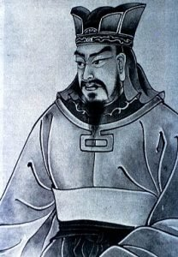
Sun Tzu
Late 6th Century BCE in China
Wrote book of war strategy The Art of War
Effective tactical & strategic general
Historical proof of Sun Tzu is unclear. Some claim The Art of War is a compilation of wisdom over several centuries, and Sun Tzu didn’t exist.
The Art of War is a preeminent source of military strategy, still studied today

Slide 87
Sun Tzu

Slide 88
Leadership Lessons
Know thyself
You need to understand your strengths and weaknesses, and your enemy’s
Keep people around you who are good at your weaknesses
Take advantage of your strengths, work on your weaknesses
The use of deception
In war, if you can win by deception, it’s a plus that saves lives. It works in business too!
Know when to fight and when not to fight
Conquer your enemy without fighting if possible. Use of deception helps in this, but there are other ways
Diplomacy beats war if you can get what you want without fighting

Slide 89
Quotes
All men can see these tactics whereby I conquer, but what none can see is the strategy out of which victory is evolved.
For to win one hundred victories in one hundred battles is not the acme of skill. To subdue the enemy without fighting is the acme of skill.
That general is skillful in attack whose opponent does not know what to defend; and he is skillful in defense whose opponent does not know what to attack.
Strategy without tactics is the slowest route to victory. Tactics without strategy is the noise before defeat.
The supreme art of war is to subdue the enemy without fighting.
If you are far from the enemy, make him believe you are near.
Regard your soldiers as your children, and they will follow you into the deepest valleys; look on them as your own beloved sons, and they will stand by you even unto death.
Know thy self, know thy enemy. A thousand battles, a thousand victories.
Opportunities multiply as they are seized.

Slide 90
Check on Learning . . .
What did Sun Tzu accomplish?
What leadership lessons can we take away?
What traits did he exhibit?
What do you admire about him?
Is there anything about Sun Tzu that you dislike and don’t want to emulate?
What did you learn that you can use to improve your own leadership?

Slide 91
Steve Jobs
OBJECTIVES
DESIRED OUTCOME (Self-Mastery)
Cadets learn about Steve Jobs, the reasons for his success, and what his experience added to the study of leadership.
Plan of Action:
A1. Identify the basic facts about Steve Jobs, and what he accomplished.
A2. Explain what leadership lessons we can learn from familiarity with Steve Jobs’ story.
A3. Compare the leadership of Steve Jobs with your own leadership skills, styles, and dynamics.
Essential Question: What can we learn about our own leadership, how to build our traits and skills, based on the leadership of Steve Jobs?

Slide 92
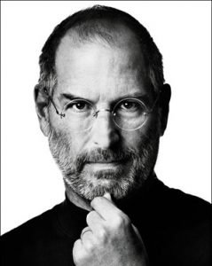
Steve Jobs
1955-2011
Multi-Billionaire
Cofounder of Apple Computer, Inc.
Founder of NeXT Inc
Built Pixar into the major animation studio it is

Slide 93
Steve Jobs

Slide 94
Leadership Lessons
Don’t Do it for the Money
Find your passion, and figure out how to make it your profession
Don’t leave the people in your life behind in pursuit of your career
Set Impossibly High Standards
Setting high standards, even when they’re not met, is better than setting low standards and meeting them
Hire the Best
As a leader, surround yourself with intelligent, passionate people who share your vision
Keep your closest advisors diverse – welcome different opinions and points of view
Don’t micro-manage. Let your followers do their job; mentor them into doing it better if necessary

Slide 95
Quotes
The people who are crazy enough to think they can change the world are the ones who do.
For the past 33 years, I have looked in the mirror every morning and asked myself: ‘If today were the last day of my life, would I want to do what I am about to do today?’ And whenever the answer has been ‘No’ for too many days in a row, I know I need to change something.
Your work is going to fill a large part of your life, and the only way to be truly satisfied is to do what you believe is great work. And the only way to do great work is to love what you do. If you haven’t found it yet, keep looking. Don’t settle. As with all matters of the heart, you’ll know when you find it.
Remembering that you are going to die is the best way I know to avoid the trap of thinking you have something to lose. You are already naked. There is no reason not to follow your heart.
Getting fired from Apple was the best thing that could have ever happened to me. The heaviness of being successful was replaced by the lightness of being a beginner again. It freed me to enter one of the most creative periods of my life.
I'm convinced that about half of what separates successful entrepreneurs from the non-successful ones is pure perseverance.
Innovation distinguishes between a leader and a follower.
My favorite things in life don’t cost any money. It’s really clear that the most precious resource we all have is time.
Have the courage to follow your heart and intuition. They somehow know what you truly want to become.
We don’t get a chance to do that many things, and every one should be really excellent. Because this is our life. Life is brief, and then you die, you know? And we’ve all chosen to do this with our lives. So, it better be damn good. It better be worth it.

Slide 96
Check on Learning . . .
What did Steve Jobs accomplish?
What leadership lessons can we take away?
What traits did he exhibit?
What do you admire about him?
Is there anything about Steve Jobs that you dislike and don’t want to emulate?
What did you learn that you can use to improve your own leadership?

Slide 97
Ray Kroc
OBJECTIVES
DESIRED OUTCOME (Self-Mastery)
Cadets learn about Ray Kroc, the reasons for his success, and what his experience added to the study of leadership.
Plan of Action:
A1. Identify the basic facts about Ray Kroc, and what he accomplished.
A2. Explain what leadership lessons we can learn from familiarity with Ray Kroc’s story.
A3. Compare the leadership of Ray Kroc with your own leadership skills, styles, and dynamics.
Essential Question: What can we learn about our own leadership, how to build our traits and skills, based on the leadership of Ray Kroc?

Slide 98
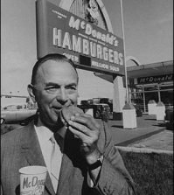
Ray Kroc
1902-1984
Bought a hamburger restaurant franchise, then bought out the chain
Built it into the McDonald’s fast-food chain
Revolutionized the food industry

Slide 99
Ray Kroc

Slide 100
Leadership Lessons
Have a big vision
Ray Kroc saw a small restaurant chain, and envisioned an empire
If you have a vision, develop and pursue it!
Commitment to Excellence
Ray Kroc obsessed over cleanliness and excellence throughout his restaurants
Commit yourself to excellence and you’ll set a standard that will ensure success

Slide 101
Quotes
Luck is a dividend of sweat. The more you sweat, the luckier you get.
The two most important requirements for major success are: first, being in the right place at the right time, and second, doing something about it.
All money means to me is a pride in accomplishment.
When you’re green, your growing. When you’re ripe, you rot.
While formal schooling is an important advantage, it is not a guarantee of success nor is its absence a fatal handicap.
You’re only as good as the people you hire.
The quality of a leader is reflected in the standards they set for themselves.
Its easy to have principles when you’re rich. The important thing is to have principles when you’re poor.
Creativity is a highfalutin word for the work I have to do between now and Tuesday.
If you work just for money, you’ll never make it, but if you love what you’re doing and you always put the customer first, success will be yours.
If you’re not a risk taker, you should get the hell out of business.
None of us is as good as all of us.

Slide 102
Check on Learning . . .
What did Ray Kroc accomplish?
What leadership lessons can we take away?
What traits did he exhibit?
What do you admire about him?
Is there anything about Ray Kroc that you dislike and don’t want to emulate?
What did you learn that you can use to improve your own leadership?

Slide 103
Walt Disney
OBJECTIVES
DESIRED OUTCOME (Self-Mastery)
Cadets learn about Walt Disney, the reasons for his success, and what his experience added to the study of leadership.
Plan of Action:
A1. Identify the basic facts about Walt Disney, and what he accomplished.
A2. Explain what leadership lessons we can learn from familiarity with Walt Disney’s story.
A3. Compare the leadership of Walt Disney with your own leadership skills, styles, and dynamics.
Essential Question: What can we learn about our own leadership, how to build our traits and skills, based on the leadership of Walt Disney?

Slide 104
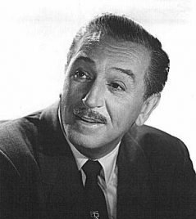
Walt Disney
1901-1966
Liked to draw
Struggled for almost 10 years before creating Mickey Mouse
Made animated movies
Created Disneyland, opening in 1955

Slide 105
Walt Disney

Slide 106
Leadership Lessons
Never stop dreaming
A dream is a vision!
Pursue your dreams/visions
Keep on keepin’ on
Don’t let failure stop you – regroup and try again!
Tenacity and persistence are key to success
Most people will quit. Great leaders don’t
Storytelling is powerful
Inspire people in ways that work

Slide 107
Quotes
The more you like yourself, the less you are like anyone else, which makes you unique.
The way to get started is to quit talking and begin doing.
There is more treasure in books than in all the pirate’s loot on Treasure Island.
A man should never neglect his family for business.
Of all the things I’ve done, the most vital is coordinating those who work with me and aiming their efforts at a certain goal.
We keep moving forward, opening new doors, and doing new things, because we’re curious and curiosity keeps leading us down new paths.
You reach a point where you don’t work for money.
Disneyland is a work of love. We didn’t go into Disneyland just with the idea of making money.
I believe in being an innovator.
When you believe in a thing, believe in it all the way, implicitly and unquestionable.
When you’re curious, you find lots of interesting things to do.
If you can dream it, you can do it.
All the adversity I’ve had in my life, all my troubles and obstacles, have strengthened me… You may not realize it when it happens, but a kick in the teeth may be the best thing in the world for you.

Slide 108
Check on Learning . . .
What did Walt Disney accomplish?
What leadership lessons can we take away?
What traits did he exhibit?
What do you admire about him?
Is there anything about Walt Disney that you dislike and don’t want to emulate?
What did you learn that you can use to improve your own leadership?

Slide 109
Henry Ford
OBJECTIVES
DESIRED OUTCOME (Self-Mastery)
Cadets learn about Henry Ford, the reasons for his success, and what his experience added to the study of leadership.
Plan of Action:
A1. Identify the basic facts about Henry Ford, and what he accomplished.
A2. Explain what leadership lessons we can learn from familiarity with Henry Ford’s story.
A3. Compare the leadership of Henry Ford with your own leadership skills, styles, and dynamics.
Essential Question: What can we learn about our own leadership, how to build our traits and skills, based on the leadership of Henry Ford?

Slide 110
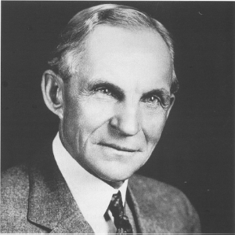
Henry Ford
1863-1947
Great at taking things apart and putting them back together
His first auto company failed
Founded Ford Motor Co in 1903
Paid high wages
Assembly lines
Affordable, mass produced cars

Slide 111
Henry Ford

Slide 112
Leadership Lessons
Value your workers
Henry Ford valued his workers, paid them well, and made them all members of his team. They responded by being enthusiastic and reliable in doing their jobs
Self-Belief is essential
Confidence in yourself builds trust in others, as long as you stay humble and respect others
Be a service leader
Ford focused on solving the needs of his customers, employees, and community
Focus on what value and service you can give to your team

Slide 113
Quotes
If there is any one secret of success, it lies in the ability to get the other person’s point of view and see things from that person’s angle as well as from your own.
If you think you can do a thing or think you can’t do a thing, you’re right.
An idealist is a person who helps other people to be prosperous.
Anyone who stops learning is old, whether at twenty or eighty. Anyone who keeps learning stays young. The greatest thing in life is to keep your mind young.
There is no man living that cannot do more than he thinks he can.
The man who will use his skill and constructive imagination to see how much he can give for a dollar, instead of how little he can give for a dollar, is bound to succeed.
There are no big problems, there are just a lot of little problems.
Thinking is the hardest work there is, which is probably the reason why so few engage in it.
It has been my observation that most people get ahead during the time that others waste.
Before everything else, getting ready is the secret of success.
Failure is simply the opportunity to begin again, this time more intelligently.

Slide 114
Check on Learning . . .
What did Henry Ford accomplish?
What leadership lessons can we take away?
What traits did he exhibit?
What do you admire about him?
Is there anything about Henry Ford that you dislike and don’t want to emulate?
What did you learn that you can use to improve your own leadership?

Slide 115
James Doolittle
OBJECTIVES
DESIRED OUTCOME (Self-Mastery)
Cadets learn about James Doolittle, the reasons for his success, and what his experience added to the study of leadership.
Plan of Action:
A1. Identify the basic facts about James Doolittle, and what he accomplished.
A2. Explain what leadership lessons we can learn from familiarity with James Doolittle’s story.
A3. Compare the leadership of James Doolittle with your own leadership skills, styles, and dynamics.
Essential Question: What can we learn about our own leadership, how to build our traits and skills, based on the leadership of James Doolittle?

Slide 116
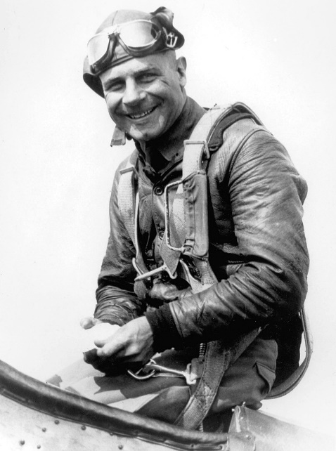
James Doolittle
1896-1993
Born in Alameda, CA
Army aviator
Aviation pioneer
Many aviation ‘firsts’
Led raid over Tokyo
Medal of Honor
Commanded Air Forces in Europe thru WWII
4-star General

Slide 117
James Doolittle

Slide 118
Leadership Lessons
Be an innovator
Jimmy Doolittle helped develop instrument flying
Planned the raid on Tokyo right after Pearl Harbor
Embraced new bombing tactics over Europe
Courage and determination
Exhibited personal bravery in bombing raids and innovative flying
Lead by example
Always led his men – didn’t send them out to do missions without him

Slide 119
Quotes
Nothing is as strong as the heart of a volunteer
The first lesson is that you can’t lose a war if you have command of the air, and you can’t win a war if you haven’t
If we should have to fight, we should be prepared to do so from the neck up instead of from the neck down.
I am not a very timid type. It’s very important to some people, but not to me. I have a simple philosophy: worry about those things you can fix. If you can’t fix it, don’t worry about it; accept it and do the best you can.
Just try to make the world a better place for your having been here.
To become an ace a fighter must have extraordinary eyesight, strength, and agility, a huntsman’s eye, coolness in a pinch, calculated recklessness, a full measure of courage and occasional luck!
I have been luckier than the law of averages should allow. I could never be so lucky again.

Slide 120
Check on Learning . . .
What did James Doolittle accomplish?
What leadership lessons can we take away?
What traits did he exhibit?
What do you admire about him?
Is there anything about James Doolittle that you dislike and don’t want to emulate?
What did you learn that you can use to improve your own leadership?

Slide 121
Chester Nimitz
OBJECTIVES
DESIRED OUTCOME (Self-Mastery)
Cadets learn about Chester Nimitz, the reasons for his success, and what his experience added to the study of leadership.
Plan of Action:
A1. Identify the basic facts about Chester Nimitz, and what he accomplished.
A2. Explain what leadership lessons we can learn from familiarity with Chester Nimitz’ story.
A3. Compare the leadership of Chester Nimitz with your own leadership skills, styles, and dynamics.
Essential Question: What can we learn about our own leadership, how to build our traits and skills, based on the leadership of Chester Nimitz?

Slide 122
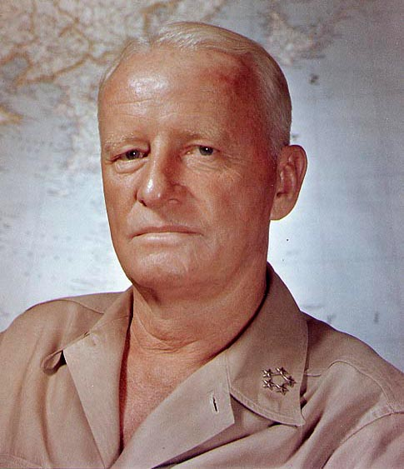
Chester Nimitz
1885-1966
Annapolis 1905
Expert on submarines
Innovator in ship replenishment
Took over Pacific Fleet after Pearl Harbor
Won the War in the Pacific
Served UN post-war

Slide 123
Chester Nimitz

Slide 124
Leadership Lessons
Select able subordinates and allow them to do their jobs without interference
At strategic levels especially, you can’t micro-manage
Build a team of qualified people
Lead by example
Nimitz was a servant leader with a cool head
Provided calm, confident leadership
Find the positive
Nimitz emphasized optimism
The right attitude after Pearl Harbor

Slide 125
Quotes
God grant me the courage not to give up what I think is right even though I think it is hopeless.
Leadership consists of picking good men and helping them do their best.
When you’re in command, command.
If you’re not making waves, you’re not underway.
Luck can be attributed to a well-conceived plan carried out by a well-trained and indoctrinated task group.
Some of the best advice I’ve had comes from junior officers and enlisted men.
The best that science can devise, and that naval organization can provide must be regarded only as an aid, and never as a substitute for good seamanship.
Hindsight is notably cleverer than foresight.
They fought together as brothers in arms; they died together and now they sleep side by side. To them we have a solemn obligation.

Slide 126
Check on Learning . . .
What did Chester Nimitz accomplish?
What leadership lessons can we take away?
What traits did he exhibit?
What do you admire about him?
Is there anything about Chester Nimitz that you dislike and don’t want to emulate?
What did you learn that you can use to improve your own leadership?

Slide 127
Douglas MacArthur
OBJECTIVES
DESIRED OUTCOME (Self-Mastery)
Cadets learn about Douglas MacArthur, the reasons for his success, and what his experience added to the study of leadership.
Plan of Action:
A1. Identify the basic facts about Douglas MacArthur, and what he accomplished.
A2. Explain what leadership lessons we can learn from familiarity with Douglas MacArthur’s story.
A3. Compare the leadership of Douglas MacArthur with your own leadership skills, styles, and dynamics.
Essential Question: What can we learn about our own leadership, how to build our traits and skills, based on the leadership of Douglas MacArthur?

Slide 128
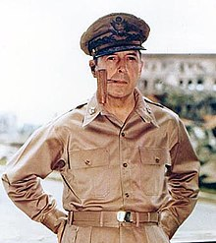
Douglas MacArthur
1880-1964
Top of West Point Class 1903
WWI up to Division Commander
Superintendent of West Point
Service in Philippines
Army Chief of Staff 1930-1935
Field Marshall of Philippines
Led Army in Pacific in WW2
Medal of Honor
Rebuilt Japan after the war
Led UN in Korean War
Relieved by President Truman

Slide 129
Douglas MacArthur

Slide 130
Leadership Lessons
Learn from history and look to the future
Rebuilding of Japan was prescient
Be optimistic
Requires vision, courage, hard work. Never quit
Break rules
Achievement and solving problems more important
Lead by example
The critical requirement of a leader
Listen to subordinates
Had Truman listened to MacArthur, we may not have had to deal with North Korea for the past 70+ years

Slide 131
Quotes
A true leader has the confidence to stand alone, the courage to make tough decisions, and the compassion to listen to the needs of others. He does not set out to be a leader but becomes one by the equality of his actions and the integrity of his intent.
History fails to record a single precedent in which nations subject to moral decay have not passed into political and economic decline. There has been either a spiritual awakening to overcome the moral lapse or a progressive deterioration leading to ultimate national disaster.
Even when opportunity knocks, a man still has to get up off his seat and open the door.
"Duty, Honor, Country" - those three hallowed words reverently dictate what you ought to be, what you can be, what you will be.
Have a good plan, execute it violently, and do it today.
For those to whom much is given, much is required. It is not whether you get knocked down, it's whether you get up. There is no substitute for victory.
Rules are mostly made to be broken and are too often for the lazy to hide behind.

Slide 132
Check on Learning . . .
What did Douglas MacArthur accomplish?
What leadership lessons can we take away?
What traits did he exhibit?
What do you admire about him?
Is there anything about MacArthur that you dislike and don’t want to emulate?
What did you learn that you can use to improve your own leadership?

Slide 133
Chesty Puller
OBJECTIVES
DESIRED OUTCOME (Self-Mastery)
Cadets learn about Chesty Puller, the reasons for his success, and what his experience added to the study of leadership.
Plan of Action:
A1. Identify the basic facts about Chesty Puller, and what he accomplished.
A2. Explain what leadership lessons we can learn from familiarity with Chesty Puller’s story.
A3. Compare the leadership of Chesty Puller with your own leadership skills, styles, and dynamics.
Essential Question: What can we learn about our own leadership, how to build our traits and skills, based on the leadership of Chesty Puller?

Slide 134
Chesty Puller
1898-1971
Enlisted in USMC 1918
Served in Haiti, Nicaragua, China
Commissioned 1919
Received 5 Navy Crosses, DSC, Silver Star, LOM with ”V”, Bronze Star with “V”, Air Medal, Purple Heart
Commanded Bn-Regt in WW2
Commanded Division in Korea
Promoted tp Lt Gen on retirement

Slide 135
Chesty Puller
Warning: foul language

Slide 136
Chesty Puller

Slide 137
Leadership Lessons
Find a way to win
Chesty Puller never quit
Make your team’s welfare a priority
Chesty looked after his Marines
Share the tough times
Lead by example
Never ask your troops to do something you wouldn’t do, and get in there with them if possible
If your subordinates are in a tough place, join them

Slide 138
Quotes
Hit hard, hit fast, hit often.
All right. They’re on our left, they’re on our right, they’re in front of us, they’re behind us . . they can’t get away this time.
We make generals today on the basis of their ability to writ a damned letter. Those kinds of men can’t get us ready for war.
My definition, the definition that I've always believed in, is that esprit de corps means love for one's own military legion - in my case, the United States Marine Corps. It means more than self-preservation, religion, or patriotism. I've also learned that this loyalty to one's corps travels both ways: up and down.
I've always believed that no officer's life, regardless of rank, is of such great value to his country that he should seek safety in the rear... Officers should be forward with their men at the point of impact.
In the Marine Corps, your buddy is not only your classmate or fellow officer, but he is also the Marine under your command. If you don't prepare yourself to properly train him, lead him, and support him on the battlefield, then you're going to let him down. That is unforgivable in the Marine Corps.

Slide 139
Check on Learning . . .
What did Chesty Puller accomplish?
What leadership lessons can we take away?
What traits did he exhibit?
What do you admire about him?
Is there anything about Chesty Puller that you dislike and don’t want to emulate?
What did you learn that you can use to improve your own leadership?

Slide 140
Frederick Douglass
OBJECTIVES
DESIRED OUTCOME (Self-Mastery)
Cadets learn about Frederick Douglass, the reasons for his success, and what his experience added to the study of leadership.
Plan of Action:
A1. Identify the basic facts about Frederick Douglass, and what he accomplished.
A2. Explain what leadership lessons we can learn from familiarity with Frederick Douglass’ story.
A3. Compare the leadership of Frederick Douglass with your own leadership skills, styles, and dynamics.
Essential Question: What can we learn about our own leadership, how to build our traits and skills, based on the leadership of Frederick Douglass?

Slide 141
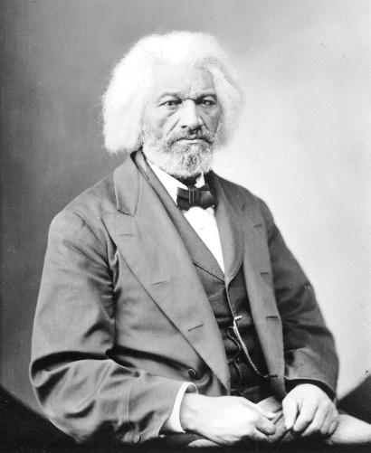
Frederick Douglass
1818-1895
Born a slave, escaped to New York, bought his freedom
Great speaker and writer
Joined anti-slavery movement
Advised President Lincoln
Wrote best selling books
Diplomat after Civil War

Slide 142
Frederick Douglass

Slide 143
Leadership Lessons
Demonstrate moral courage
Risked his life to speak out against slavery
Lead others with vision
Douglass motivated others
His oratory and writing were inspirational
Value learning
Initially taught the alphabet, he continued to pursue learning how to read and write
Douglass was a lifelong learner
Recognize others
Douglass was humble
Give credit where credit is due

Slide 144
Quotes
I prefer to be true to myself, even at the hazard of incurring the ridicule of others, rather than to be false, and to incur my own abhorrence.
It is easier to build strong children than to repair broken men.
If there is no struggle, there is no progress. Those who profess to favor freedom, and yet depreciate agitation, are men who want crops without plowing up the ground. They want rain without thunder and lightning. They want the ocean without the awful roar of its many waters. This struggle may be a moral one; or it may be a physical one; or it may be both moral and physical; but it must be a struggle.
Liberty is meaningless where the right to utter one's thoughts and opinions has ceased to exist.
You are not judged by the height you have risen, but from the depth you have climbed.
Where justice is denied, where poverty is enforced, where ignorance prevails, and where any one class is made to feel that society is an organized conspiracy to oppress, rob and degrade them, neither persons nor property will be safe.
Education means emancipation. It means light and liberty.
A man's rights rest in three boxes: the ballot box, the jury box, and the cartridge box.
Once you learn to read, you will be forever free.

Slide 145
Check on Learning . . .
What did Frederick Douglass accomplish?
What leadership lessons can we take away?
What traits did he exhibit?
What do you admire about him?
Is there anything about Frederick Douglass that you dislike and don’t want to emulate?
What did you learn that you can use to improve your own leadership?

Slide 146
Mohandas Gandhi
OBJECTIVES
DESIRED OUTCOME (Self-Mastery)
Cadets learn about Mohandas Gandhi, the reasons for his success, and what his experience added to the study of leadership.
Plan of Action:
A1. Identify the basic facts about Mohandas Gandhi, and what he accomplished.
A2. Explain what leadership lessons we can learn from familiarity with Mohandas Gandhi’s story.
A3. Compare the leadership of Mohandas Gandhi with your own leadership skills, styles, and dynamics.
Essential Question: What can we learn about our own leadership, how to build our traits and skills, based on the leadership of Mohandas Gandhi?

Slide 147
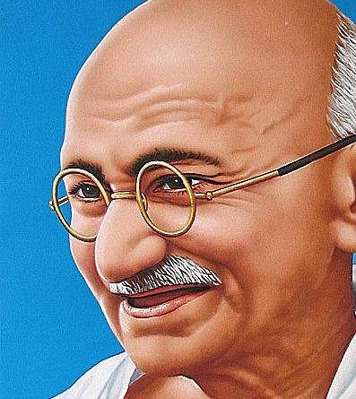
Mahatma Gandhi
1869-1948
Studied law in England
Lawyer and civil rights activist in South Africa and India
Inspired followers with his piety
Advocated nonviolence
Won independence of India from Great Britain
Couldn’t keep India united; Pakistan formed as separate Muslim country

Slide 148
Mahatma Gandhi

Slide 149
Mahatma Gandhi

Slide 150
Leadership Lessons
Transformational Leader:
Individual Consideration
Treats people as unique individuals
Mentors
Intellectual Stimulation
Gandhi challenged people to simplify concepts
Inspirational Motivation
Gandhi called on people to be better than they were
His followers were devoted to him
Idealized Influence
Gandhi led by example

Slide 151
Quotes
Nobody can hurt me without my permission.
Whatever you do may seem insignificant, but it is most important that you do it.
You must be the change you wish to see in the world.
Cowards can never be moral.
Hatred can be overcome only by love.
Fear has its use but cowardice has none.
Purity of mind and idleness are incompatible.
Live as if you were to die tomorrow. Learn as if you were to live forever.
An eye for an eye will only make the whole world blind.
Happiness is when what you think, what you say, and what you do are in harmony.
Hate the sin, love the sinner.
You must not lose faith in humanity. Humanity is like an ocean; if a few drops of the ocean are dirty, the ocean does not become dirty.
The best way to find yourself is in the service of others.
The future depends on what you do today.
The greatness of a nation and its moral progress can be judged by the way its animals are treated.
Earth provides enough to satisfy every man’s needs, but not every man’s greed.

Slide 152
Check on Learning . . .
What did Mahatma Gandhi accomplish?
What leadership lessons can we take away?
What traits did he exhibit?
What do you admire about him?
Is there anything about Mahatma Gandhi that you dislike and don’t want to emulate?
What did you learn that you can use to improve your own leadership?

