Slide 1
Wellness 3C: Curriculum On Facts about Fitness
Facts about Fitness
Cardiorespiratory Endurance
Muscular Strength
Muscular Endurance
Body Composition
Flexibility

Slide 2
Health & Wellness Agenda
C1. Fitness Component: Cardio-Respiratory Endurance
C2. Fitness Component: Muscular Strength
C3. Fitness Component: Muscular Endurance
C4. Fitness Component: Body Composition
C5. Fitness Component: Flexibility

Slide 3
Facts about Fitness: Unit Objectives
The desired outcome of this unit is for students to learn various fitness facts in the five components of fitness, understand the human anatomy as it pretends to fitness, as well as the psychology involved in exercise and sports or as it relates to their life long health.
Plan of Action:
Each step of executing PRE safely using weights
Explain muscle-bound and why and an individual should not practice it
Understand the history of Plyometrics
Define how Plyometrics is used now and other terms it is disguised by
Explain interval training
Understand and explain the myths of females fitness
Understand the Submaximal Endurance Capacity
Define the Central Nervous Systems’ role in fatigue and how it can be challenges or combatted.

Slide 4
Facts about Fitness: Unit Objectives
Explain muscle-bound and why and an individual should not practice it
Understand the history of Plyometrics
Define how Plyometrics is used now and other terms it is disguised by
Explain interval training
Understand and explain the myths of females fitness
Understand the Submaximal Endurance Capacity
Define the Central Nervous Systems’ role in fatigue and how it can be challenges or combatted.
Identify all body composition measurement methods in order from most clinically accurate to the lest accurate
Calculate the density of the body using the equation

Slide 5
Facts about Fitness: Unit Objectives
Define Body Composition
Define the two main types of eating disorders and signs/characteristics of each
Identify substance abuse
Define some characteristics of substance abuse
Define relative body fat
Understand the dehydration of the body
Explain chronic fatigue syndrome
Explain Body mass Index ( BMI) chart, and how it is used specifically

Slide 6
Physical Fitness: Unit Objectives
Explain the three specific different health-related issues ONLY females have being underweight
Understand the anatomical structure of tendons vs ligaments
Define flexibility
Explain and execute a Static stretch, a PNF stretch, and a ballistic stretch.
Define hypermobility

Slide 7
Facts about Fitness: Cardiorespiratory Endurance
Objectives: Cadets will be able to
Define cardiorespiratory endurance
Describe the three principles of exercise
Explain how to use FITT formula for moderate to vigorous exercise
Relate their natural patterns to the Physical Activity Pyramid
Essential Question:
How to utilize scientific proven patterns, and principles to positively impact cardiorespiratory endurance.

Slide 8
Cardiorespiratory Endurance
Cardiorespiratory endurance is the combination of cardiovascular meaning heart, blood and blood vessels, with lungs, and oxygen from outside the body.
A physically active person typically has more branching blood vessels on their heart, whereas a non-physical active person will have less, aiding to the supply of oxygen and blood
Involuntary contractions signals to contract without consciously telling it to do so. Building cardiorespiratory endurance is mostly completed through aerobic activity is a steady activity that supplies oxygen to the muscles from the heart.
Vigorous aerobics is defined as activities that elevate heart rate above the threshold for the duration of exercise an effective way to increase cardiorespiratory.

Slide 9
Cardiorespiratory Endurance
There are three principles of physical activity, one already discussed in the previous lesson W3 B. Physical Training, was the Principle of Specificity.
Principle of Overload, which decrees that the only way to create health and activity benefits is to require the body to do far more than it would normally do.
Principle of Progression, which states to increase activities exercises intensity gradually and allow the body to adapt to the levels of exercise.

Slide 10
FITT Formula
FITT Formula is defined as Frequency, Intensity, Time and Type, in short meaning how often, how hard, how long, and what type of exercises.
Frequency is how a task is performed.
Intensity the vigorousness of a task or exercise.
Time the length of the task or exercise.
Type the specific kind of exercise or task being performed.

Slide 11
3 Patterns of Activity
Pattern one (Daily) is to be engaged in continuous activity per day, for example, a one 30 minute session.
Pattern two (Accumulated) is to accumulate the activity time, in broken-down 10-minute sessions to hit your goal of total activity time, for example, 10 mins + 10mins +10mins throughout a daily schedule. It can accumulate more than 30 minutes if the individual target is a longer amount of time.
Pattern three (weekend warrior) is deemed the “weekend warrior,” meaning having a long duration of activity sessions sometimes for several hours in one day per week or weekend. Even though this is a pattern choice it is not recommended due to the increased risk factors and it violates the principle of progression, resulting in soreness and higher injury opportunity

Slide 12
Check On Understanding
What are the three principles of exercise?
Pattern three of moderate activity is highly recommended to do. ( T/F)
The heart is a voluntary muscle. (T/F)

Slide 13
Facts About Fitness: Muscular Strength
Objectives:
Cadets will be able to
Define PRE
explain FIT Formula
Restate in own words Double Progressive System
Explain Steps of safely working out
Explain the difference between weightlifting, powerlifting and bodybuilding
Define Plyometrics and how its used
Define and Execute interval training
Essential Question:
How is muscular strength safely built.

Slide 14
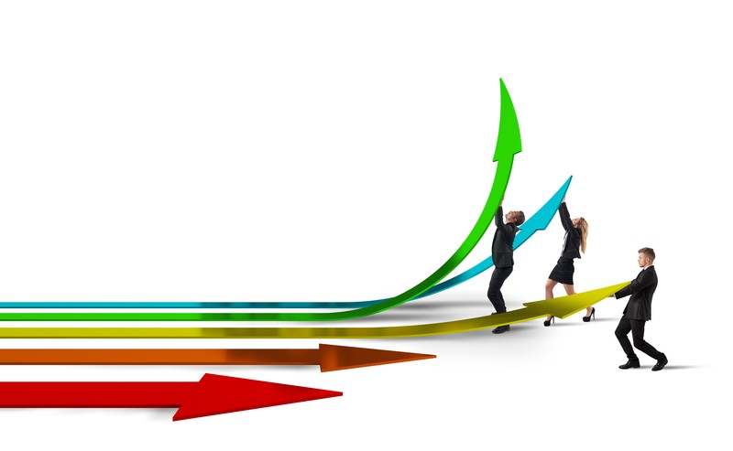
PRE
PRE as it is commonly referred to, Progressive Resistance Exercise is the most basic routine to build up muscular strength.
FIT formula focuses the exercise to Frequency how often, Intensity (% of 1RM) and the time, how many reps and sets that are completed.
Double Progressive System of PRE is increasing reps as the individual increases the sets, the second portion to create a double progression is to increase the resistance or weight of each focused exercise.

Slide 15
Steps of Executing PRE
Warm-Up before every workout
Use Proper Exercise techniques
Moderate speed for completing the movements
Do a full range of motion ( concentric and eccentric contractions)
Avoid quick movement
No holding your breath during exercise
Always use good biomechanics( stay away from awkward body positions)
Make sure the area is safe
Use spotters with free weights
Progress gradually
Select major Muscle group exercises
Always remember to rest between sets
Allow for rest days
To keep engagement vary your exercises
Avoid overhead lifts with free weights
Master single-joint exercises
Then progress to multiple-joint exercises
Ex: a Clean or a Jerk
Be safe with the free weights and never use carelessly
Never compete using resistance training

Slide 16
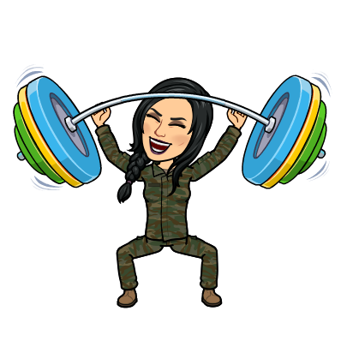
Bodybuilding, Weightlifting & powerlifting
Bodybuilding is where the participants are more focuses on the body/physique's appearance. Particularly being judged by the way the muscles are shaped, defines, and size having nothing to do with the muscular strength.
muscle-bound is having big bulky muscles that inhibit free movement or range of motion. This results in an issue such as inflexibility, inability to utilize the full capacity of muscular strength and instability of the joint.
Weightlifting is an Olympic Sport that involves free weights being lifted at maximum load of each individual, in two categories, the Clean and the Jerk.
Powerlifting is a competitive sport that involves free weights being lifted at maximum load of each individual, in three categories, the bench press, the squat, and the deadlift

Slide 17
Plyometrics & Interval Training
Plyometrics exercise, is a type of exercise that is designed to enhance athletic abilities by jumping, hopping, and other exercises that cause a lengthening of muscles that then cause a shortening contraction of the muscles.
Famously used by the Olympic Soviet Union Track and Field coaches in the 1980’s
These also have been called and interchanged with agility exercises or drills.
Interval training is bouts of high-intensity exercises that allow for small rest periods or breaks.
useful and helpful in other sports such as soccer, hockey, football, and basketball.
Referred to as HIT or HIIT (high Interval/intensity training)

Slide 18
Check On Understanding
Define the FIT Formula as it relates to the PRE.
What is the difference between Weightlifting and Powerlifting?
Muscle bound is the same as Body Building (T/F)

Slide 19
Facts about Fitness: Muscular Endurance
Objectives:
Cadets will be able to
Define Muscular Endurance
Explain Submaximal Endurance Capacity
Explain Lactic acids roles
Explain the CNS systems role in neuromuscular fatigue
Essential Question:
What happens during muscular endurance building, and the factors that encompass fatigue

Slide 20
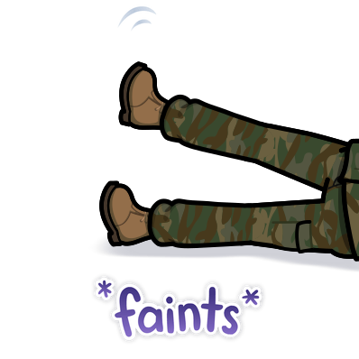
Muscular Endurance
Muscular endurance is the basic muscular ability to not fatigue or become tired.
Submaximal endurance capacity is the average of absolute output-power a person can maintain for a fixed amount of time, sometimes referred to in layman's terms as a clinical stress test.
Lactate is the salt produced from lactic acid the product that allows the muscles to produce energy without oxygen in the moment of exercise, which is during an anaerobic function.

Slide 21
Central Nervous System
Central Nervous System, the vital system of the human body that consists of the brain and spinal column.
An interesting fact about fatigue is that the CNS is responsible for limiting exercise performances and enacting signals of fatigue, but it can be challenged and combatted by the athlete listening to music, or cheering crowds. It cues a different part of the brain to allow for the athlete to push further or through the fatigue they were beginning to feel
Neuromuscular fatigue, the exercise-induced inability or lack of ability of a muscle to apply force or produce power.

Slide 22
Check On Understanding
Check on Understanding:
Explain the difference between submaximal endurance capacity and neuromuscular fatigue.
Neuromuscular fatigue is any ability to not produce power or apply force (T/F)
Explain what can override the CNS when an athlete starts to fatigue, why do you think it is possible?

Slide 23
Facts about Fitness Body Composition
Objectives:
Cadets will be able to
Identify the various clinical methods of measuring body composition
Define the Purpose of BMI
Explain Body Dysmorphia
Define two major eating disorders
Understand the seriousness of substance abuse
Identify underweight health issues for females
Essential Question:
How body composition is measured, and used to maintain life long health.

Slide 24
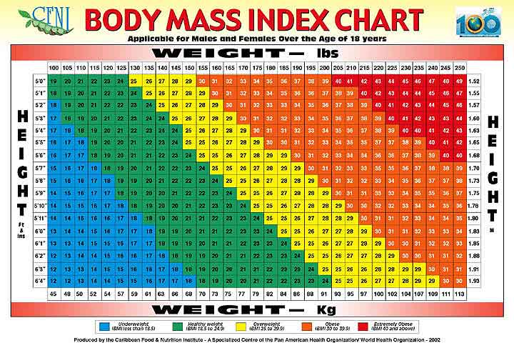
Body Composition
Body Mass Index is a chart of body fat relative of a weight to height ratio by medical standards

Slide 25
Body Composition : Clinical Methods by accuracy
X-Ray Absorptiometry (DXA) it is an X-Ray that can detect the difference between fat, bone, muscle, and tissue
Underwater weighing, a procedure where the person is weighed on land, then weighed in a big water tank after expelling all air from the lung reserve for 10-15 seconds, and then weighed again, a math equation is applied to the results and the test gives the approximate underwater weight and lung capacity seen also known as hydrostatic weighing
bod pod in which is an assessment done through a machine that looks like an egg capsule and the space the person being tested body moves the air out of the pod is how it calculates the body fat percentage.
skinfold test in a widely accepted and applied way of measuring body composition, it measures the body’s density of mass in a comparison of body fat and fat-free mass though using a caliper method at one or more sites.

Slide 26
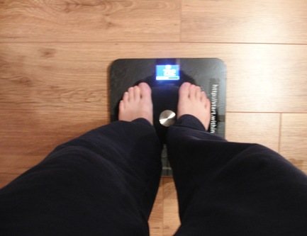
Body Composition:
bioelectric impedance, a scale-like device that sends an electric current through the body back to the machine that gives the percentage of body fat by calculating the amount of resistance of the current through the tissue.
This type of measuring tool is the least accurate and only gives a relative body fat measurement

Slide 27
Body Composition: Body Density Equation
Density of the body= Mass of Body ÷ Body Volume
(D=M÷V)
then you can calculate the body fat percentage through, % of body fat= (495 ÷ Body Density)- 450,
%BF=(495÷D)-450

Slide 28
Body Composition: Relative Body Fat (Part 1)
Relative body fat is the ratio of fat mass to total body mass, usually expressed as a percentage amount.
For example, in the study from 1977, most distance runners are usually under 12% body fat and it was discovered the top long-distance runners in the same study were measured at 6% body fat.
But the best United States distance runner was measured at 17% body fat and the women who held the best record time for the 50-mile run had 37% body fat.
The relative portion is that the sport and the competitive level does not always predict the body fat percentage expectation.

Slide 29
Body Composition: Relative Body Fat (Part 2)
Dehydration (loss of body fluids) techniques such as fasting, low-calorie diets, and lack of water consumption. Forcing the body to low weight can cause lifelong repercussions.
Chronic fatigue syndrome appears to be an immune system dysfunction that causes extreme fatigue, muscle soreness, and cognition dysfunctions that lasts for months or year.
The issues females can encounter if they are underweight:
oligomenorrhea infrequent or really light menstrual flow
amenorrhea stopped the regular menstrual flow
delayed menarche the absence or never starting their period.
These health concerns can be caused by underweight, but also by caloric restriction, and some vegetarian diets

Slide 30
Psychology of Body Composition: Disorders
Body dysmorphia is when an individual becomes obsessed with building muscle. Some psychologists refer to it as “reverse anorexia.”
Anorexia Nervosa is an eating disorder that includes three to four key characteristics, refusal to keep a healthy body weight by medical standards, afraid of gaining weight, disturbance in how one view’s their weight or body, the fourth characteristic is for females only, the absence of three consecutive menstrual cycles.
Bulimia is an eating disorder that can be any combination of five characteristics reoccurring binge eating, lack of control during binge eating, regular self-induced vomiting, an average of two binge-eating per week for at least three months, over-concerned with one's body image or weight.

Slide 31
Substance Abuse and its role in Body Composition
Substance abuse is one term that may include anything from, performance-enhancing drugs (steroids), recreational drugs (street drugs, over the counters (OTC’s) and pharmaceuticals) and alcohol.
Signs of substance abuse are but not limited to; change in behavior, changes in peer-group, personality changes, mood swings, athletic performance changes, being apathetic, anxiety, coordination changes, grooming, and hygiene may fail, sweating profusely and muscle twitches.
This type of abuse may be more prevalent in sports that need a certain body composition, weight range, or body image. These sports would be but not limited to, wrestling, swimming, diving, water polo, cheerleading, gymnastics, weight training, dance, ballet, and pole vault.

Slide 32
Check On Understanding
Check on Understanding:
Name 3 of the 5 methods to measure body composition for an individual.
Body Dysmorphia is only related to working out too much in men/males. (T/F)
Females are at no risk for health-related issues when they are underweight (T/F)

Slide 33
Facts about Fitness Flexibility
Objectives:
Cadets will be able to
Define and explain the difference between the anatomical structures of ligaments and tendons
Define and execute all three types of stretches
Define Hypermobility
Essential Question:
How to stretch properly to the best desire of need.

Slide 34
Flexibility the Forgotten Part of Fitness
Flexibility one of the 5 components of fitness, sometimes known as the “forgotten part” of fitness.
WHY?
Maintaining flexibility is crucial to maintaining overall health and mobility.
The older people become the more the flexibility begins to decrease, this is why ROM is so important to be able to complete and build towards full ROM.
Flexibility is important as a lifelong skill but it plays a larger part in select sports, gymnastics, dance, swimming, and football kickers.
It is seen as a good performance skill in tennis, baseball and golf for longer backswings, and faster forward swings.

Slide 35
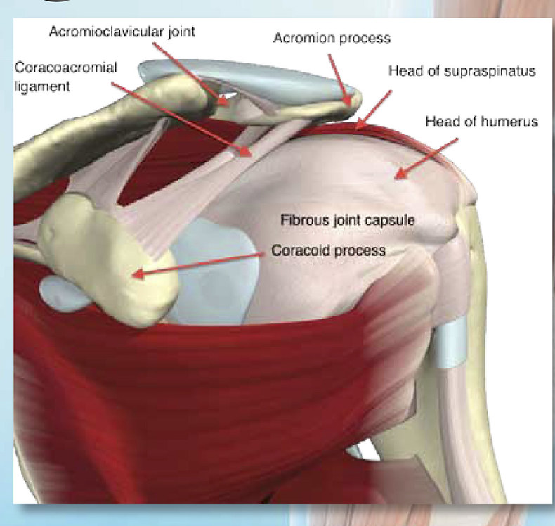
Muscle Tendon Unit
Muscle-tendon unit (MTU) is skeletal muscles and tendons that are attached to bones, they are called a unit because they work together.
Ligaments are non-elastic bands of connective tissue that connect bone to bone.
Tendons are semi-elastic bands of connective tissue that connect muscle to bone.

Slide 36
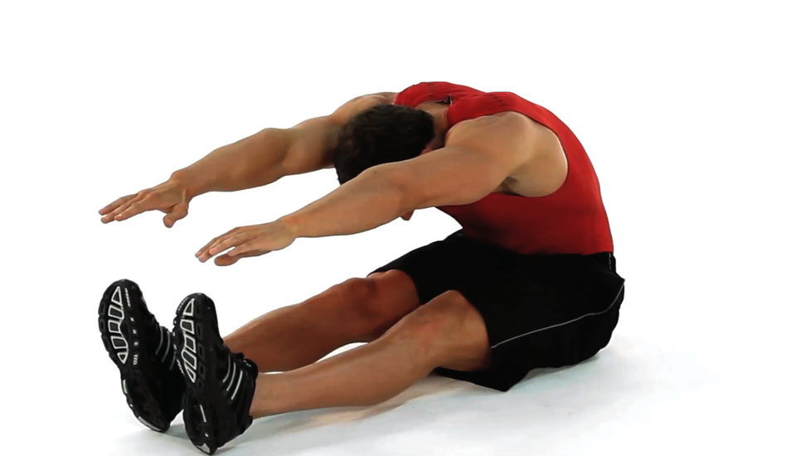
Stretching (Part 1)
The static stretch this can be completed as an active or passive type of stretch that is slow stretching as far as an individual can go without pain
Ballistic stretch is a stretching method that involved bouncing and bobbing motions.
Heredity plays its part in the ability skill of flexibility .

Slide 37
Stretching (Part 2)
Proprioceptive neuromuscular facilitation (PNF) stretch, it is a combination of static stretching paired with contracting the muscle before stretching it, this method was widely used by a physical and occupational therapist for soldiers who had been injured, but is now used in a recreational manner.
CRAC, contract-relax-antagonist-contract, which is exactly as it reads, contract eh muscle you want to stretch let it relax and then contract the antagonist muscle during that relaxation period.

Slide 38
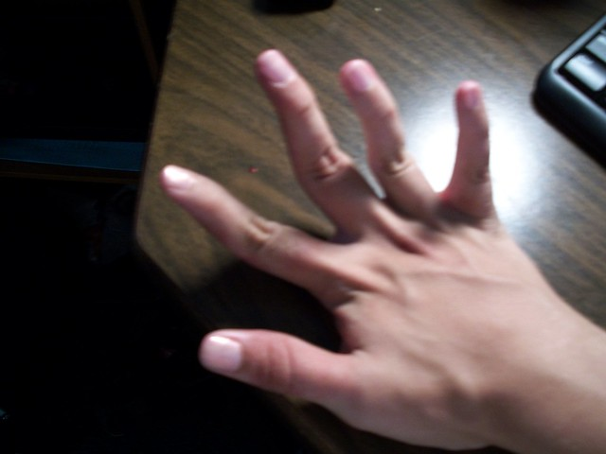
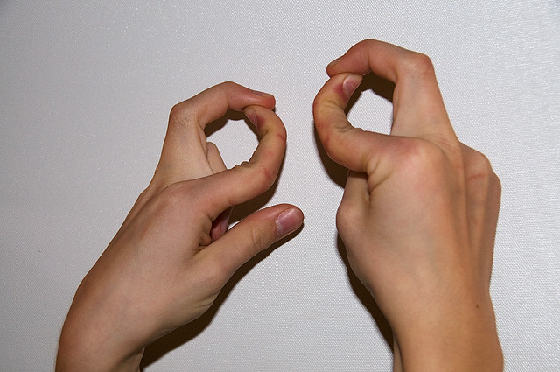
Hypermobility
Hypermobility is the larger or past the full range of motion in certain joints also known as double-jointed.
Females tend to be more flexible than males, twice as many females to males are more flexible

Slide 39
Check On Understanding
Check on Understanding:
PNF Stretching is only used on soldiers who have been injured and not allowed to be used recreationally. (T/F)
This connective tissue connects Bone to muscle _____________.
The name of the non-elastic band of connective tissue is ________________.

