Slide 1
Wellness 3B: Curriculum On Physical Training
Ways to Train
Aeropbic Capacity
Fitness for the Upper Body
Fitness for the Abdominal
Fitness for Strength & Power
Fitness for Endurance
Fitness for Balance
Fitness for the Heart

Slide 2
Agenda
B1. Ways to Train
B2. Aerobic Capacity
B3. Fitness for the Heart
B4. Fitness for the Upper Body
B5. Abdominal Fitness
B6. Strength & Power
B7. Endurance
B8. Balance

Slide 3
Ways to train
Objectives:
Cadets will be able to
Understand the difference between Skill Related Fitness and Fitness abilities
Identify the 5 elements of Skill Related Fitness
Define the Principle of Specificity
Give examples of how to train to build muscular strength vs muscular muscular endurance
Explain flexibility’s role in Range of Motion
Essential Question:
How to train to be the best version of one’s self, through utilization of the principle of specificity, skill related fitness and fitness abilities.

Slide 4
Skills
Skill related fitness refers to a group of basic abilities that helps you perform well in sports and activities requiring certain physical skills.
Skill is being able to do a task through knowledge and practice.
Physical/motor skills are skills that refer to muscles and nerves working together to complete a series of movements that together are applied to fitness and recreational movement

Slide 5
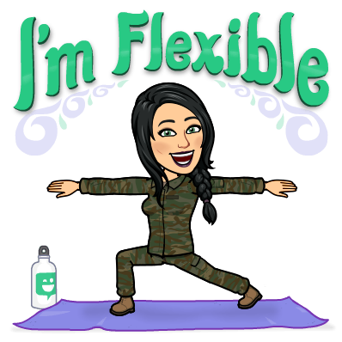
Abilities & Specificity
Fitness abilities are the natural talents and abilities based on genetics or strict conditioning; good balance can translate to gymnastics; foot speed can translate to running because of heredity and body composition.
Personal Determinants such as heredity, age, gender, disability or other factors can affect the way some people condition or plan out their fitness.
Principle of Specificity is to choose a sport or activity that aligns with a person’s skill-related fitness abilities
(example: Flexible & agile – gymnastics).

Slide 6
Train for desired fitness
Muscular Strength
Develop a plan that includes gradual increase in amounts of resistance or weight and repetitions after the ability to complete it becomes relatively easy
Workout options: Lifting Weights, Resistance bands, Climbing stairs, Cycling, Rowing, Push Ups, Sit Ups, Squats, Yoga/ Pilates, the one you most enjoy
Dietary Needs: Drink lots of water, red meats, fish, seafood, beans, whole grains, nuts, oatmeal, green vegetables, brown rice, salad, fruit

Slide 7
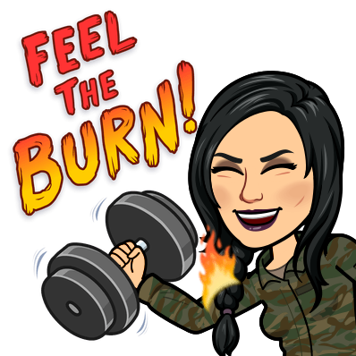
Train for desired fitness
Muscular Endurance – the ability to use your muscles many times without tiring
Helps lose fat/weight/improve body composition
Workout options: Running, Swimming, Cycling, Rowing, Lifting Weights, Resistance bands
Dietary Needs: Nothing specific

Slide 8
Cardiovascular Endurance & Aerobic Exercise
Cardiovascular Endurance, the ability exercise your entire body for a long time without stopping.
Aerobic exercises will increase energy, stamina, control blood pressure and cholesterol, and burns more calories.
Engaging in activities that target large muscle groupings, especially the legs, are continuous or follow a rhythm, and challenge your heart and lungs
Bigger, Faster Stronger (BFS) Approach- to push further, farther, longer, faster, heavier each time you have a workout

Slide 9
Flexibility & RangE of Motion
Flexibility, the ability to use your joints through a full range of motion without injury.
Factors to take into consideration : genetics, body build, gender, age and routine stretching
Range of motion (ROM), the amount of movement in a specific joint that is considered to be healthy (neither too little nor too much).

Slide 10
Student
Activity:
See Handout

Slide 11
Check On Understanding
Skill related fitness is just one skill related to a sport or activity. ( T/F)
If a person has asthma that is considered a fitness ability. ( Yes/ No)
To build muscular strength what is recommended that you do for your diet?

Slide 12
Aerobic Capacity
Objectives:
Cadets will be able to
Explain Aerobic Capacity's role in the VO2Max test
Understand how Aerobic Capacity is measured in multiple models, methods and clinical tests.
Essential Question:
How is aerobic capacity measured and why.

Slide 13
Aerobic Capacity & measuring it
Aerobic Capacity is the ability of the cardiorespiratory system to provide oxygen during hard exercises over a specific amount of time
VO₂Max is the maximum amount of oxygen the body can utilize during a specified period of usually intense exercise. Includes the athlete’s body weight.
Maximal oxygen uptake test is a reliable assessment for determining cardiovascular fitness, completed through running on a treadmill while connected to a gas meter; as difficultly increases it measures the amounts of oxygen used.
Graded Exercise Test is administered by a health professional, where the individual being tested is closely monitored through Blood pressure cuffs, speed and treadmill grade difficulty while the individual keeps going until completely exhausted.

Slide 14
Check On Understanding
There is no difference between VO₂MAX and Aerobic capacity. T/F
What does VO₂Max stand for? Define it.
What is the purpose of the gas meter in the Maximal Oxygen Uptake test?

Slide 15
Fitness for the Heart
Objectives:
Cadets will be able to
Understand and define the anatomy of the blood vessels of the heart
Explain the difference between low-density lipoprotein and high-density lipoprotein
Define the clinical definition of a heart attack
Calculate their own Target Heart Rate and Target Ceiling Heart rate using the Heart Rate Reserve equation method.
Essential Question:
How to exercise the heart to its threshold, and ceiling of capabilities for the individual.

Slide 16
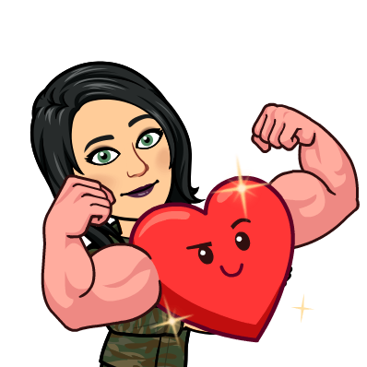
Heart Constructs
homeostasis - the stability and balance of all systems within the human body.
arteries carry oxygenated blood from the heart to all parts of the body
veins carry de-oxygenated blood or waste filled blood to the heart

Slide 17
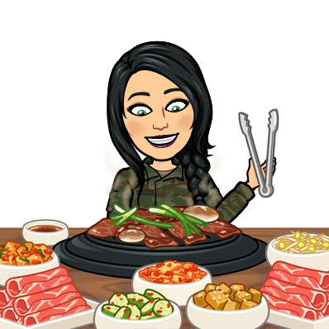
Heart Health Components
cholesterol - a substance found in meat, dairy, and eggs that collects and forms a waxy and fatty texture that sticks to the interior walls of blood vessels and arteries
low-density lipoprotein (LDL) - “bad cholesterol” it carries the cholesterol to your body that contributes to atherosclerosis
atherosclerosis fat build up in blood vessels, constricts blood flow in the arteries
High-density lipoprotein (HDL) is nicknamed “good cholesterol”. It carries the excess cholesterol out of the bloodstream to the liver so the body can eliminate or excrete it from the body.

Slide 18
Heart Attack
Heart attacks occur when there is a significant restraint or reduction of blood supply causing areas of muscles in the heart to die.
Technical Term: Myocardial Infarction

Slide 19
Heart Rate Target Zones
Maximum heartrate is 220 minus the individual’s age
Resting Heartrate is the rate your heart beats normally when your body is at rest
Heartrate Reserve is Max HR minus Resting HR
Threshold Heartrate is the percentage of heart rate an individual can sustain during exercise over a long period
Example: 16-year-old
MAX heart rate 220-16=204
Threshold Calculation
204
-67 (resting heart rate)
---------------------------------
= 137 HRR
x.60
------------------------------
82
+ 67 (resting heart rate)
------------------------------------
149 (threshold HR)

Slide 20
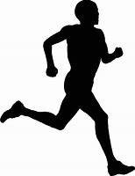
Heart Fitness Exercises
Running
Swimming
Cardio Kickboxing
Zumba
Dancing
Cycling
Any activity that raises the heart rate for the duration of the time period

Slide 21
Check On Understanding
Check on Understanding:
Define cholesterol. Explain the different types of cholesterol and their role.
To improve or maintain heart fitness one should exercise below the threshold and the target ceiling. (T/F)
What are examples of heart fitness exercises?

Slide 22
Fitness for the Upper Body
Objectives:
Cadets will be able to
Identify the major upper body muscle groups
Explain the difference between isotonic and isometric contraction
Give examples of exercise for isotonic and isometric
List multiple exercises per upper body muscle group
Essential Question:
How to exercise the upper body for the best-rounded fitness

Slide 23
Upper Body Anatomy
“Upper body” is commonly referred to for a portion of muscles above the naval, to the top of the shoulders and extending through the arms to the hands.
This grouping is made up of the major muscle groups:
trapezius (traps)
deltoid
triceps
brachioradialis
biceps
latissimus dorsi (lats)
pectoralis major (pecs)

Slide 24
Major Muscle Groups
Upper-body Muscles
Trapezius
Deltoid
Triceps
Brachioradialis
Biceps
Latissimus dorsi (“lats”)
Pectoralis major (“pecs”)
Abdominals (“abs”)
External oblique
Rectus abdominis
Quadriceps (“quads”)
Flectus lumoria
Vastus lateralis
Vastus intermedius
Vastus medialis
Hamstrings
Rectus femoris
Semitendanosus
Semimembranosus
Calves
Gastronenemius
Soleus
Fibularus longus

Slide 25
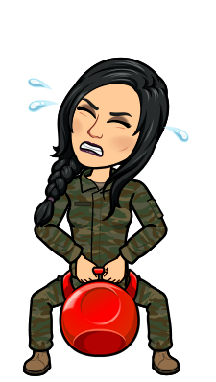
Strengthening Muscles
Hypertrophy: to build or grow muscle endurance, strength, or size of the muscle.
Concentric Contractions - shortening of the muscle.
Eccentric contractions - lengthening of the muscle
Isotonic contractions – muscles pull on bones to result in a body movement
Isotonic exercise is where the muscle must contract to move body parts, like lifting weights.

Slide 26
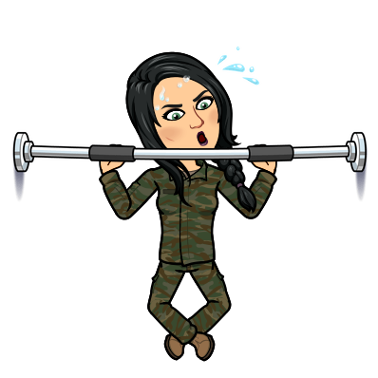
Strengthening Muscles
Isometric contraction also known as a static contraction is when a muscle is activated in opposite directions with equal force but does not shorten or lengthen.
Isometric exercises is when the body does not move during the exercise. An example of this would be holding a plank, flexed arm hangs etc.
Isokenetic exercise uses a constant speed no matter how much effort you expend. Specialized machines control the pace of an exercise by fluctuating resistance throughout your range of motion. Your speed remains consistent despite how much force you exert.

Slide 27
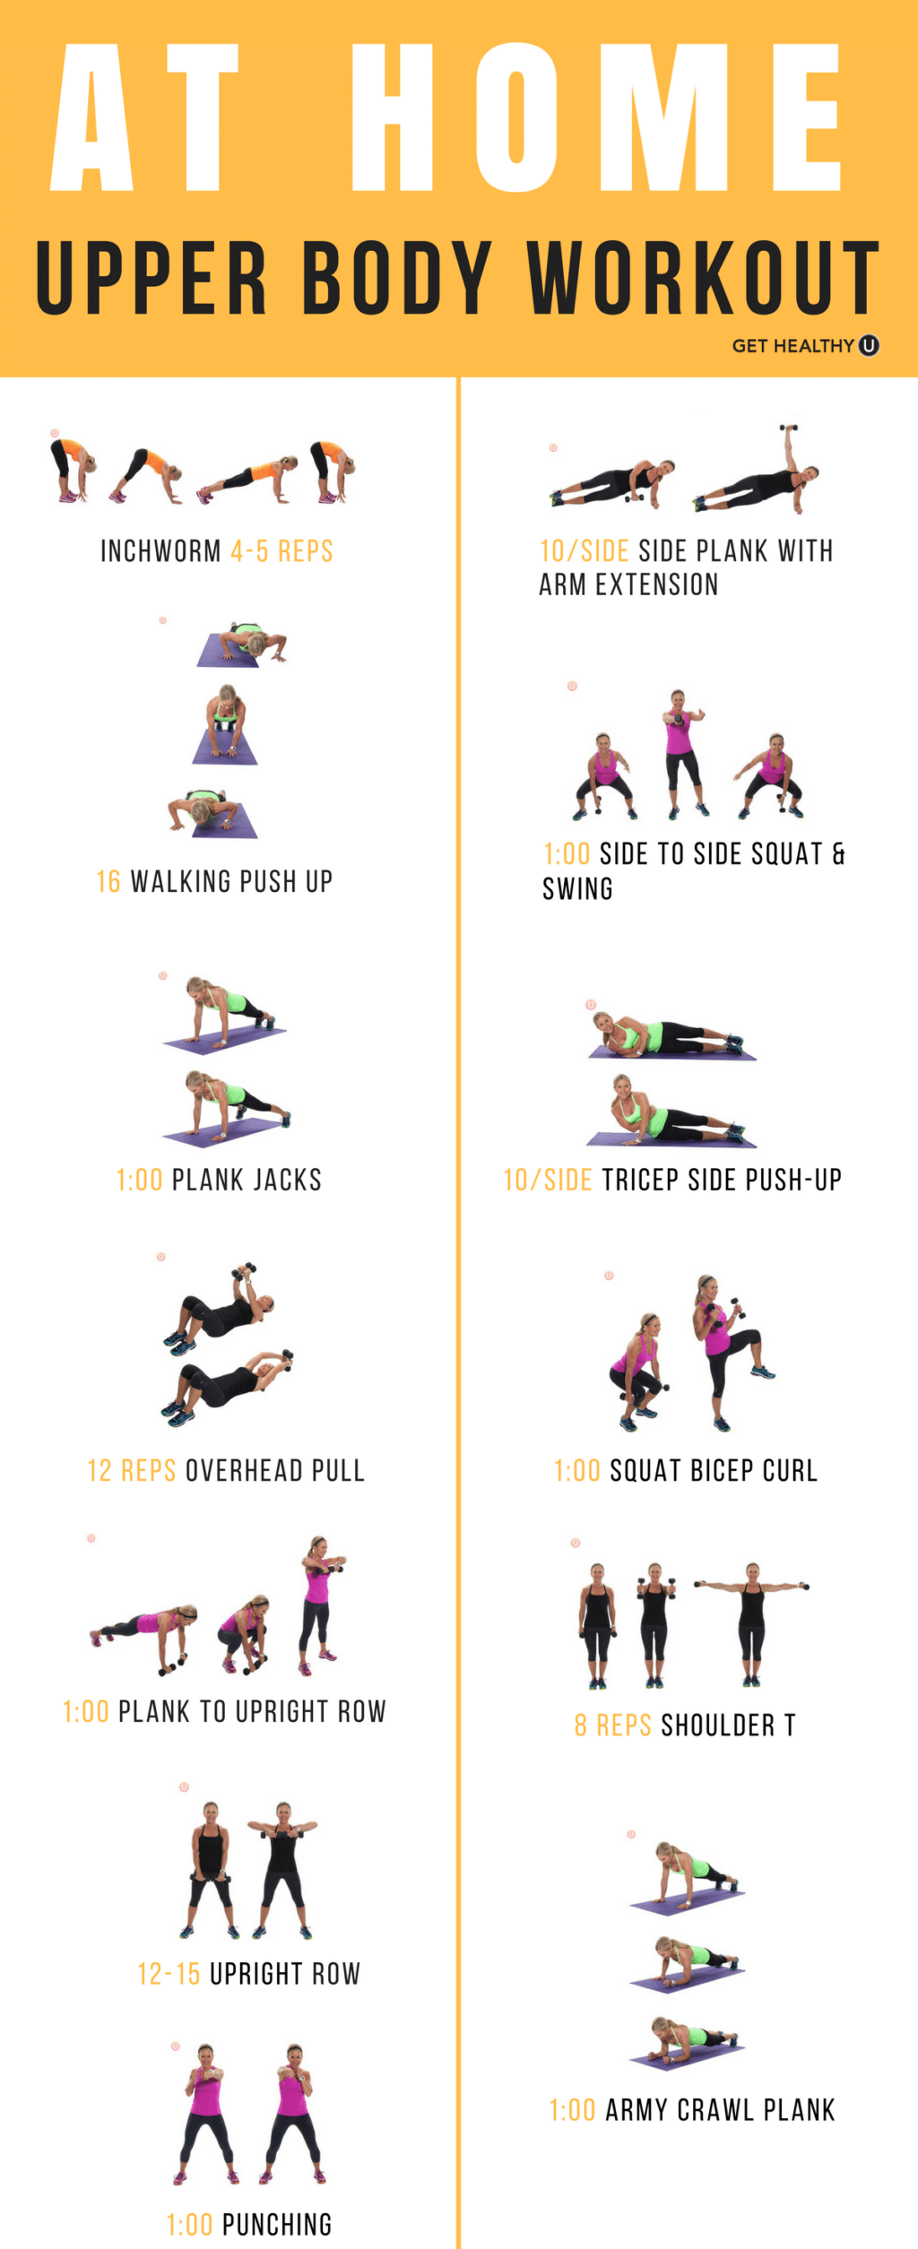
Upper Body Exercises
If you want to build upper body strength:
Pull Ups
Bicep Curls
Tricep Extensions
Push Ups

Slide 28
Check On Understanding
Check on Understanding:
There are only 8 muscles in the upper body. (T/F)
Increase in muscle size is ________________.
What is the best type of exercises, isotonic, isometric, isokinetic? Explain your answer as to why you feel that way, use deductive reasoning.

Slide 29
Abdominal fitness
Objectives:
Cadets will be able to
Identify the Abdominal muscle groups
Explain the difference between ptosis, lordosis, and kyphosis
Give examples of exercise for isotonic and isometric for the core
Essential Question:
How to exercise the abdominal muscles for the best-rounded fitness and posture

Slide 30
Abdominal Anatomy
MAJOR MUSCLE GROUPS
Core / “abs” / trunk (even though the muscles are not only in the trunk area)
Oblique’s are the major (belly) core muscles (love handles)
Transversus Abdominis - the area below the navel to the pelvic area
Rectus Abdominis - the “six pack area” center body front.
MINOR MUSCLES GROUPS
Gluteus Maximus - the butt muscles
Latimissmus Dorsi - the middle back big flat muscle that wraps towards the front of the body
Trapezius the upper back muscle that leads from middle spine up towards the neck

Slide 31
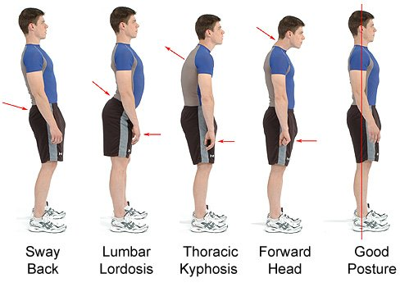
Weak Core Health Conditions
Having a weak core puts unneeded stresses on the short back muscles and causes poor posture that cause health issues such as:
ptosis the abdomen to protrude causing a round belly look
lordosis excessive back arch
kyphosis rounded back or swayback also nicknamed hunchback or humpback

Slide 32
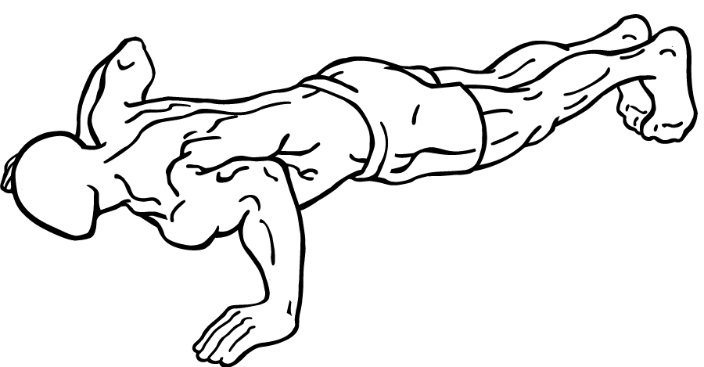
Strengthening the Core
Calisthenics- Exercises completed through using all or part of the body weight to create resistance
Exercises for core strength:
Curl Ups
Trunk Lift
Side Plank
Reverse Curl
Bridging
Supine Leg lifts (on back)
Push Ups
Prone Arm lift (face down/ belly down)
Stride Jump
Side Leg Lift
Knee to Nose (mountain climber)

Slide 33
Check On Understanding
Check on Understanding:
Are the abdominal muscles only in the trunk or belly area of the human body? ( T/F)
Other than aiding in body posture what else do the abdominal muscles support?
Three “sis” suffix conditions listed due to poor abdominal strength. Name and explain them in your own words or define.

Slide 34
Strength & power
Objectives:
Cadets will be able to
Explain the difference between Power and Strength
Define Max weight or 1RM
Calculate muscular power through the equation provided
Define the difference of Aerobic power and Anaerobic Power.
Essential Question:
How to calculate muscular strength and power of the body.

Slide 35
Strength vs Power
Strength is the max amount of force muscles can exert.
A measure for strength is shown as 1RM, or 1-repetition maximum; it’s the max amount of weight a person can lift or press once, being unable to lift or press it again.
Power is the capacity to use strength and speed quickly

Slide 36
Types of Strength
Static Strength, is completed through exercises that involve no movement; also known as isometric exercises. (ex: flexed arm hang)
Dynamic Strength is completed through exercises that involve joint movement, also known or referred to as isokinetic exercises. (ex: weightlifting)

Slide 37
Muscular Power
Muscular power is defined and found through an equation which is
$Power=\frac{Force x Distance}{Time}$
Speed is found through the equation
S$peed=\frac{Strength+Distance}{Time}$ .

Slide 38
Aerobic vs Anaerobic
Aerobic Power is an indicator of cardiovascular fitness and development in the weight bearing endurance sports such as cross country running and Nordic skiing. It is the oxygen intake per unit of body weight.
Anaerobic Power is energy that is stored in muscles and that can be accessed without the use of oxygen. Tennis, basketball, racquetball, soccer, volleyball, football and other start-and-stop sports are anaerobic because of the high heart rates, short durations and longer recovery periods you experience when you play them.

Slide 39
Check On Understanding
Check on Understanding:
What is strength?
Dynamic Strength is completed by using isokinetic exercises or isometric exercises?
What type of power does not involve uptake of oxygen?

Slide 40
Endurance
Objectives:
Cadets will be able to
Define muscular endurance
Explain the difference between slow-twitch, fast-twitch, and intermediate- twitch
Give examples of abilities/activities for each type of muscular fiber
Essential Question:
How to identify muscle fiber types for the best fitness.

Slide 41
Muscular Endurance
Muscular endurance is the ability of a muscle or group of muscles to resist fatigue, or to sustain repeated contractions for an extended time period and not tire.
This type of endurance does not rely on oxygen or respiratory system, but on muscle fibers.

Slide 42
Muscular Endurance
There are three primary muscle fiber types:
Slow-Twitch (Type II) muscle fibers that help long endurance
Fast-Twitch/(Type I) muscle fibers that facilitate powerful movements while having least endurance, used in strength activities – explosive, short term or highly intensive exercises
Intermediate-twitch fibers mirror both characteristics of slow and fast twitch fibers.
Based on body make up and heredity, genetics determines if a person has more slow, fast or intermediate fibers.

Slide 43
Check On Understanding
Check on Understanding:
What is the definition of muscular endurance?
A high jumper is an example of what type of muscle fiber? Type I or Type II? Explain why?
Fast-twitch fibers is a perfect example of what would be expected to be found in long distance runners. True or False?

Slide 44
Balance
Objectives:
Cadets will be able to
Define Muscular Balance
Define Balancing Energy
Calculate caloric burn using METs Equation
Essential Question:
How to calculate individual caloric burn using METs equation for a full 24-hour day

Slide 45
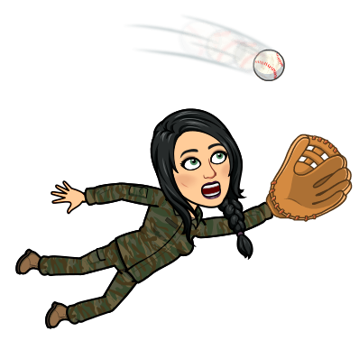
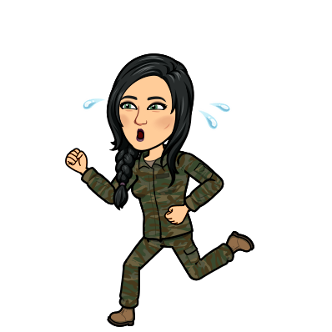
Balance
Muscular Balance is defined as an ability to remain in an upright position while standing or moving. It is a component of skill-related fitness.
excellent balance-related skills: bicycling, dance, gymnastics, skating/ice skating, hockey, skiing and tai chi
good balance-related skills: baseball, basketball, bowling, extreme sports, football, and martial arts
fair balance-related skills: tennis, golf, soccer, softball, and volleyball
poor balance-related skills: jogging and swimming

Slide 46
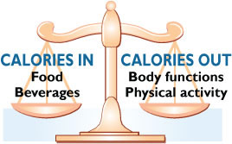
Balancing Energy
Balancing energy is balancing intake with output, such as food intake with energy output through exercises and activities.
Input vs Output

Slide 47
Measuring/ Calculating Caloric Burn
Metabolic Equivalent (METS) is a unit that measures the metabolic cost (oxygen consumption) of any physical activity or exercise.
Its mathematical definition is 3.5ml of O₂ multiplied by kg multiplied by min. $METS=3.5ml x kg x mins$.
For example, a 155-pound person is (rounded) 70kgs, (lbs to kg is # lbs divided by 2.2), who spends 8 hours resting (8 x 60= 480 minutes) utilizes roughly 588 calories. (resting is 1 met)
$\frac{( 1met x 3.5ml x70)}{200} X 480=588 calories.$

Slide 48
Measuring/ Calculating Caloric Burn Continued

Slide 49
Measuring/ Calculating Caloric Burn Continued

Slide 50
Check On Understanding
Check on Understanding:
Balance definition only refers to muscular. (T/F)
What does METS stand for and define it.
Calculate this person’s metabolic output in calories burned (round kg and all answers to closest whole)
Patient is 175 lbs.
Averages 8 hours of sleep
Does a moderate gym routine for 2 hours
Treadmill at 3.5 mph for 1 hour
Swims slow moderate front crawl/freestyle for 1 hour
Does office work for 8 hours
Showers for 30 minute
Grooms for 30 minutes
Eats for 15 minutes 4 times a day
Relaxes at home for 4 hours before bed.

