Slide 1

California Cadet Corps
Curriculum on Wellness
“Don’t Steal From Your Future!”
W1/A: Finances: Money Management

Slide 2
Agenda
A1. Introduction to Personal Finance
A2. Cash
A3. Savings
A4. Checking Accounts
A5. Debt, Loans, and Credit Cards
A6. Personal Budgeting
A7. Life After High School

Slide 3
Introduction to
Personal Finance

Slide 4
Introduction to Personal Finance
OBJECTIVES
Cadets will be able to put into practice good money management skills.
Plan of Action
1. Identify the reasons to wisely manage money
Essential Question:
Why is it important to actively be involved in managing your money?

Slide 5
Introduction to Personal Finance
Important to be responsible with any money you receive
  Job
  Allowance
  Gift
Good money management skills are essential!
  For Now
  For the Future
    Financial independence from parents
    Less stress when not in debt
Be Smart with Your Money!

Slide 6
Introduction to Personal Finance
Where do we learn our money management skills?
  Parents
  Other family members
If family doesn’t handle money well, it’s time to break the cycle!

Slide 7

Introduction to Personal Finance
YOU Decide what to do with Your Money – Don’t Let Your Money Decide for You!

Slide 8
Introduction to Personal Finance
Three key ways to manage your money:
  Wise/planned spending
  Saving
  Planning/Budgeting

Slide 9
Introduction to Personal Finance
Practical Exercise
Commandant writes on the board answers to the following question asked of Cadets:
“How do you acquire money?”
(For example: an allowance from mom or dad)
*Cadets: Note somewhere your own personal answer(s) to this question as you’ll be applying it in an exercise in another lesson.*

Slide 10

Introduction to Personal Finance
SPENDING
One of the biggest things people do with money is spend it!
On things we need
Just because we want something

Slide 11
Introduction to Personal Finance
How do you spend your money?
Practical Exercise
Commandant writes on the board answers to the following question asked of Cadets:
“What do you spend your money on?”
*Cadets: Note somewhere your own personal answer(s) to this question as you’ll be applying it in an exercise in another lesson.*

Slide 12
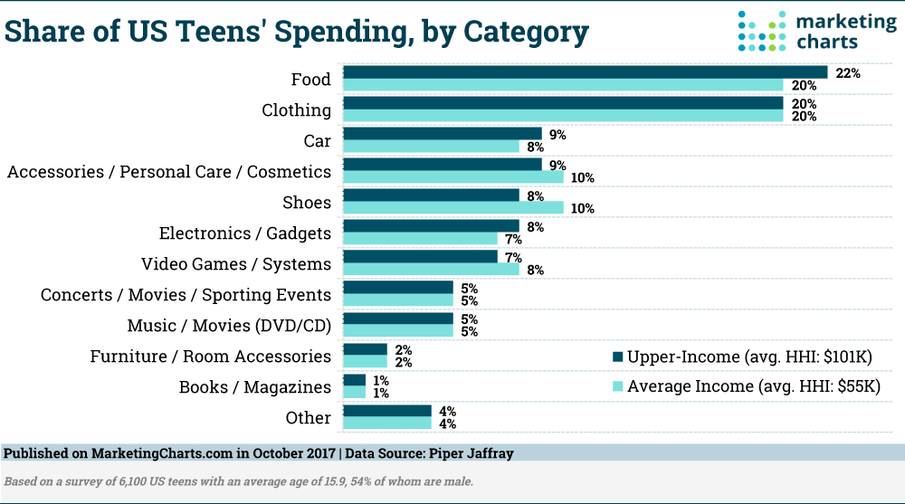
Introduction to Personal Finance
How Are Teens Spending Money? (2017, October 19). Retrieved from Marketing Charts: https://www.marketingcharts.com/demographics-and-audiences-80708/attachment/piperjaffray-share-of-us-teen-spending-by-category-oct2017

Slide 13
Check on Learning
Explain in your own words why it’s important that you actively and wisely manage your money.

Slide 14
Cash

Slide 15
Cash
OBJECTIVES
Cadets will be able to put into practice good money management skills.
Plan of Action
2. Explain why it’s best to use cash instead of debit cards
Essential Question:
Why is it best to use cash instead of debit cards?

Slide 16

Cash
It’s best to use cash to pay for purchases!
WHY?
The feel of cash leaving your hands makes it very personal to you!
You become aware of what you’re doing with your money
    It hurts to part with your cash!

Slide 17
Cash
Cash
1. Money in the form of coins or banknotes, especially that issued by a government.
2. Money or an equivalent, as a check, paid at the time of making a purchase.
Cash. (2019). Retrieved from Dictionary.com: https://www.dictionary.com/browse/cash

Slide 18

Cash
A paper check is often considered “cash”
  BUT not the same as handing over that green paper!
  Checks often used to pay rent, utilities, etc.
    (or pay bills using online banking)
Plan ahead & carry the amount of cash you plan to spend
  More likely to spend wisely & thoughtfully!

Slide 19

Cash
Downsides of using a debit card in place of cash:
You don’t feel the cash leaving your hand
Really easy to do unplanned spending – overspending!
May overdraw your bank account
  Bank penalty fees for overdrawing

Slide 20
Check on Learning
Why is it better to use cash rather than a debit card?

Slide 21
Savings

Slide 22
Savings
OBJECTIVES
Cadets will be able to put into practice good money management skills.
Plan of Action
3. Open a savings account
Essential Question:
Why is it important to have a savings account?

Slide 23
Savings
Wise money management includes putting aside some money for savings
Need to make some savings goals
Possible savings goals right now:
  a car
  college or vocational/trade school
  “first & last” months’ rent for an apartment

Slide 24
Savings
Regularly putting money in a savings account establishes a good lifetime habit
Possible savings goals as an adult:
“emergency savings” for expected & unexpected things
    Medical emergencies, job loss, car and house repairs
A car
Down payment to buy a home
Vacations
Christmas gifts
Children’s college

Slide 25

Savings
Why not save your money…
- in a box in your closet?
- under your mattress?
- or somewhere else in your house?
BECAUSE…
Someone may steal it if they find it
You may spend it because of easy access!

Slide 26
Savings
Save your money in a savings account at a financial institution such as a bank or credit union:
Safest place for your money
Your money will earn compound interest

Slide 27

Savings
Compound Interest: A process of growing your money
Bank pays you interest on the money you’ve deposited
  Interest is calculated on the total money you’ve deposited (assuming you haven’t taken money out of your account)
  Every time the bank calculates interest, it includes:
    the interest the bank previously paid you
    plus any additional amounts you had deposited

Slide 28
Savings
The bank determines the frequency of interest calculation. Frequencies are:
Annual compounding: Interest is calculated and paid once a year.
Quarterly compounding: Interest is calculated and paid once every three months.
Monthly compounding: Interest is calculated and paid each month.
Daily compounding: Interest is calculated and paid every day.
How Often Is Interest Accrued on a Savings Account? (2019). Retrieved from The Motley Fool: https://www.fool.com/saving/how-often-is-interest-accrued-on-a-savings-account.aspx

Slide 29
Compound Interest
Example
“Start with the concept of simple interest: you deposit money, and the bank pays you interest on your deposit. For example, you might deposit $100 for one year at 5 percent, and you’d earn $5 in interest over the year.
What happens next year? That’s where compounding comes in. You’ll start earning interest on your initial deposit, and you’ll earn interest on the interest you just earned:
You’ll earn 5 percent on your original deposit $100 again.
You’ll earn 5 percent on the new $5 of interest earnings the bank paid to your account.
That means you’ll earn more than $5 next year because your account balance is now $105, even though you didn’t make any deposits, so your earnings will accelerate. At many banks, especially online banks, interest compounds daily and gets added to your account monthly, so the process moves even faster.”
How Compound Interest Works and How to Calculate It. (n.d.). Retrieved from the balance: https://www.thebalance.com/compound-interest-4061154

Slide 30
Savings
The main point to remember:
Putting your money in a savings account (and not drawing it out), will increase your savings through compound interest plus your additional savings deposits.
Regularly saving money makes your savings grow even faster!

Slide 31
Opening a Savings Account
If under 18 years old, it’s likely you’ll need a parent or legal guardian to be a co-owner
You’ll receive an ATM card
  ATM card used to deposit or withdraw money from an Automated Teller Machine (ATM)
  you will also get a Personal Identification Number (PIN) associated with the card
    You must use this PIN when you use your debit card
  Don’t every give your ATM card or PIN to anyone!

Slide 32
Practical Exercise #1
Each Cadet writes down at least one savings goal
(Cadets should save what they’ve written for application in a future exercise)

Slide 33
Practical Exercise #2
(To do outside of the classroom setting)
Each Cadet is encouraged to do this exercise with a parent or guardian.
Go to a local bank or credit union and open a savings account. Many financial institutions have student savings accounts.
When researching a savings account online or when talking to the bank/financial institution representative, the parent and Cadet should make ensure the account has no limits on the amount and the frequency of deposits.

Slide 34
Check on Learning
Name some reasons why it’s important to have a savings account:
1.
2.
3.
4.

Slide 35
Checking Accounts

Slide 36
Checking Accounts
OBJECTIVES
Cadets will be able to put into practice good money management skills.
Plan of Action
4. Identify why a checking account is needed as an adult
Essential Question:
Why is a checking account needed?

Slide 37
Checking Accounts
An account at a bank or other financial institution to deposit & withdraw money
If under 18, parent or guardian needs to be a co-owner
Need checking account to:
  deposit money from a job
  pay bills (such as rent, mortgage, & utilities)
    Online bill payments are now common

Slide 38
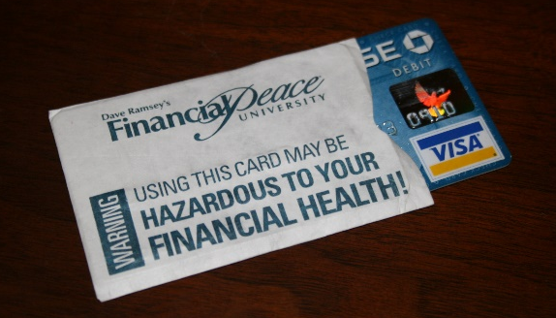
Checking Accounts
Debit Cards
Commonly used to withdraw money from an account
Not a credit card
Interest is not charged
Need to keep track of how much money is an account
  Don’t take out money you don’t have in your account (overdraw)!!

Slide 39
Check on Learning
What’s the purpose of having a
checking account?

Slide 40
Debt, Loans, and
Credit Cards

Slide 41
Debt, Loans, and
Credit Cards
OBJECTIVES
Cadets will be able to put into practice good money management skills.
Plan of Action
5. Identify why loans and credit cards are not good sources of money
Essential Questions:
Why is it best not to take out loans?
Why is it best not to use credit cards?

Slide 42

Debt, Loans, and
Credit Cards
A lot of Americans are deep in personal debt!
Why?
We want instant gratification & don’t have the cash to pay for it
Our ego – we want to impress others with nice things we have (car, clothes, house, etc.)
We haven’t saved to buy what we need or want

Slide 43
Debt, Loans, and
Credit Cards
A lot of adults in our life use credit cards
  Only pay the minimum monthly payment
  They don’t pay off the balance
Many adults have credit card balances & loans
  For cars, big screen TVs, washers & dryers, etc.
  They’re deep in debt
  We want you to break the cycle!

Slide 44
Debt, Loans, and
Credit Cards
Credit Cards
Interest charges applied to unpaid balance
  Applied from date of the transaction/purchase
  Interest charges usually very high – sometimes over 20%!
  Balance owed grows & will never be paid off if only the monthly minimum payments are made
Being in debt is stressful!
  Prevents you from every getting ahead financially

Slide 45
Debt, Loans, and
Credit Cards
Loans
“The borrower is a slave to the lender”
(from an ancient scripture that still holds true today)
Borrowing money makes you indebted to the person or institution who lends it to you

Slide 46
Debt, Loans, and
Credit Cards
Loans
If borrow from family or friend
  Relationships can sour or be lost completely if:
    either person feels something went wrong
    a payment is skipped or the loan is never repaid

Slide 47
Debt, Loans, and
Credit Cards
Loans
If borrow from a financial institution
  The item can be repossessed if you fail to make the payments
    I.e., if you get a loan for a car, then lose your job & can’t make the payments, the loan holder will have the car physically taken from you (“repossessed”)

Slide 48

Debt, Loans, and
Credit Cards
Loans
Buying a Home
  Understandably, it’s the one item where most adults have to get a loan
  Very few people have the cash up front to pay the total cost

Slide 49
Check on Learning
Explain why it’s best not to use credit cards?
Interest charges on credit cards are applied on balances from the date of the .
Why should you not borrow money from a family member or friend?
Why is it best not to take out a loan to buy something like a car?

Slide 50
Personal Budgeting

Slide 51
Personal Budgeting
OBJECTIVES
Cadets will be able to put into practice good money management skills.
Plan of Action
6. Create and use a personal budget
Essential Question:
How do I create a personal budget?

Slide 52

Personal Budgeting
A plan you create to manage your money
A tool used to allocate each dollar you get
Different methods used to manage money
  Two simplest methods (and probably most efficient):
    The Envelope System
    The Budget Spreadsheeet

Slide 53

Personal Budgeting
The Envelope System
Label envelopes with each of your expense categories
Distribute your cash among the envelopes
  According to the amounts designated in your budget

Slide 54
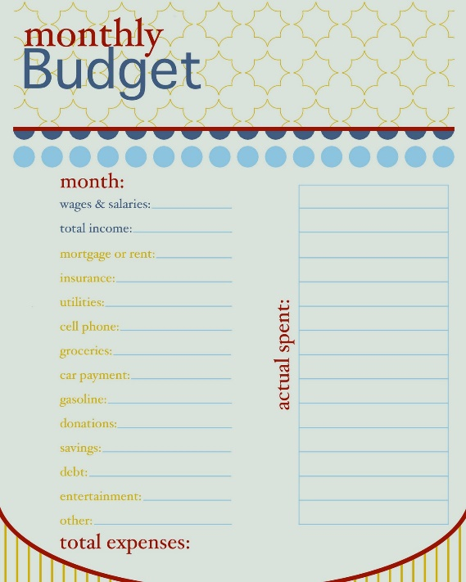
Personal Budgeting
The Budget Spreadsheet
Pre-made form to track your spending
  Paper or
  Electronic worksheet
    Computer program (such as Microsoft Excel)
    Online apps (such as the YNAB, Every Dollar, Good Budget, and Mint)
    Easiest & quickest
      Does the calculations when you plug in the dollar amounts

Slide 55
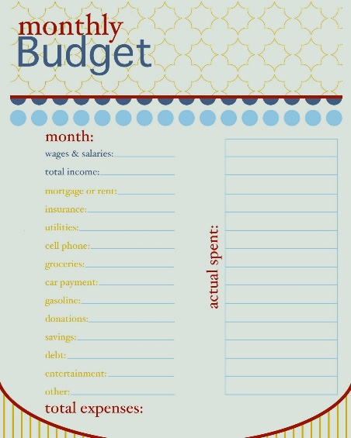
Personal Budgeting
The Budget Spreadsheet (continued)
Each time money is received or spent:
  Enter the amount in the spreadsheet for that category.
  Update totals so you know what you have left to spend in that category
A written budget is important!
  Allows you to track expenditures
  If needed, shows you where you need to adjust any budget categories in future months

Slide 56
Blank Budget Worksheet Example

Slide 57
Completed Budget Worksheet Example

Slide 58
Personal Budgeting
Practicum
Using a provided budget worksheet form, the Commandant explains how to use the worksheet, walking through each row and column on the worksheet, using a completed worksheet as an example.*
Cadets plug in their own numbers on the worksheet. If the Cadet doesn’t have numbers to plug in, then he/she should put in some numbers as a model for them to follow.*
*Blank (with and without formulas) and Example budget worksheets are available on the CACC Curriculum web page both electronically and for printing hard copies

Slide 59
Check on Learning
What is the purpose of a personal budget?
Name some tools you can use to create a personal budget.

Slide 60
Life after high school

Slide 61
Life After High School
OBJECTIVES
Cadets will be able to put into practice good money management skills.
Plan of Action
7. Make a plan for saving for life after high school
Essential Questions:
What do I think I want to do after I finish high school?
How am I going to fund what I think I want to do?

Slide 62

Life After High School
What are you going to do after high school?
Prepare now!
The sooner you start preparing, the better
Regardless of plans, financial resources likely needed to fund your plan
Put money away in savings

Slide 63

Life After High School
Do you want to go to college or a vocational/trade school?
  Paying back student loans after college can be a big financial burden for a very long time!
    Because of the burden & stress, student loans are not an ideal way to finance college or trade/vocational education
  Can you live at home while going to school?
    This can save you moneyCan you work part-time while going to school?
    This can help pay for school

Slide 64

Life After High School
Do you want to take “a gap year”?
  What are you going to do during a gap year?
  Where are you going to get the money to support yourself while you take a gap year?
Do you want to travel?
  Where are you going to get the funds to pay for travel?

Slide 65

Life After High School
Are you going to get a job or do you currently have a job?
  Do you have a job now and are you saving money?
    If not, it’s time to start saving!
  Don’t currently have a job, but plan to get one?
    you’ll want to start saving money from your job as soon as you start receiving an income from it
  Are you going to live at home after high school?
    If so, do you need to help your parent(s) or guardian with expenses?

Slide 66

Life After High School
Do you want to go into the military?
  This may be a good option to:
    get a job skill
    pay for college if you don’t have the money or desire to go to college or vocation school right after high school

Slide 67
Life After High School
Gap Year and Travel Financing and Savings*
Most gap years tend to involve travel of some kind
  Many countries offer doing paid work while on a tourist visa
Paid Internship
Working or interning gives you on-the-job experience to:
  Gain understanding of your strengths & weaknesses in a job
  Learn likes & dislikes in a job
  Prepare you for a more meaningful college experience
*College Planning & Financial Aid. (2017, November 7). Retrieved from LendKey: https://www.lendkey.com/blog/paying-for-school/take-gap-year-prepares-college-personally-financially/

Slide 68
Life After High School
Practical Exercise
Take some time to think through the following questions, then write down your answers.
What do I think I want to do after I finish high school?
2. How am I going to fund what I think I want to do?

Slide 69


Life After High School
Planning for life after high school involves a lot of money planning!
Getting started now – if you aren’t already doing so – is a smart thing to do!

Slide 70
Check on Learning
Name some things high school students may need to plan for after they finish high school.
What are some ways to fund the things mentioned in question 1.?

