Slide 1
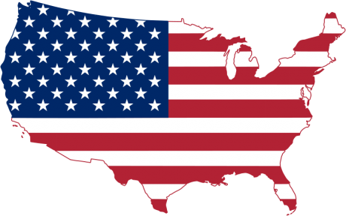
California Cadet Corps
Curriculum on Citizenship
“What We Stand For”
C8A: Common American Values
Updated 26 OCT 2020

Slide 2
Common American Values Agenda
A1. Declaration of Independence
A2. The Constitution
A3. The Bill of Rights
A4. A Democratic Republic
A5. Democratic Values
A6. Capitalism
A7. Individualism
A8. Freedom
A9. Importance of Time and Work Ethic
A10. Equality

Slide 3
The Declaration of Independence
OBJECTIVES
DESIRED OUTCOME (Followership)
At the conclusion of this training, Cadets will have a better concept of the values that Americans as a nation hold dear, their meaning, and the sources of those values.
Plan of Action:
Identify who wrote the Declaration of Independence, when, and why.
Identify the five parts of the Declaration of Independence.
Identify the American values established in the Declaration of Independence
Essential Question: What did the Declaration of Independence do for the fledgling American nation?

Slide 4
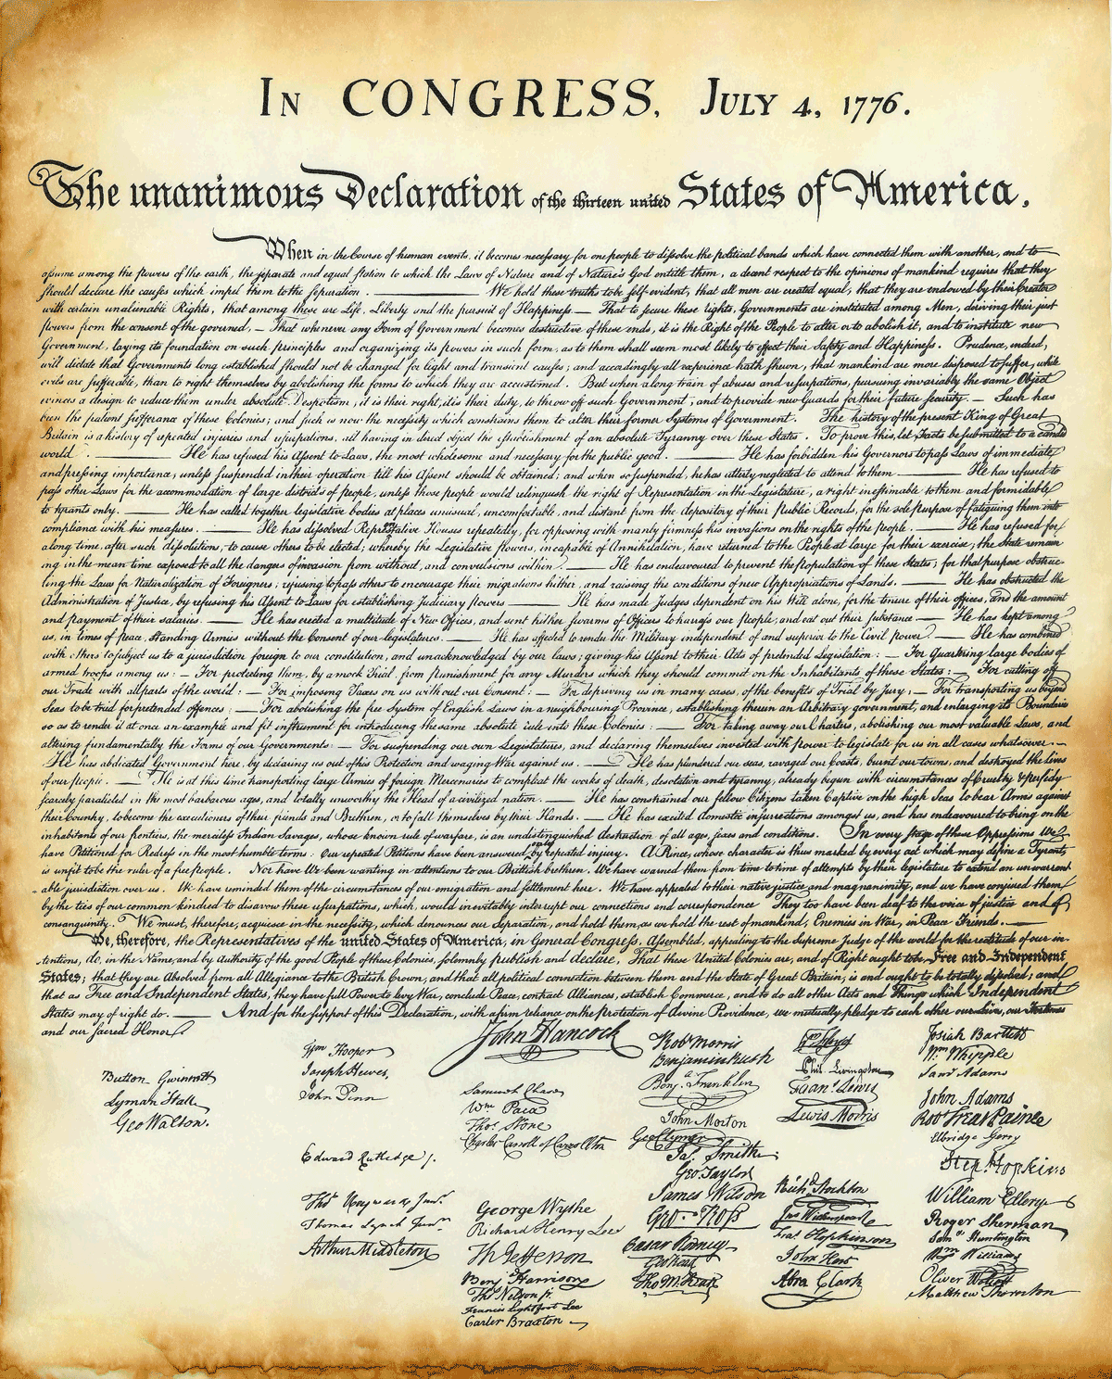
Declaration of Independence
Published July 4, 1776
Drafted by Thomas Jefferson with help from a committee of Ben Franklin, John Adams, Roger Sherman, & Robert Livingston
Proclaimed the colonies’ independence from Great Britain and King George
Edited & approved by the members of the 2nd Continental Congress

Slide 5
5 Parts
Introduction “When in the course of human events . . .”
Preamble “We hold these truths to be self-evident . . .”
Indictment grievances against the King & Parliament
Denunciation of the British People
what we’ve done to warn you . . .
Conclusion “We, therefore, . . . “

Slide 6
The Signers
56 members of the 2nd Continental Congress
Signed by state (colony) groups
John Hancock – President of Congress
For more information:
Declaration of Independence Signers

Slide 7
Main Ideas in the Declaration of Independence
Main Ideas:
From the Enlightenment – European philosophies
Equality “all men are created equal”
Freedom “Life, Liberty, & the pursuit of Happiness”
Opportunity “pursuit of Happiness”
Power of government comes from the consent of the people governed
People have the right to abolish their government and institute a new one

Slide 8
Values in the Declaration of Independence
Equality
Liberty
Opportunity

Slide 9
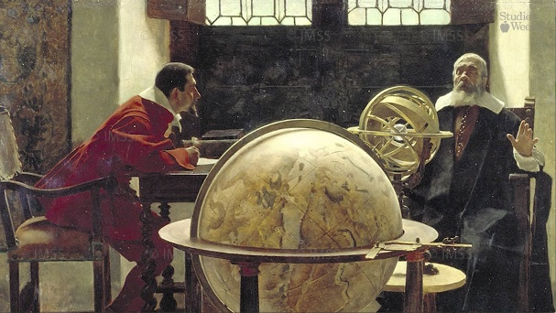
The Enlightenment
a European intellectual movement of the 17th and 18th centuries that emphasized reason and science. The philosophy advocated for a society based upon reason rather than faith, a civil order based on natural law and science, with ideals such as liberty, progress, tolerance, fraternity, constitutional government, and separation of church and state. Radicals believed in democracy, individual liberty, freedom of expression, and eradication of religious authority.
(Lumen, Accessed in OCT 2020)

Slide 10
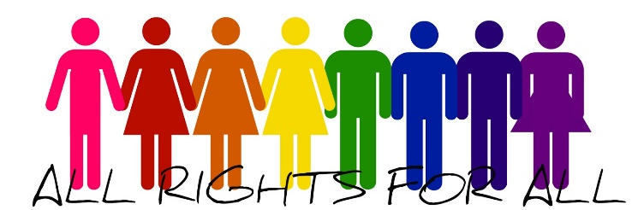
Equality
The value of equality as it comes from our nation’s founding documents, is the equal treatment of people irrespective of social or cultural differences. It has grown, in law, to mean equal treatment and rights regardless of race, color, gender, religion, age, sexual orientation, or national origin.

Slide 11
Liberty
The state of being free. As a value, Liberty refers to the ability to choose our own path, believe and say and do what we want (as long as it doesn’t hurt others). The Bill of Rights – the first ten amendments to the Constitution - guarantees Americans freedom of speech, press, and religion, the right to bear arms, to refuse to have soldiers quartered in your house, freedom of unreasonable search and seizure, right to a speedy and fair trial by jury, and against self-incrimination, and freedom from excessive bail or fines. “It’s a free country” implies your ability to do something that’s not illegal or forbidden, even if others don’t like it.

Slide 12
Opportunity
What is ‘the right to Life, Liberty, and the pursuit of Happiness’ if not opportunity to make something of yourself. This is a strongly held value in America and is a value that many immigrants have held most dear. The American Dream

Slide 13
Check on Learning
What are the three values put forth in
the Declaration of Independence?
What two points does the Declaration of Independence make about people and their government?
What are the 5 parts of the Declaration of Independence?
When was the Declaration of Independence signed?
Who primarily drafted the Declaration of Independence?

Slide 14
The Constitution
OBJECTIVES
DESIRED OUTCOME (Followership)
At the conclusion of this training, Cadets will have a better concept of the values that Americans as a nation hold dear, their meaning, and the sources of those values.
Plan of Action:
Identify the US Constitution by a description of its purpose
Identify principles outlined in the US Constitution
Identify the concepts put forth in the seven Articles of the Constitution
Identify the main values reinforced by the US Constitution
Essential Question: What is the significance of the Constitution in reinforcing American values?

Slide 15
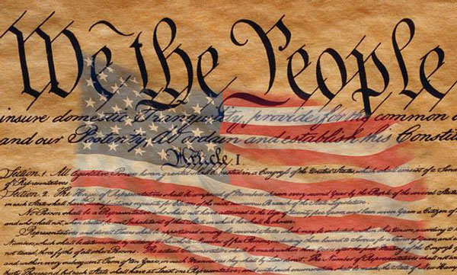
US Constitution
Establishes the law of the United States
Establishes the government of the US
Ratified on Constitution Day: September 17, 1787

Slide 16
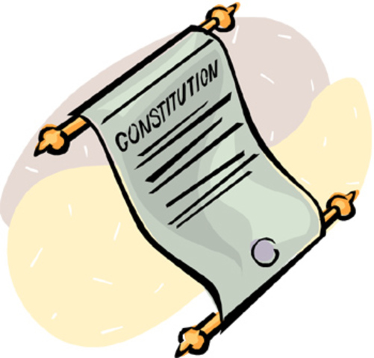
Principles in the Constitution
Popular sovereignty, meaning rule by the people
Republicanism, meaning the right to vote for representatives
Federalism, meaning power is shared between the national and state governments
Separation of powers into branches that make, enforce or interpret laws
Balance of Power - controls (checks) can be made on the other branches
Limited government - everyone is bound by the US Constitution
Individual rights - personal freedoms are guaranteed by the Bill of Rights
Judicial Review – the power of the courts to determine the legality of laws

Slide 17
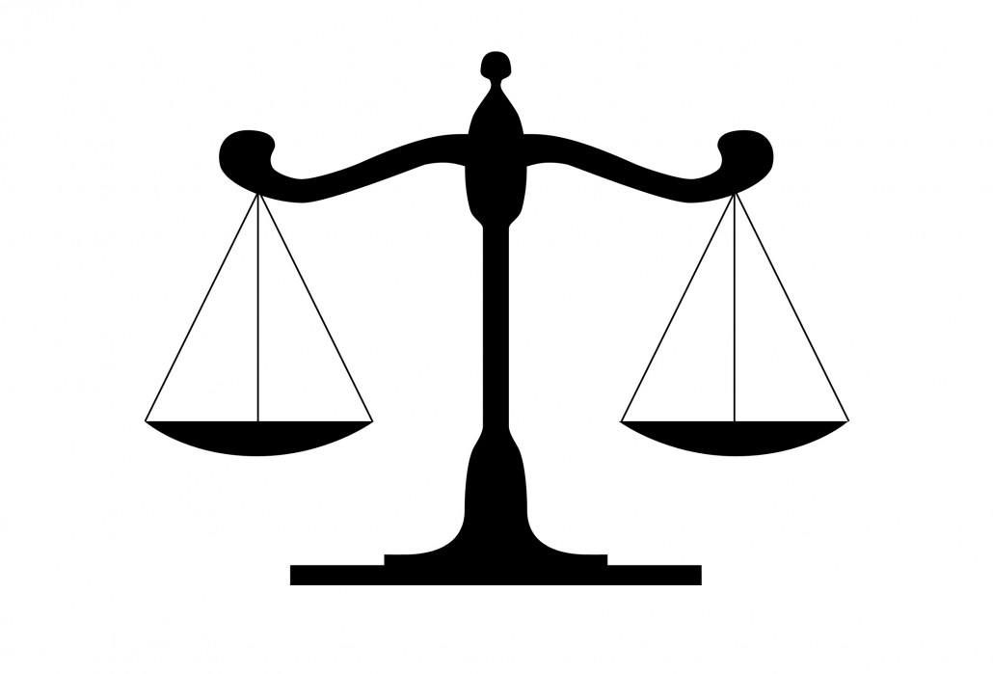
Justice
The quality of being fair and reasonable
A focus of much of the Constitution
Amendments 4-8 give protection from many of the grievances against the King’s system of justice

Slide 18
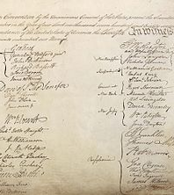
Parts of the Constitution
Preamble: purpose & guiding principles
7 Articles: branches of gov’t, amending process, relations between the states, establishes law, establishing government
Closing Endorsement – 39 delegates signed
Amendments: Bill of Rights & 17 more

Slide 19
Seven Articles
I: Describes the Legislative Branch of government
II: Describes the Office of the President of the US
III: Describes the court system
IV: Outlines relations among the states and between each state and the federal government
V: Outlines the process to amend the Constitution
VI: Establishes that the Constitution and federal laws and treaties are the law of the land
VII: Describes how the government is established

Slide 20
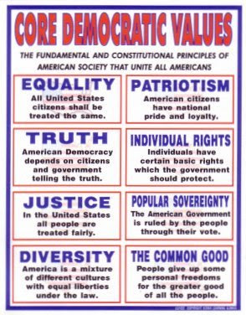
Values in the Constitution
Liberty (Amendments 1-3)
Equality (14th Amendment)
Justice (Amendments 4-8)
Privacy (Amendments 4,5,9 & 14)

Slide 21
Privacy
The right to be left alone
Free from unreasonable search & seizure
Right to free assembly
Right to due process
Privacy within family, marriage, motherhood, procreation, & child rearing
Personal autonomy / right to choose
Personal information

Slide 22
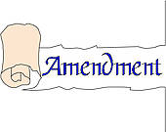
Key Constitutional Amendments
Congress votes, states ratify (3/4 must ratify)
First 10 are the Bill of Rights
13th abolished slavery
14th defined American citizenship
15th gave all men the right to vote
16th established income tax
18th / 21st Prohibition
19th gave women the right to vote
22nd limited presidency to two terms

Slide 23
Check on Learning
Define:
Popular sovereignty
Separation of powers
Judicial review
How many articles are in the Constitution?
What are the constitutional values we named?

Slide 24
The Bill of Rights
OBJECTIVES
DESIRED OUTCOME (Followership)
At the conclusion of this training, Cadets will have a better concept of the values that Americans as a nation hold dear, their meaning, and the sources of those values.
Plan of Action:
Identify the purpose of the Bill of Rights
Identify the rights spelled out in the Bill of Rights
Essential Question: What rights are put forth in the Bill of Rights for all Americans?

Slide 25
Why the Bill of Rights
When the 2nd Continental Congress drafted the Constitution, they argued a lot
Federalists vs Anti-Federalists
Needed vagueness and compromise to get all states to vote to ratify the Constitution
James Madison drafted 12 amendments
1 was ratified in 1992, 1 was never ratified
Ratified and added to Constitution Dec 15, 1791

Slide 26
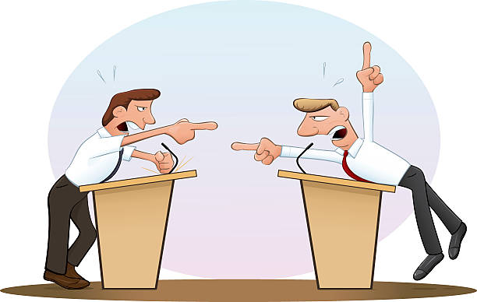
Debate
The Federalists wanted a strong federal government. They were led by James Madison and influenced by Alexander Hamilton.
The Anti-Federalists opposed a strong federal government. They wanted states to have more authority. They were concerned that the presidency might evolve into a monarchy. They were led by Patrick Henry. They wanted a bill of rights to ensure individual rights wouldn’t erode.

Slide 27
Ratification of the Constitution
Of the 13 states, only five ratified the Constitution with relative ease (DE, PA, NJ, GA, & CT)
The rest only came to ratification through recommending amendments
These amendments were compiled by Madison into the Bill of Rights

Slide 28
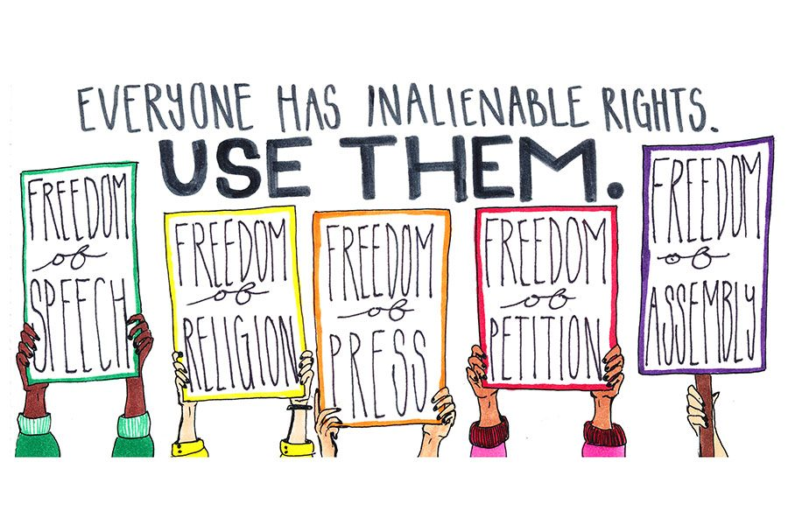
First Amendment
1: Freedom of Religion, Freedom of Speech, Freedom of the Press, Right to Assemble, Right to petition the Government for a redress of grievances

Slide 29
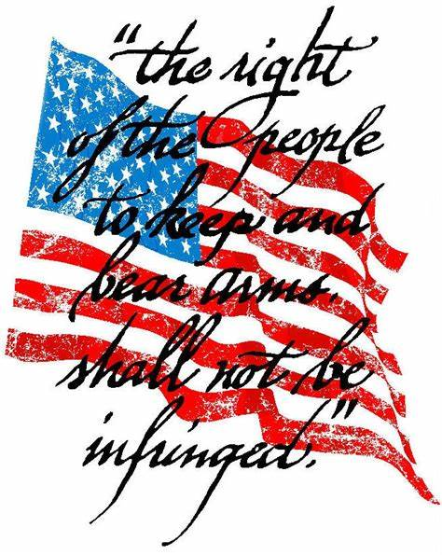
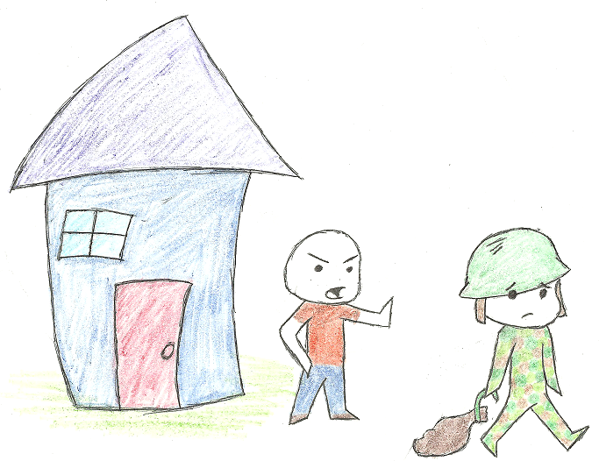
2nd & 3rd Amendments
Citizens’ rights to bear arms
Prevents the government from quartering troops in private homes

Slide 30
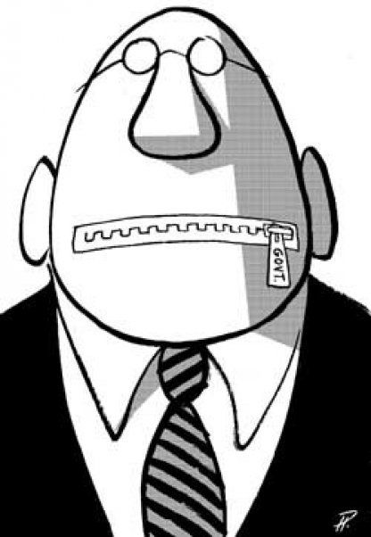
4th & 5th Amendments
No unreasonable search and seizure of the property of US citizens
No self-incrimination (“take the fifth”), no prosecution or punishment without due process, no double jeopardy, eminent domain

Slide 31
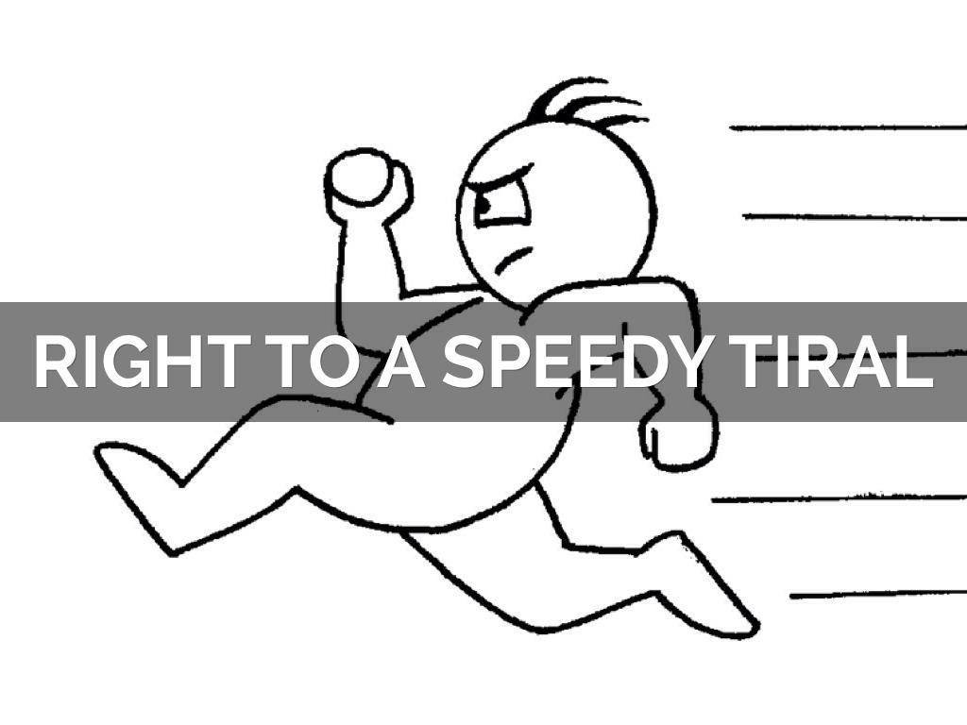
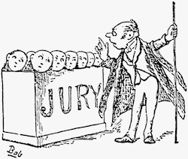
6th & 7th Amendments
Guarantees a speedy trial by a jury of one’s peers, being informed of the crime you’re accused of, and the right to confront witnesses, compel testimony, and have legal representation.
Provides that civil cases also be tried by jury.

Slide 32
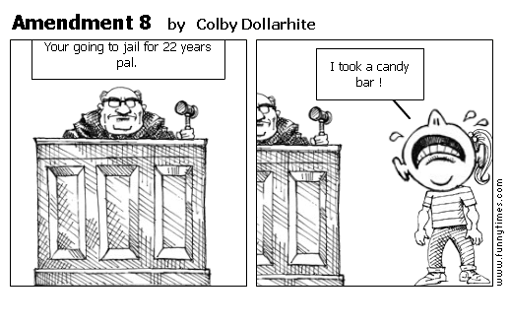
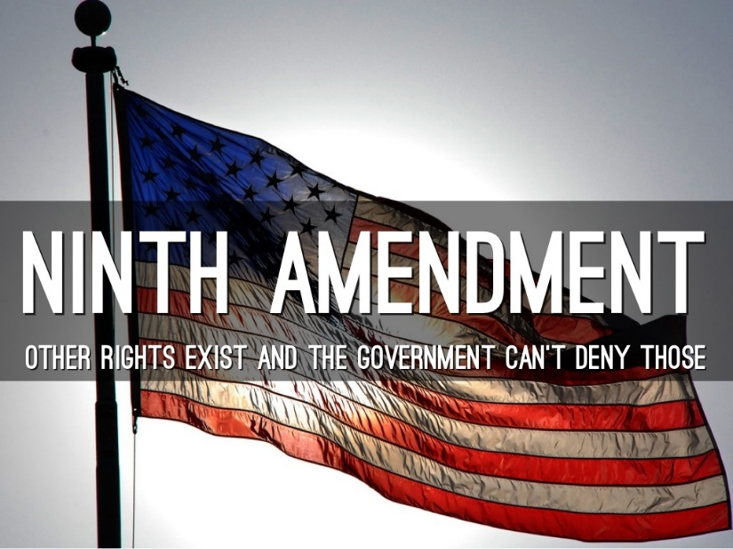
8th & 9th Amendments
Prohibits excessive bail, excessive fines, and cruel and unusual punishments.
The list of rights in the Constitution is not exhaustive, and that the people still have all the rights that are not listed.

Slide 33
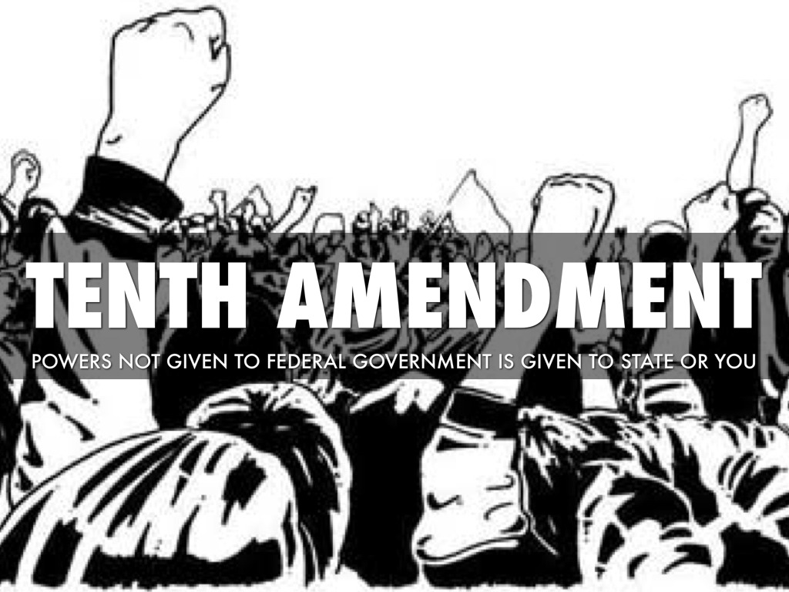
10th Amendment

Slide 34
State Rights
The Bill of Rights applied only to the federal government
After the Civil War, with the passage of the 14th Amendment, courts began interpreting the Constitution in favor of extending these rights to state and local governments
Most of the Bill of Rights is now enforceable against state governments
This is called incorporation

Slide 35
Check on Learning
Whose concern that rights might be eroded, and the presidency turn into a monarchy caused the Bill of Rights to be written?
Federalists
Anti-Federalists
Match a right to its Amendment:
Amendments:
1st
2nd
3rd
4th
5th
6th
7th
8th
9th
10th
Free Speech
No Self-incrimination
Bear Arms
Freedom of Religion
Speedy trial
Powers not specified to the
US gov’t go to the states

Slide 36
A Democratic Republic
OBJECTIVES
DESIRED OUTCOME (Followership)
At the conclusion of this training, Cadets will have a better concept of the values that Americans as a nation hold dear, their meaning, and the sources of those values.
Plan of Action:
Differentiate a Republic from a Democracy
Identify key attributes of government put forth in the Declaration of Independence and Constitution
Essential Question: How does representation work in a republic, and what are other attributes of our governmental systems?

Slide 37
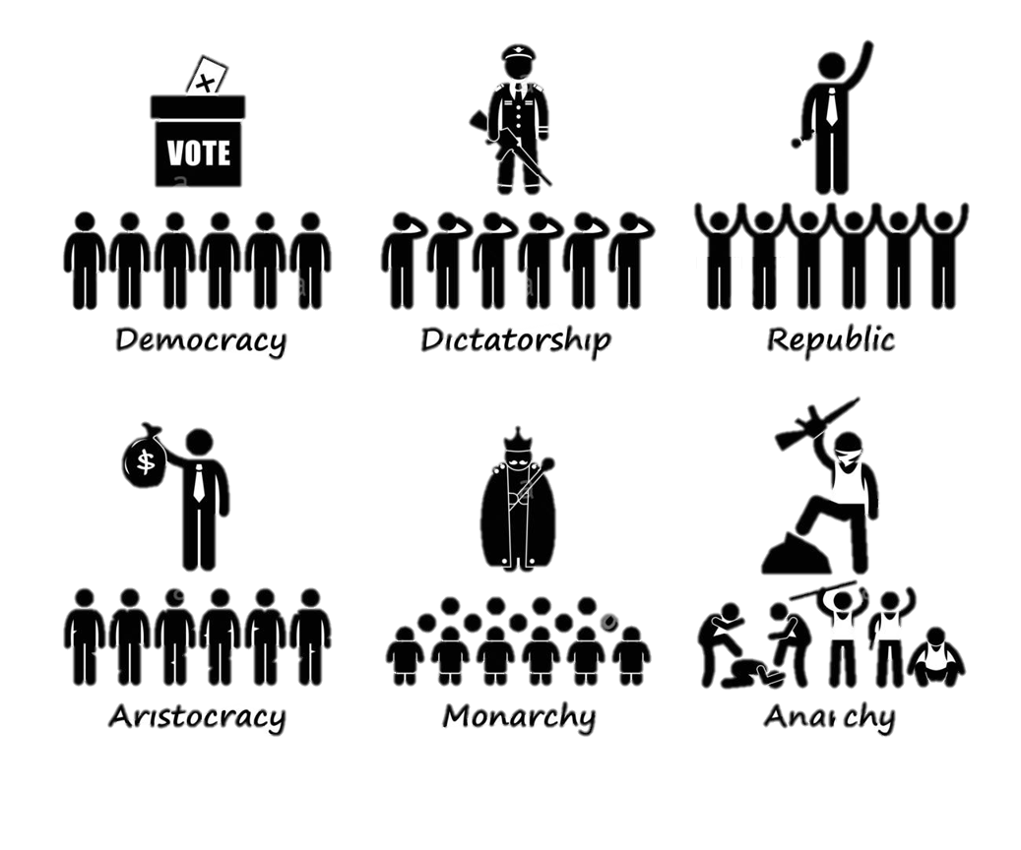
Forms of Government

Slide 38
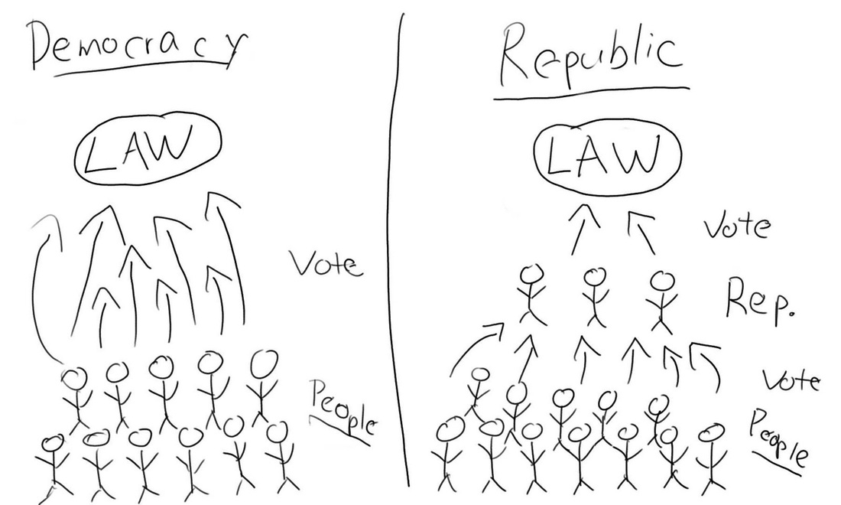
How they Work

Slide 39
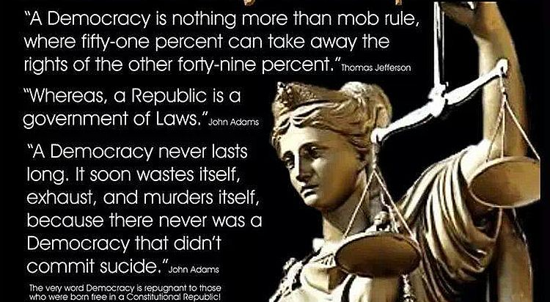
Democracy vs Republic

Slide 40
Meaning has Changed
In today’s terminology, a republic is considered a democracy
They are both forms of government in which supreme power resides in the citizens
Democracy can refer to representational government, or it can refer to what is also called a direct democracy, in which the citizens themselves participate in the act of governing directly

Slide 41
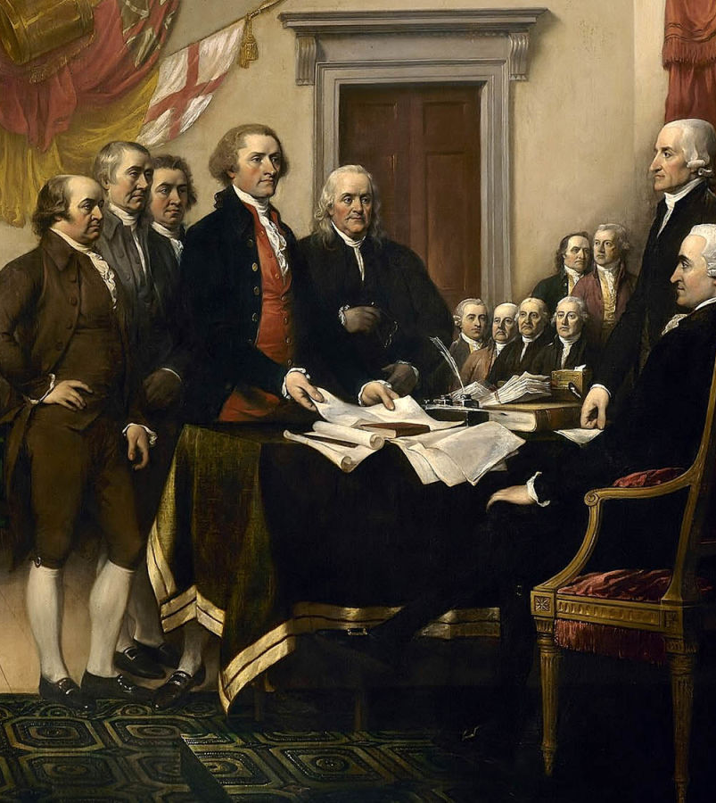
Why?
Why did the founding father make the US a republic?
It worked better
They were solving the problems they’d suffered under

Slide 42
Attributes of US System
Republic vs Monarchy (popular sovereignty)
All citizens are equal before the law
Political parties provide legitimate opposition
Federalism, meaning power is shared between the national and state governments
Separation of powers into branches that make, enforce or interpret laws
Balance of Power - controls (checks) can be made on the other branches
Individual rights - personal freedoms are guaranteed by the Bill of Rights
Judicial Review – the power of the courts to determine the legality of laws
Separation of Church and State
No taxation without representation
Opportunity to pursue happiness
Government controlled by Law (the Constitution)

Slide 43
Check on Learning
Is the United States a republic or a democracy?
What’s the difference?
Which of these is part of our system?
Political parties provide legitimate opposition
Power concentrated in one branch
Laws made by Congress are absolute law
No taxation without representation
Government controlled by Law

Slide 44
Democratic Values
OBJECTIVES
DESIRED OUTCOME (Followership)
At the conclusion of this training, Cadets will have a better concept of the values that Americans as a nation hold dear, their meaning, and the sources of those values.
Plan of Action:
Explain the core democratic values found in the Declaration of Independence, Constitution, and other core American foundational documents
Identify key American cultural values
Essential Question: What are the core American values as expressed in our founding governmental documents?

Slide 45
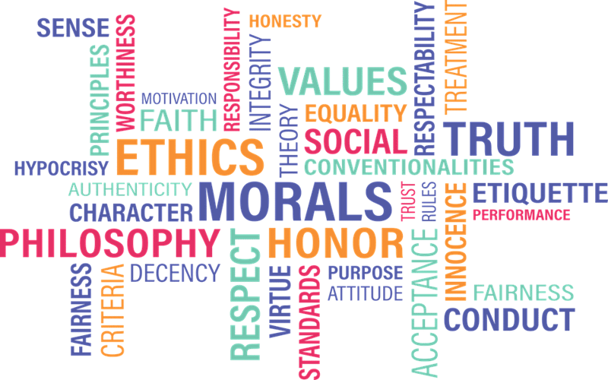
Values
Values are important because they guide our beliefs, attitudes and behavior; consequently, they are a key foundation of democracy.

Slide 46
Core Democratic Values
Life
Liberty
Pursuit of Happiness
Justice
Common Good
Equality
Truth
Diversity
Popular Sovereignty
Patriotism

Slide 47
Life
Each citizen has the right to the protection of his or her life

Slide 48
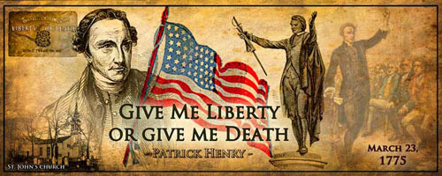
Liberty
Includes the freedom to believe what you want, freedom to choose your own friends, and to have your own ideas and opinions, to express your ideas in public, the right for people to meet in groups, the right to have any lawful job or business

Slide 49
Pursuit of Happiness
Each citizen can find happiness in his or her own way, so long as he or she does not step on the rights of others

Slide 50
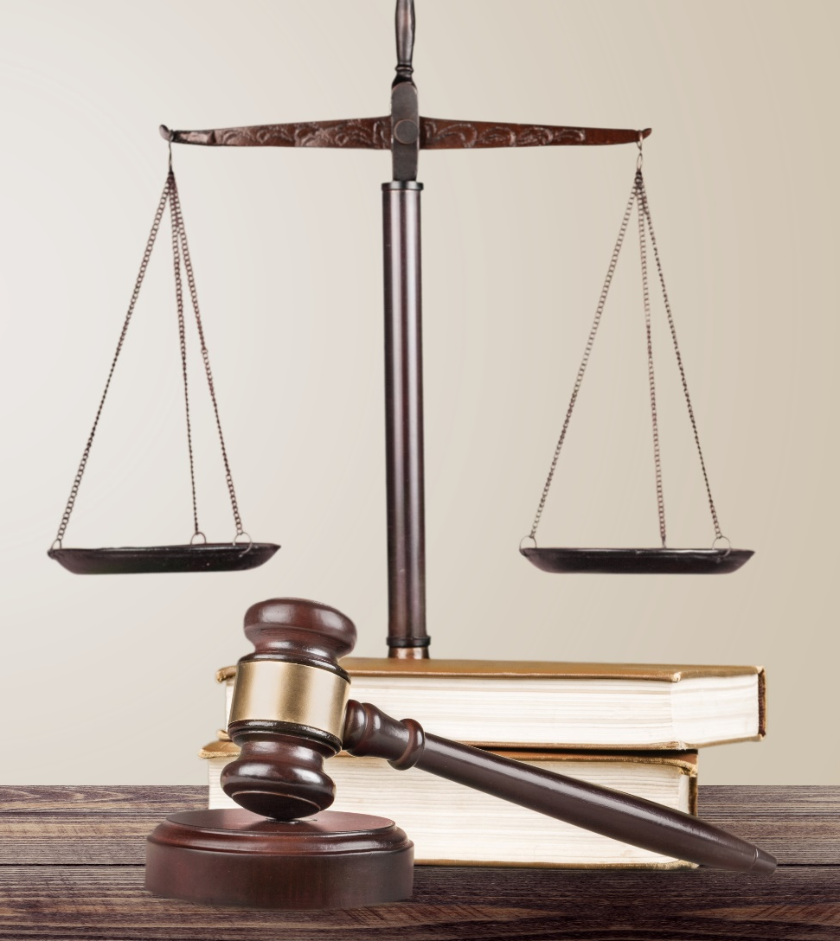
Justice
All people should be treated fairly in getting advantages and disadvantages of our country. No group or person should be favored.

Slide 51
Common Good
Citizens should work together for the good of all. The government should make laws that are good for everyone.

Slide 52
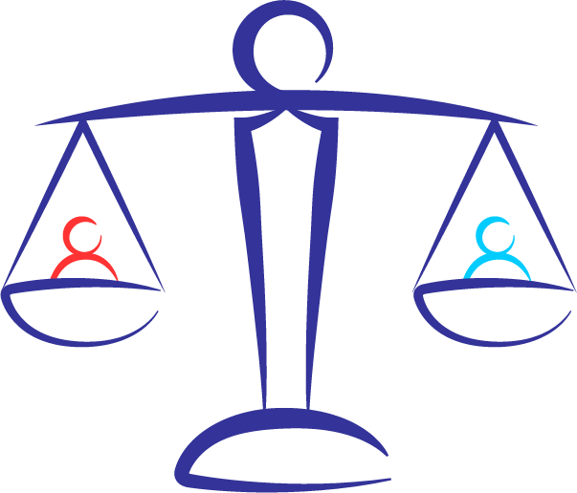
Equality
Everyone should get the same treatment regardless of where their parents or grandparents were born, their race, their religion or how much money they have. Citizens all have political, social, and economic equality.

Slide 53
Truth
The government and citizens should not lie.

Slide 54
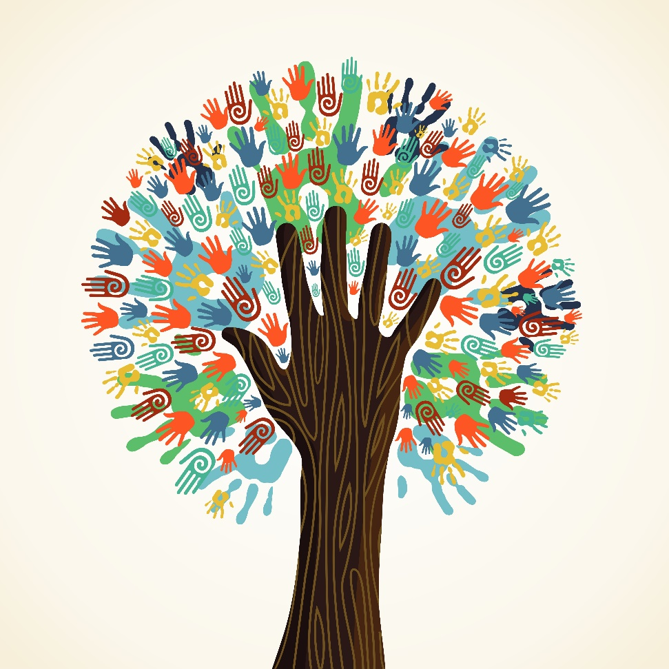
Diversity
Differences in language, dress, food, where parents or grandparents were born, race and religion are not only allowed but accepted as important.

Slide 55
Popular Sovereignty

Slide 56
Patriotism
This means having a devotion to our country and the core democratic values in what we say and what we do.

Slide 57
Cultural Values
Common popular ideologies or standards of behavior that persist in American culture.
Personal control over the environment
Change/mobility
Time and its importance
Equality/egalitarianism
Individualism and privacy
Self-help
Competition and free enterprise
Future orientation
Action and work orientation
Informality
Directness, Openness and honesty
Practicality/efficiency
Materialism/Acquisitions
Kohls, L. Robert; The Values Americans Live By; https://careercenter.lehigh.edu/sites/careercenter.lehigh.edu/files/AmericanValues.pdf

Slide 58
Personal Control Over the Environment
Antithesis of Fate
Man’s power over Nature
Human achievement
Challenge of what can be done, when most of the world is certain it can’t

Slide 59
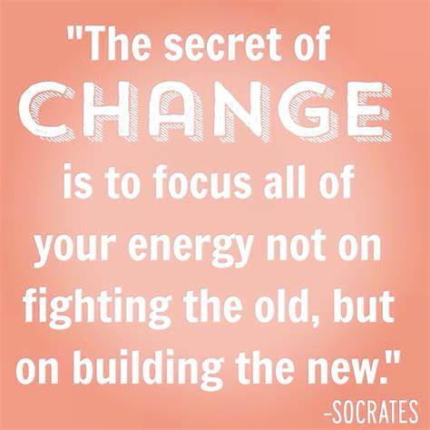
Change / Mobility
Development, improvement, progress, growth
Antithesis of tradition, continuity, a rich and ancient heritage
Moving forward toward achieving more

Slide 60
Time & its Importance
Keeping to a schedule
More important than developing deep personal relationships (especially in business or politics)
Being late is considered rude
Leads to productivity

Slide 61
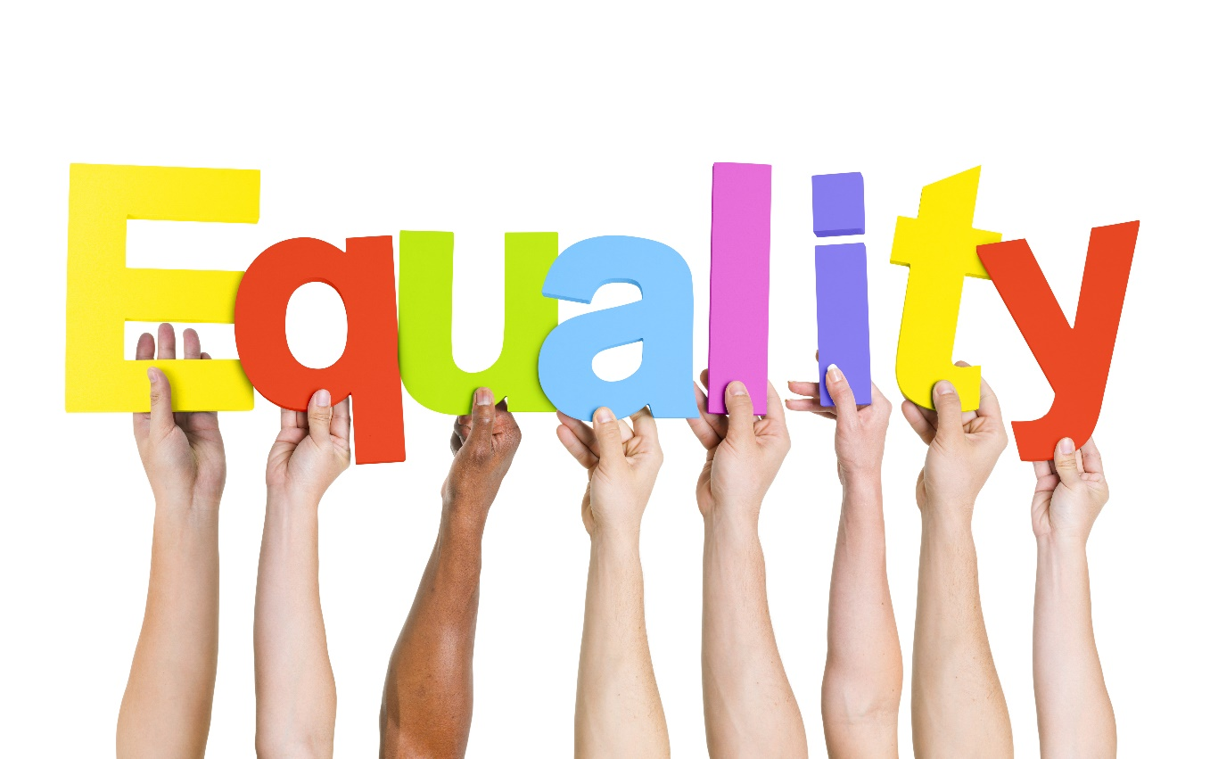
Equality / Egalitarianism
Almost a religious value (created equal)
Equal opportunity for success in life
Rank & Status not as important
Antithesis of class and authority

Slide 62
Individualism and Privacy
Everyone is completely and marvelously unique
Group’s welfare less important
People pop in and out of groups
Everyone is ‘special’ in some way
Privacy – ownership of your ‘self’

Slide 63
Self Help
Credit for what you accomplish yourself
Self-made man or woman is the ideal in America
What you accomplish yourself is worth more

Slide 64
Competition & Free Enterprise
Competition brings out the best in any individual
Antithesis of cooperation
Free enterprise – a competitive economy
A society which fosters competition progresses more rapidly

Slide 65
Future Orientation
Look to the future
Devalue the past, unconscious of the present
Work now for future rewards

Slide 66
Action & Work Orientation
Don’t just stand there – do something!
Action is superior to inaction
Leisure is less important than work
Workaholics
Identify with your profession – that’s who you are
Physical labor is a positive thing

Slide 67
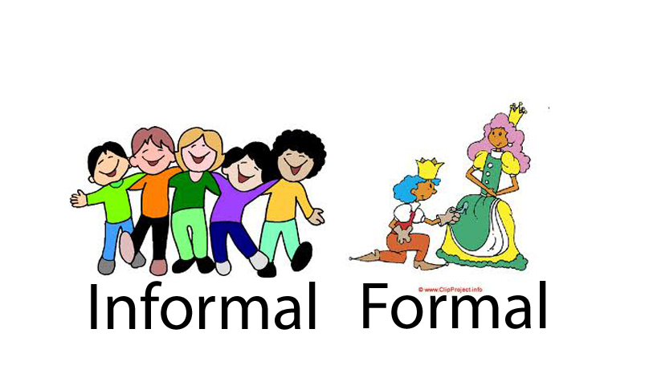
Informality
Informal and casual is widespread
Uncomfortable with titles
Informal dress in formal situations

Slide 68
Directness / Openness / Honesty
Direct approach is preferred
Honest negative evaluations
Antithesis of saving face
Hinting and subtlety discouraged
Deliver the negative message yourself, don’t use intermediaries

Slide 69
Practicality and Efficiency
Realistic, practical, efficient
Not philosophically or theoretically oriented
Philosophy of pragmatism
Rational and objective over emotional or subjective
Avoid sentimental decisions
Trial and error

Slide 70
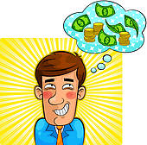
Materialism / Acquisitions
The American Dream – ‘stuff’
May be generational, not as obvious as 50 years ago
Protection of property is important
Throw-away society
Trading up – car, house, etc.

Slide 71
Check on Learning
In your own words, define:
Liberty
Justice
Diversity
Time and its importance
Competition and free enterprise
Directness, openness, and honesty

Slide 72
Capitalism
OBJECTIVES
DESIRED OUTCOME (Followership)
At the conclusion of this training, Cadets will have a better concept of the values that Americans as a nation hold dear, their meaning, and the sources of those values.
Plan of Action:
Define capitalism and identify its main characteristics
Essential Question: What is capitalism, and how does it contribute to the American governmental system?

Slide 73
Capitalism
Capitalism refers to an economic system in which a society’s means of production are held by private individuals or organizations, not the government, and where products, prices, and the distribution of goods are determined mainly by competition in a free market.

Slide 74
The Good and the Bad
At its best, capitalism is a system where people can be successful (i.e. make money) by working hard, being a good competitor, delivering products wanted by consumers
At its worst, capitalism is a system where greedy wealthy capitalists (the owner class) take advantage of a poor working class, making money at the expense of others.
Both aspects happen – not all good or bad

Slide 75
Characteristics of Capitalism
Private Ownership
Capital Accumulation
Capital Concentration (1%)
Voluntary Participation
Free Markets
Wage Labor
Competition
Innovation
Minimal government involvement

Slide 76
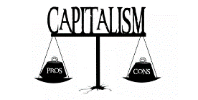
Capitalism Pro & Con
PRO
CON
Strong incentives to be productive, efficient, and to improve things
Tends to result in economic growth and improvement in standard of living
Can result in a high concentration of wealth in the hands of a relatively small group of people
Produces undesirable outputs (i.e. pollution) with little incentive to prevent them
Government policy can mitigate these issues with regulation, taxation, and spending programs designed to improve quality of life and reduce bad outcomes

Slide 77
Case Study
Germany
Especially in banking and education
Prosperous industries – trained labor force
Specialization in certain markets
Local entrepreneurs develop new industries

Slide 78
Case Study
USA
Environment encourages risk taking and expansion of small businesses into larger
Encourages hard work – equal opportunity
National values support competition, hard work, reach for wealth
Rights and patents enforced
Allowances for some monopolies

Slide 79
Case Study
China
Focused on educating the masses – work force
Encourages exports
Pro-business and pro-market
Jobs help country prosper, quality of life
Encourages entrepreneurship within political and social boundaries

Slide 80
Case Study
India
Provides human capital for offshore needs (i.e. call center and telemarketing)
Struggling to outgrow its caste system
Many poor workers with little way up
Developing new industries
Well-educated working worldwide
Looking to the future

Slide 81
Case Study
Japan
Post World War II rebuild and boom
Near collapse in the 1990s – rebounding
State-led economic machine
Reforming labor, banking, corporate govern-ance (management) and supplier relations
Focus on a few key industries
Rewards loyalty & long-term employment

Slide 82
Check on Learning
T / F Capitalism is a system where prices are set by the government
Which of the following are characteristics of capitalism?
Government-driven Innovation
Competition Capital control
Free markets Capital concentration
Slave labor Private ownership

Slide 83
Individualism
OBJECTIVES
DESIRED OUTCOME (Followership)
At the conclusion of this training, Cadets will have a better concept of the values that Americans as a nation hold dear, their meaning, and the sources of those values.
Plan of Action:
Define individualism and differentiate it from collectivism
Essential Question: What is the concept of individualism, and how does it represent Americans as a key value of our nation?

Slide 84
Individualism
US Values of Individualism developed from:
New England Puritanism
Value of economic success
Work ethic
Emphasis on social conformity
Jeffersonianism
Limited federal power
Economic freedom
Agrarian emphasis
Natural Rights
Universal/fundamental right to:
Life
Liberty
Property
Safety
Happiness
Privacy
Founding Fathers’ Belief:
Each individual’s life belongs to himself & he has the right to live it as he sees fit, to act on his own judgement, to use the products of his effort, and to pursue the values of his choosing.

Slide 85
Individualism vs Collectivism
Individualism
Collectivism
Focuses on human independence and freedom
Against external interferences regarding personal choices
Common in Western Europe, Australia, & New Zealand
Prioritizes group cohesion over individual pursuits.
Views long-term relationships as essential since it promotes group goals.
People sacrifice for the sake of the society
Common in Asia, Africa, & Latin America

Slide 86
Alexis de Tocqueville:
The unavoidable results of individualism are egoism, the suppression of all virtues, and the concession of political deliberation to the “tyranny of the majority.”
The only way America avoided that was that they valued liberty over equality as the basis of social relations.

Slide 87
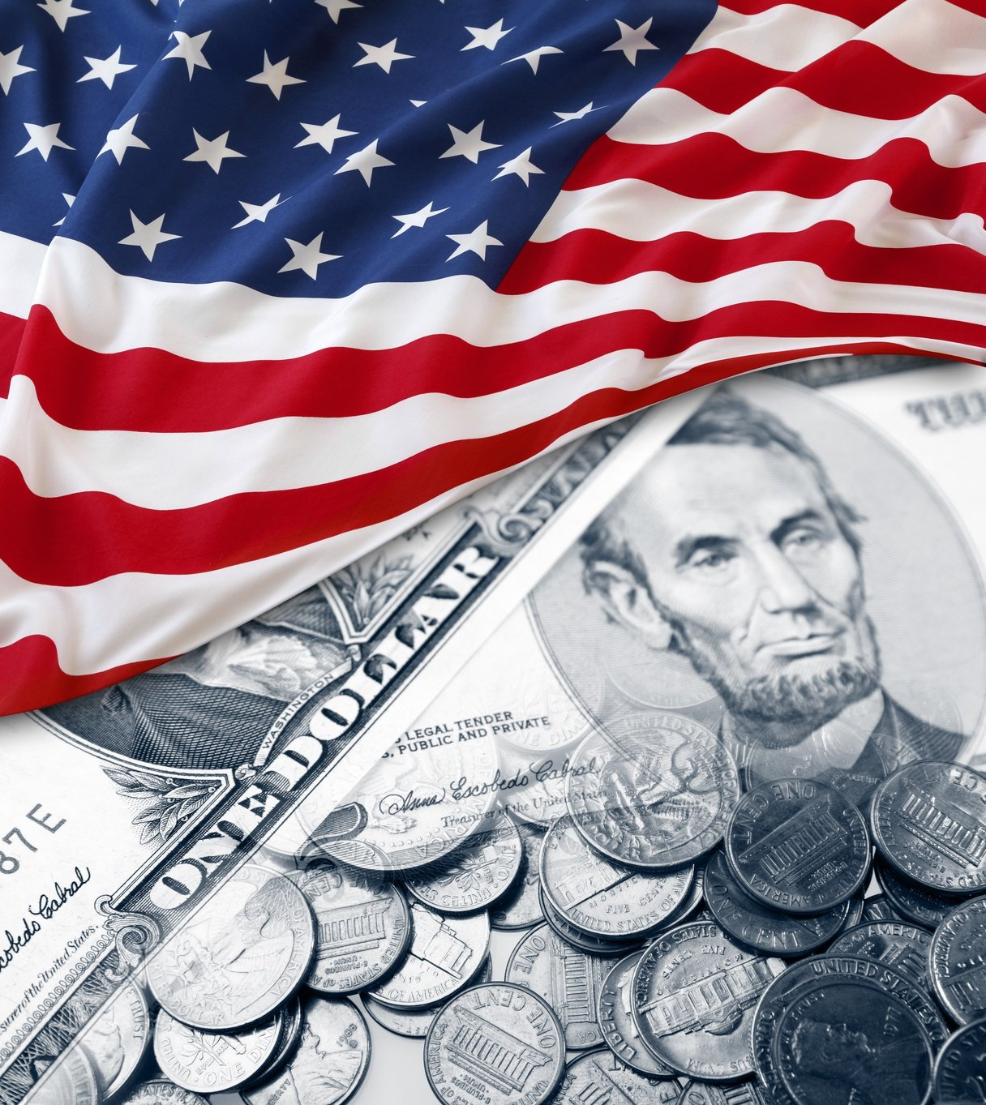
American Success
Individualism & Capitalism have led to America’s success as a productive, efficient society
Technological advances result from freedom to pursue ideas & dreams
Innovation led to invention, agricultural revolution, industrial revolution, & affordable necessities and luxuries

Slide 88
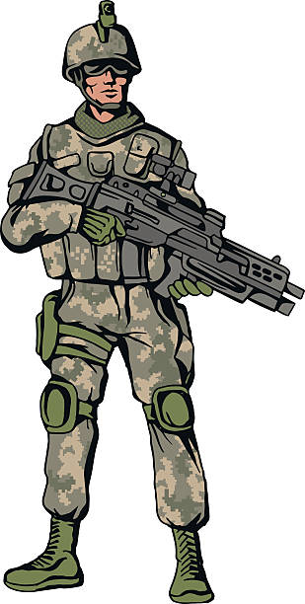
Military Benefits
American soldiers are known for their ability to act independently without direction once they know the mission and intent
There is still a focus on teamwork
Obeying orders is required, but American soldiers are expected to discern between legal and illegal orders, not to follow orders blindly
Very different from many more autocratic armies where soldiers are not allowed to take independent action

Slide 90
Check on Learning
The opposite of individualism is:
_____________________
T / F Individualism is a positive attribute for American soldiers.
Which of these cultures leans more toward individualism?
Australia
Russia
China
Pakistan

Slide 91
Freedom
OBJECTIVES
DESIRED OUTCOME (Followership)
At the conclusion of this training, Cadets will have a better concept of the values that Americans as a nation hold dear, their meaning, and the sources of those values.
Plan of Action:
Define freedom as it relates to American culture.
Essential Question: What are Americans free to do and free from?

Slide 92
Freedom
The study of American cultural values is rife with terms that relate to freedom:
Liberty
Free Enterprise
Individualism
Capitalism
Privacy
Informality
Pursuit of Happiness
What is your definition of each of these concepts?

Slide 93
Definition of Freedom
The state of being free rather than confined
Exemption from external control, interference
Political or national independence
Personal liberty (as opposed to slavery)
Ease of movement or action
Frankness of manner of speech
Civil liberty
The right to enjoy privileges in a community
The power to exercise choice
Self-determination

Slide 95
Check on Learning
How does free enterprise relate to freedom?
How does privacy relate to freedom?
How does choice relate to freedom?
How does freedom relate to “Life, Liberty, and the pursuit of Happiness?”

Slide 96
Importance of Time and Work Ethic
OBJECTIVES
DESIRED OUTCOME (Followership)
At the conclusion of this training, Cadets will have a better concept of the values that Americans as a nation hold dear, their meaning, and the sources of those values.
Plan of Action:
Explain how time and work ethic differ in some cultures
Essential Question: How do Americans’ focus on time and our work ethic define us as a culture?

Slide 97
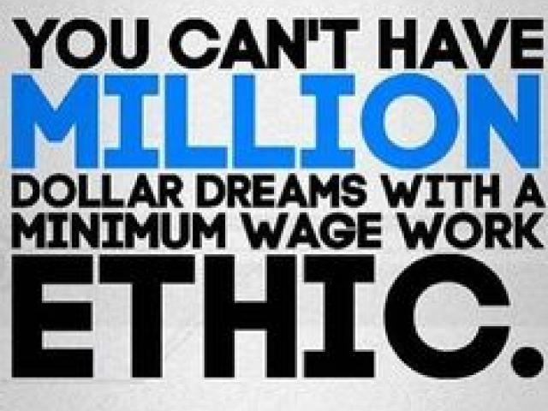
Work Ethic
This is what our cultural message is to our society
Think of the American Values we’ve discussed:
The American Dream
Free Enterprise
Pursuit of Happiness
Freedom to achieve what you’re capable of
Work to build a better future

Slide 98
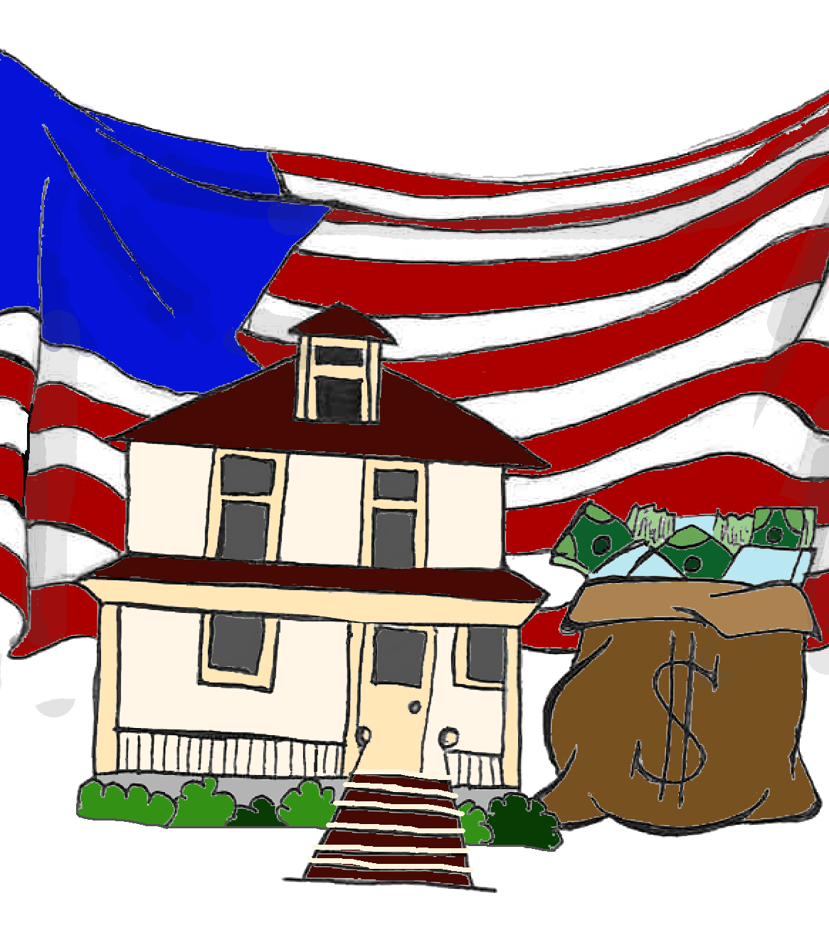
American Dream
Americans are free to pursue their dreams
Traditionally, that has meant to improve your status in life
Gain wealth
Build an empire
Do better and gain more than your parents had
Work hard and you’ll get ahead

Slide 99
Time is Cultural
Americans are known for being focused on time
After all, Time is Money!
Other cultures value relationships more
A business meeting will likely start late, be more focused on building relationships than the matter at hand, go late, and may not accomplish much
Americans want to start and end to a preset time schedule, accomplish a list of tasks
Other cultures find this rude and short-sighted

Slide 100
Work Ethic
These traits go with a good work ethic:
Reliability
Dedication
Discipline
Productivity
Cooperation
Integrity
Responsibility
Professionalism
Have these, and your boss will love you!

Slide 101
Check on Learning
In America, what is time related to?
In some other cultures, what’s more important?
Accomplishing your assigned task
Developing personal relationships
Name three traits that demonstrate a good work ethic.

Slide 102
Equality
OBJECTIVES
DESIRED OUTCOME (Followership)
At the conclusion of this training, Cadets will have a better concept of the values that Americans as a nation hold dear, their meaning, and the sources of those values.
Plan of Action:
Explain the concept of ‘protected classes’
Give four examples of ‘protected classes’
Give two examples of classes that are not currently protected
Give an example of discrimination against a protected class
Define immutable characteristics and give two examples
Essential Question: What are the classes of people who are protected from discrimination, and why?

Slide 103
Equality
The value of equality as it comes from our nation’s founding documents, is the equal treatment of people irrespective of social or cultural differences. It has grown, in law, to mean equal treatment and rights regardless of race, color, gender, religion, age, sexual orientation, or national origin.
This is one of the most basic American values.

Slide 104
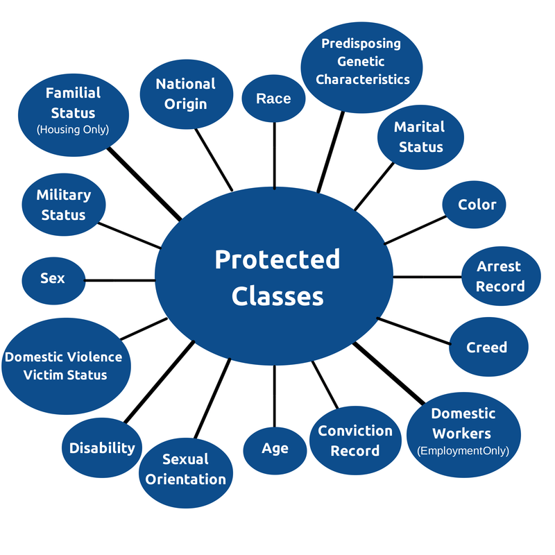
Protected Classes
Groups of people who are legally protected from being harmed or harassed by laws, practices, and policies that discriminate against them due to a shared characteristic.
The Civil Rights Act of 1964 established the following protected classes:
Race, Religious Belief, National Origin, Sex
Other laws added age, pregnancy status, immigration status, familial status, veteran status and disability
Marital status, sexual orientation, and gender identity are not covered under federal laws

Slide 105
California Protected Classes
Sex
Age
Disability
Genetic information
National origin
Pregnancy
Race/color
Religion
Sexual orientation
Marital status
Ancestry
Gender, gender identity and gender expression

Slide 106
Unprotected Classes
Certain groups are NOT treated as protected classes under anti-discrimination laws:
Level of educational attainment
Income level
Undocumented immigrants
Persons with a criminal history

Slide 107
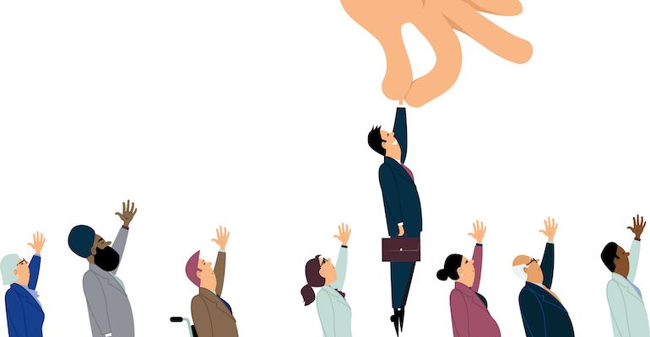
Employment Decisions
In general, employers cannot consider membership in a protected class when making employment decisions
Law does not absolutely bar consideration of a protected class always
For example, a person’s sex may be considered in employment decisions if being a specific sex is a valid qualification for the work involved

Slide 108
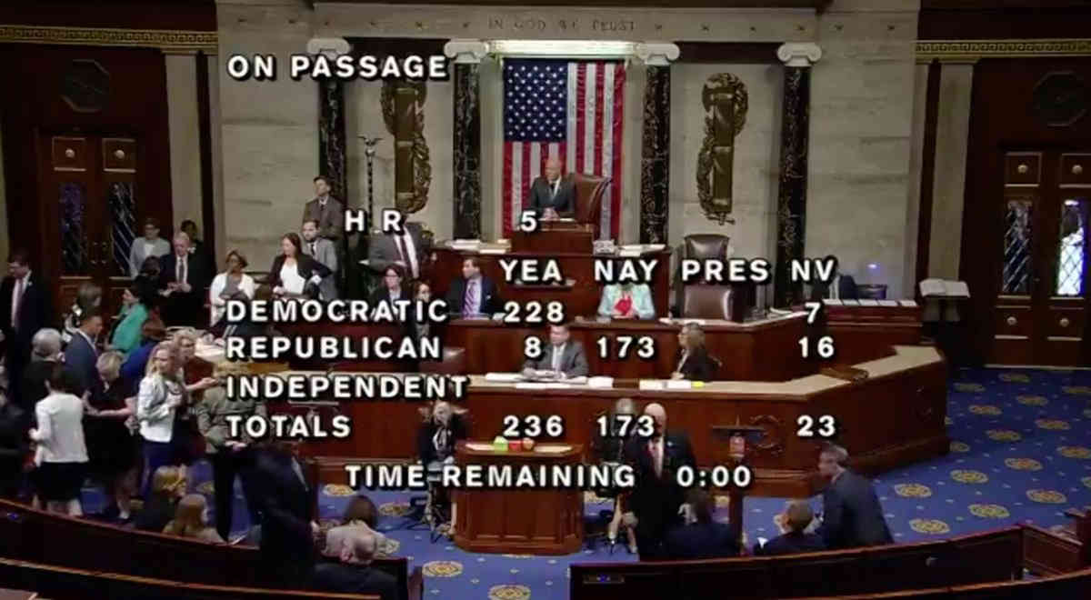
Equality Act
The Equality Act was passed by the House of Representatives, but not the Senate.
It would amend the Civil Rights Act to add sexual orientation, gender identity, pregnancy
Some states prohibit discrimination based on these groups, others don’t

Slide 109
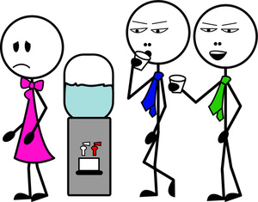
Harassment
Harassment is a form of discrimination, mostly associated with the workplace
It can include racial slurs, derogatory remarks, unwanted personal attention or touching, and similar acts
These aren’t illegal, but can be if they are so frequent or severe they result in a hostile work environment

Slide 110
Examples of Discrimination
An employee who is undergoing treatment for cancer that is under control or in remission is treated less fairly because they have a “history of disability.”
A person is denied a marriage license when they attempt to marry a person of the same sex.
A registered voter is treated differently than other voters at a polling place because of their appearance, race, or national origin.
An employee who is over 40 years of age is denied a promotion because of their age, even though they are fully qualified for the job.
A transgender person is subjected to harassment or discrimination because of their identity.

Slide 112
Immutable Characteristics
Any attribute considered impossible or difficult to change, such as
Race
National origin
Gender
Clearest way to identify whether a group is a protected class
Sexual orientation has mostly moved from being considered a choice to being considered immutable

Slide 113
Check on Learning
What is a protected class?
Name three protected classes
Name two unprotected classes
What is an immutable characteristic? Give an example.
Give an example of discrimination against a protected class.

