Slide 1
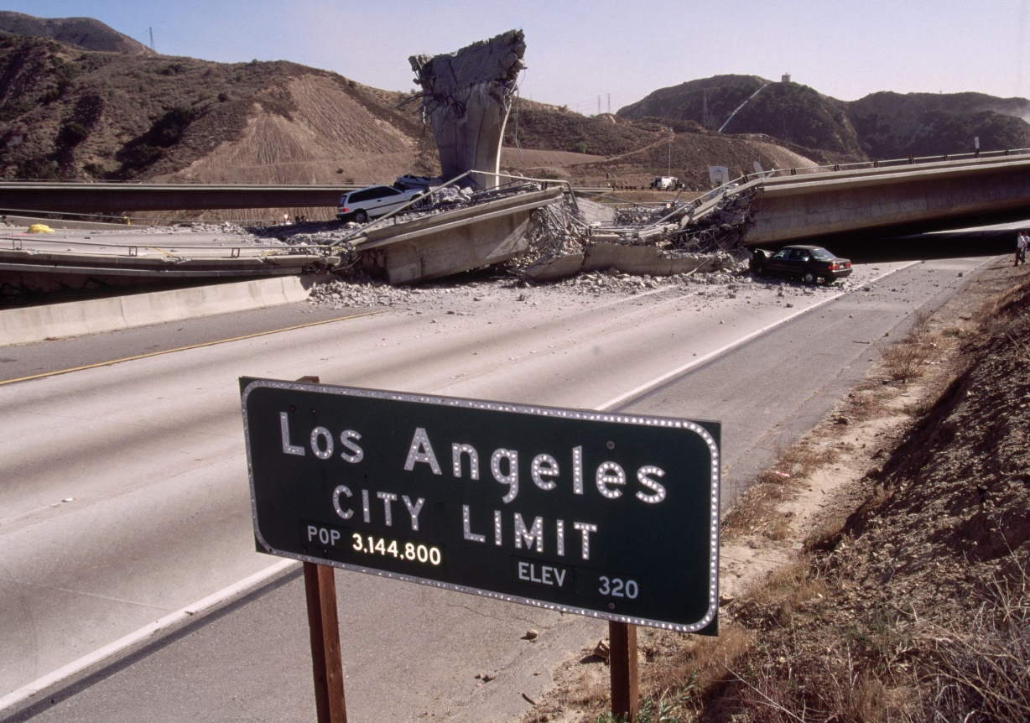
California Cadet Corps
Curriculum on Citizenship
“Disasters happen. Prepare Now, Learn How”
C5/B: Family Disaster Planning

Slide 2
California Disasters Agenda
B1. Make a Plan
B2. Shelter Plan
B3. Evacuation Plan and Route
B4. Communications Plan

Slide 3
California Disasters: Unit Objectives
The desired outcome of this unit is for cadets to conduct family disaster planning.
Plan of Action:
Assess the disaster related threats in your local area and put together a Family Disaster Plan.
Develop an adequate shelter plan for your family.
Develop an evacuation plan and routes.
Develop a disaster communications plan for your family.

Slide 4
Make a Plan
OBJECTIVES
DESIRED OUTCOME (Self-Mastery)
Cadets are familiar with the disaster emergencies that commonly occur in California and how to prepare, respond, and recover from them.
Plan of Action:
B1. Assess the disaster related threats in your local area and put together a Family Disaster Plan.
Essential Question: What is covered in an Emergency Plan and how do you go about putting one together?

Slide 5
Make a Plan

Slide 6
Assess Your Situation
Step 1: Discuss the questions below with your family, friends, or household to start your emergency plan.
How will I receive emergency alerts and warnings? Check out the link, or curriculum lesson C5A1.
What is my shelter plan? See Lesson B2
What is my evacuation route? See Lesson B3
Do I need to update my emergency preparedness kit?
Check with the Centers for Disease Control (CDC) and update my emergency plans
What is my family/household communication plan? See Lesson B4

Slide 7
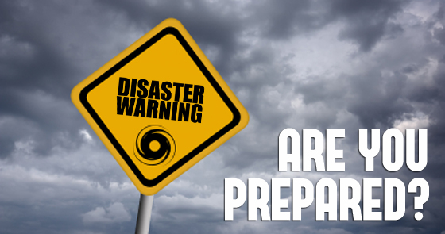
Your Specific Needs
Step 2: Consider specific needs in your household.
Different ages of members within your household
Responsibilities for assisting others
Locations frequented
Dietary needs
Medical needs including prescriptions and equipment
Disabilities or access and functional needs including devices and equipment
Languages spoken
Cultural and religious considerations
Pets or service animals
Households with school-aged children

Slide 8
Consider FEMA Information
Active Shooter
Attacks in Public Places
Avalanche
Bioterrorism
Chemical Emergencies
Cybersecurity
Drought
Earthquakes
Explosions
Extreme Heat
Floods
HAZMAT Incidents
Home Fires
Household Chemical Emergencies
Hurricanes
Landslides
Nuclear Explosion
Nuclear Power Plants
Pandemic
Power Outages
Radiological Dispersion Device
Severe Weather
Snowstorms & Extreme Cold
Space Weather
Thunderstorms & Lightning
Tornadoes
Tsunamis
Volcanoes
Wildfires
Many of these disasters are discussed in Section A of this Strand, but full information is available at https://www.ready.gov/be-informed

Slide 9
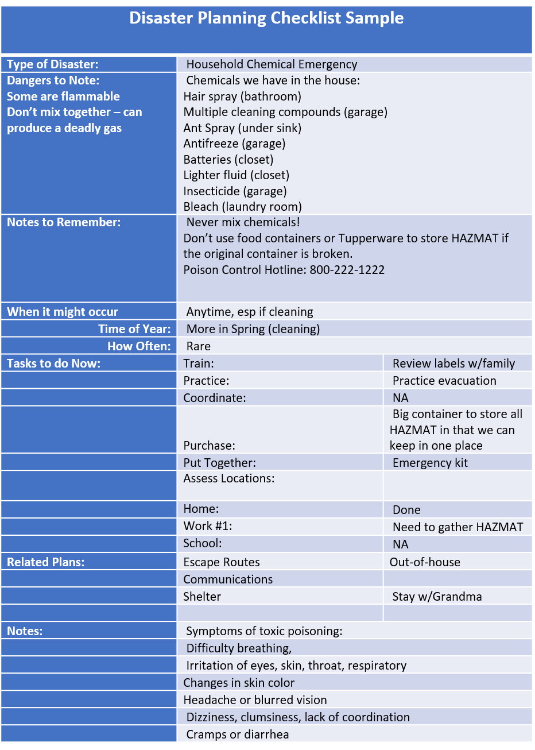
Disaster Planning Checklist
Fill one out for each disaster you want to be prepared for

Slide 10
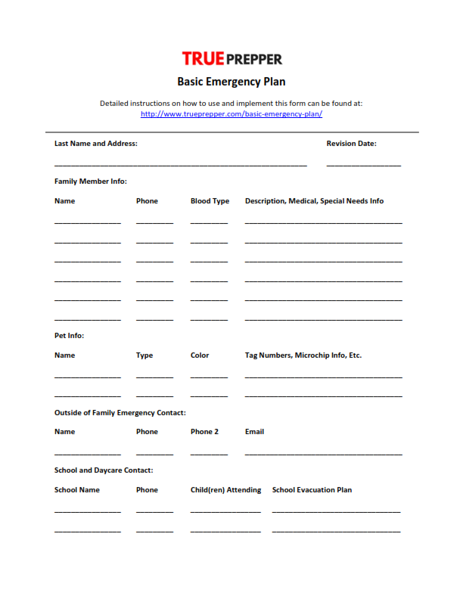
Basic Emergency Plan Page 1 of 3

Slide 11
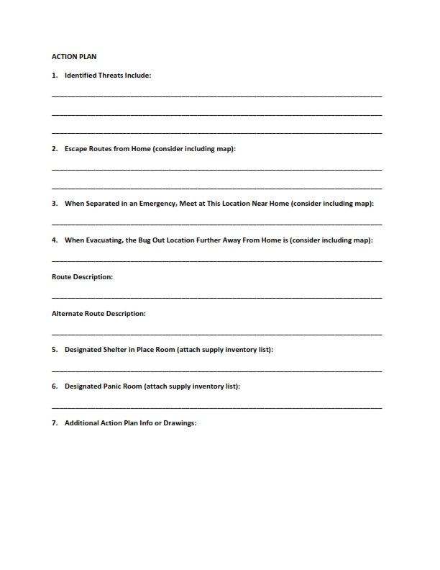
Basic Emergency Plan Page 2 of 3

Slide 12
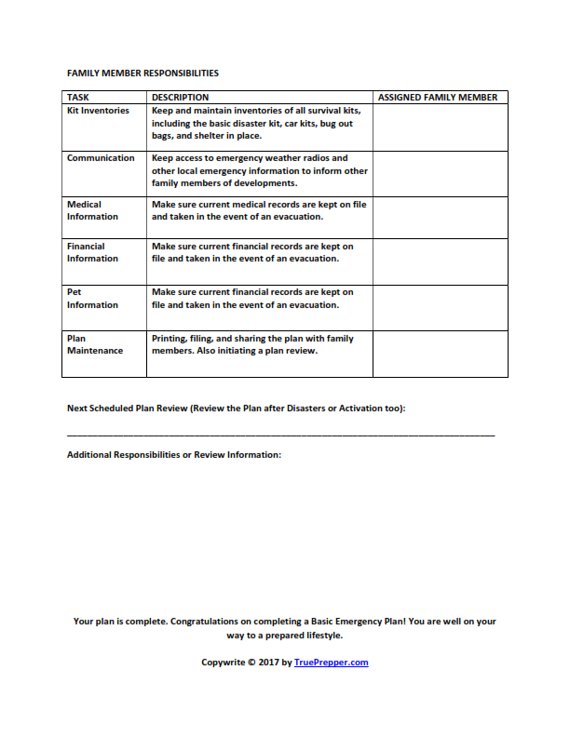
Basic Emergency Plan Page 3 of 3

Slide 13
Plan for Pets
Pet Emergency Supplies:
Food
Water
Medicines/Records
First Aid Kit
Collar w/ID
Leash
Documents
Crate/Carrier
Sanitation Items
Photo of you and pet
Toys, treats, bedding
Consider 2 Kits: One full kit, one smaller version if you have to evacuate

Slide 14
Plan for Pets
Make a Plan
Evacuate – how you will gather pets and where you’ll go
Develop a buddy system – neighbors, friends, or relatives
Talk to your Vet about planning
Gather contact information – animal control agencies, including Humane Society, ASPCA, and emergency vet hospitals

Slide 15
Practice!
Step 3: Fill out a Family Emergency Communications Plan (Lesson B4)
Step 4: Practice your plan with your family/household
Practice texting and calling
Discuss what information you should text
Who will be the lead person to send out info about the meeting place
Practice gathering at meeting places
Regularly discuss the plan (at least annually)
Challenge memorization of phone numbers
Make sure everyone understands when to call 911

Slide 16
Check On LEARNING
1. Your plan needs to take into account your specific needs. Examples of these are (select all that apply):
Age of household members
Favorite foods
Disabilities and medical equipment used
Political opinions about the government’s ability to manage an emergency
2. FEMA has published guidance on many types of disasters. Which of the following isn’t among them?
Space Weather
Nuclear Explosion
Floods
Zombie Apocolypse
3. T / F The Disaster Planning Checklist helps you fit general disaster information to your specific situation.
Your Disaster Plan should include (select all that apply):
a. Communications Plan
b. Meeting places or ways to contact each other
c. A list of your Panic Room supplies
d. Information on how you’ll save your pets

Slide 17
Shelter Plan
OBJECTIVES
DESIRED OUTCOME (Self-Mastery)
Cadets are familiar with the disaster emergencies that commonly occur in California and how to prepare, respond, and recover from them.
Plan of Action:
B2. Develop an adequate shelter plan for your family.
Essential Question: What are the types of shelters and when do you use them?

Slide 18
You Need Water
Never ration drinking water
Drink water you know in not contaminated first
Don’t drink carbonated/caffeinated beverages instead of drinking water
Treat water by boiling, chlorinating, or distilling

Slide 19
You Need Food
Store 3 days of emergency food supplies
Canned, dry goods, non-perishables
Keep food in covered containers
Throw away refrigerated food that has been at room temperature for two hours or more or has an unusual odor, color, or texture
Don’t eat food from cans that are swollen, dented, or corroded, or smells abnormal
Keep garbage outside
Use dry ice to keep food cold

Slide 20
Shelters
Stay-At-Home – remain indoors as much as possible. Patios, porches, & yards are okay
Mass Care Shelter – provides life sustaining services to disaster survivors
Text SHELTER and a ZIP Code to 43362 for list
Sheltering in Place – at home, work, other
Assess situation for signs you can leave

Slide 21
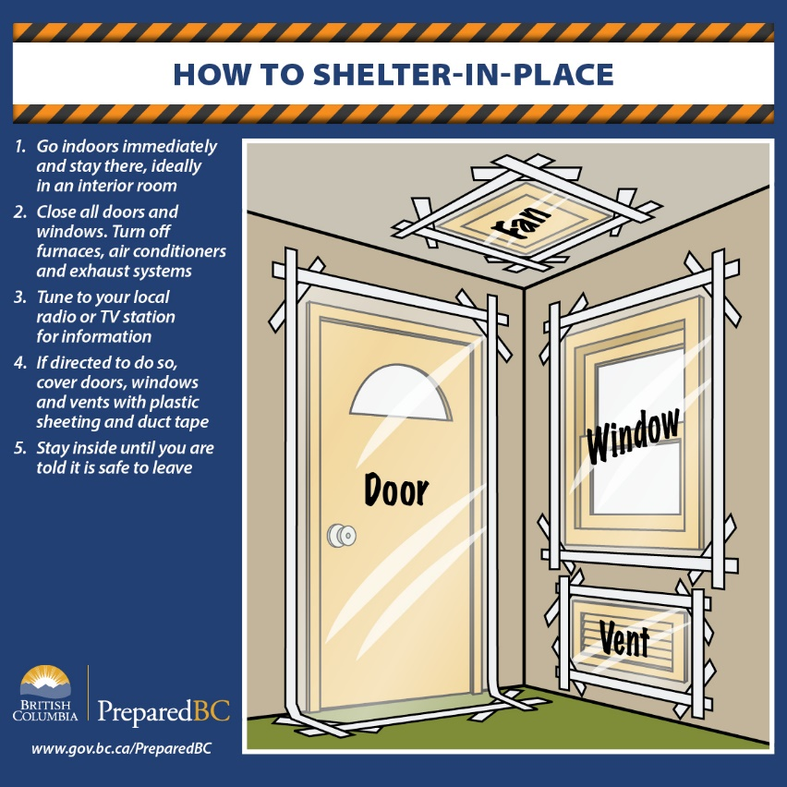
Shelter in Place – Sealing a Room
Local authorities may not be up and running
TV/radio/internet
Family & Pets inside
Secure doors, windows, vents, fireplace dampers
Interior room if possible
Duct tape plastic sheeting over cracks around doors, windows, vents, etc.

Slide 22
Check On LEARNING
1. Types of shelter in your Shelter Plan include all EXCEPT:
Stay-At-Home
Shelter-With-Family
Mass Care Shelter
Shelter In Place
2. Which of the following guidelines are given for Sheltering in Place (select all that apply)?
Lock the doors, close the windows, air vents, and fireplace dampers
Seal windows, doors, and air vents with thick plastic sheeting and duct tape
Leave pets outside
Watch TV and listen to the radio or check the internet for updates and official news
3. Which of the following conform to guidance on food safety?
a. Keep food in covered containers
b. Quickly eat any food that looks or smells abnormal, before it completely goes bad
c. Don’t let garbage accumulate inside
d. Throw away any food that has come into contact with contaminated flood water

Slide 23
Evacuation plan and route
OBJECTIVES
DESIRED OUTCOME (Self-Mastery)
Cadets are familiar with the disaster emergencies that commonly occur in California and how to prepare, respond, and recover from them.
Plan of Action:
B3. Develop an evacuation plan and routes.
Essential Question: What do you need to take into account if you have to evacuate?

Slide 24
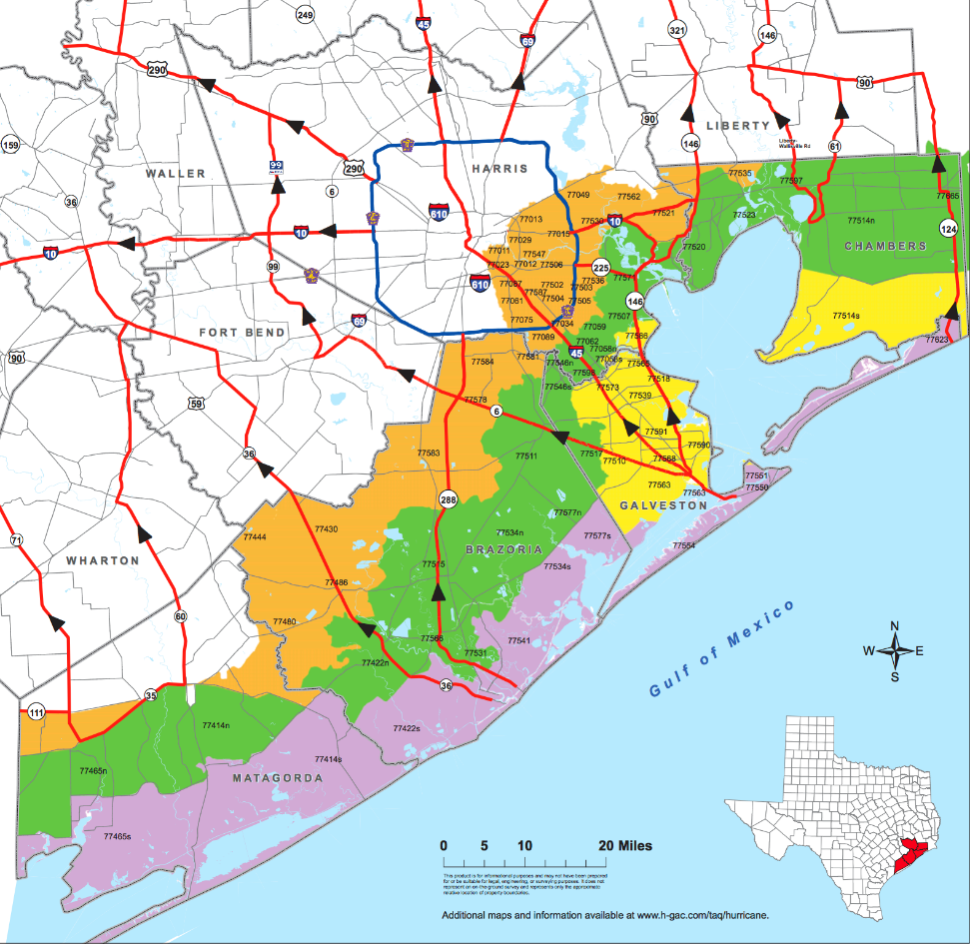
Evacuate!
Many kinds of emergencies can cause you to have to evacuate. In some cases, you may have a day or two to prepare while other situations might call for an immediate evacuation. Planning is vital to making sure that you can evacuate quickly and safely no matter what the circumstances.

Slide 25
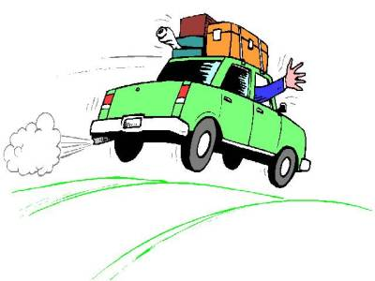
Evacuating
Different disasters – different routes
What do emergency planners tell you?
If told to go – GO!
Bring pets – but shelters may not allow them
Communications & meeting plan
If evacuation seems likely, keep a full gas tank
Have an emergency kit in the car
Plan for the weather

Slide 26
Before You Leave
Notify your out-of-area contact in your family communications plan
Lock doors and windows
Unplug electrical equipment
Leave a note saying where you went & when
Wear sturdy shoes, protective clothing (long shirt & pants) and a hat
Check on neighbors before you go

Slide 27
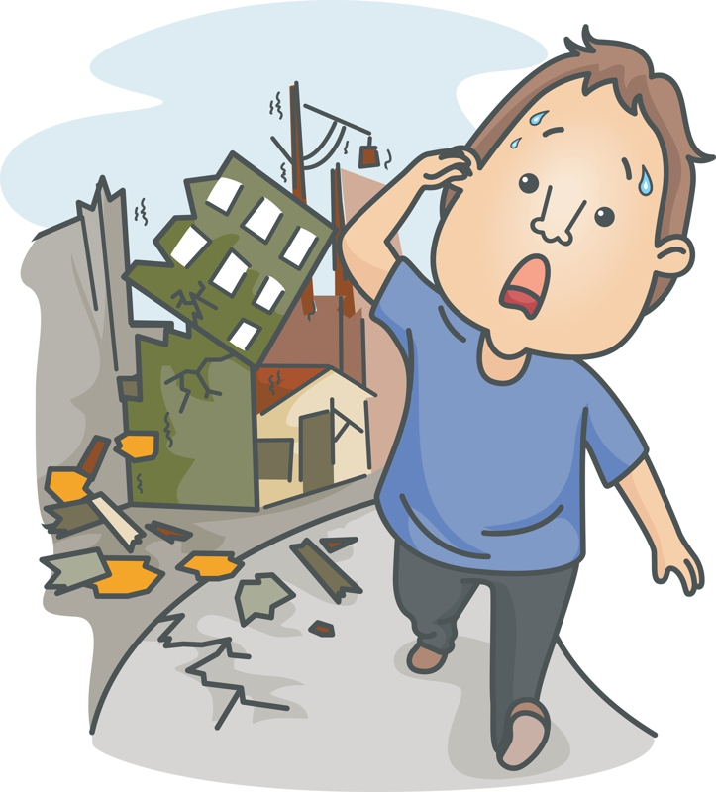
Coming Home
Don’t come until officials say you can
Notify friends and family
Keep a full gas tank
Bring food and water
Avoid downed power lines
Only use generators outside the home

Slide 28
Check On LEARNING
1. If you’re evacuating because of an emergency, which of the following is NOT true?
Identify several places you could go ahead of time
Assume public shelters will allow you to bring your pets
Develop a family plan to stay in touch in case you become separated
Keep a full tank of gas if an evacuation seems likely
2. T / F FEMA keeps a list of shelters you can access if evacuating. Other governmental agencies provide this information as well.
3. Which of the following is true for an evacuation (select all that apply)?
Leave your doors unlocked so emergency personnel don’t have to break in to secure your house
Unplug electrical equipment. Leave freezers and refrigerators plugged in except in a flood.
If there is damage to your home, you may need to shut off gas, water, and electricity before leaving.
Wear sturdy shoes and clothing that provides some protection – long pants & shirt, a hat
4. T / F When returning after an evacuation, it’s a good idea to bring the items you’ll need to survive: water, food, gas, etc.

Slide 29
Communications Plan
OBJECTIVES
DESIRED OUTCOME (Self-Mastery)
Cadets are familiar with the disaster emergencies that commonly occur in California and how to prepare, respond, and recover from them.
Plan of Action:
B4. Develop a disaster communications plan for your family.
Essential Question: How can you ensure your family will be able to find each other if a disaster happens?

Slide 30
Communications Plan
Should contain:
Household information
phone numbers and email addresses for all household members. Don’t rely on Contacts in your phone!
School, Childcare, Caregiver, Workplace
What everyone does if you’re not home when it happens
Out of Town Contact
Someone out of the area everyone can contact as a central point so you can reconnect

Slide 31
Emergency Meeting Places
Safe, familiar places your family can go for protection or to reunite. Pet-friendly
Indoor for large weather-related emergencies
In your neighborhood for localized problems
Outside your neighborhood if you can’t get home
Out of town
Everyone should have the address, contact info, and a plan on how they can get there

Slide 32
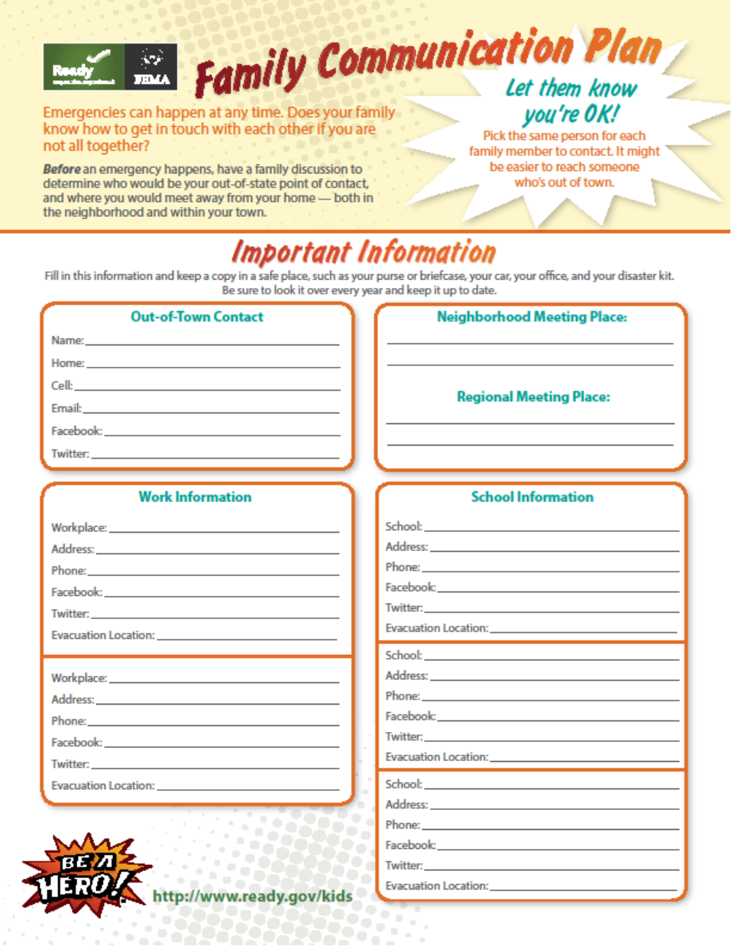
op

Slide 33
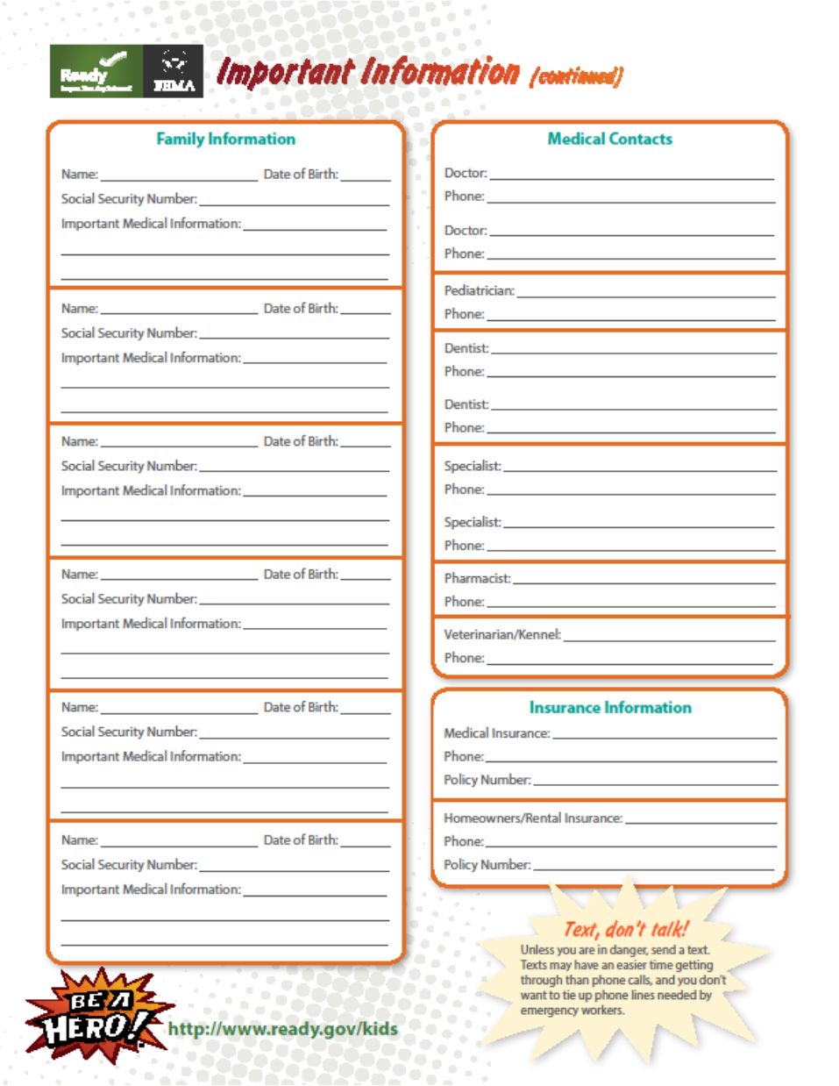

Slide 34
Make wallet cards everyone can carry with key information on them.

Slide 35
Other Important Information
Phone numbers for emergency services, utilities, service providers, medical providers, veterinarians, insurance companies.
Make sure everyone has the info (in the cloud?)
Enter household and emergency contact info in each family member’s phone
Store at least one emergency contact under the name “In Case of Emergency” or “ICE”
Know how to text, or alternative ways to communicate if they can’t text

Slide 36
Communication Tips
Text is best
Conserve phone battery
Reduce screen brightness
Airplane mode
Close apps you don’t need
No videos or games
Keep charged batteries, a phone charger, and a solar charger in your emergency kit
Don’t text while driving!

Slide 37
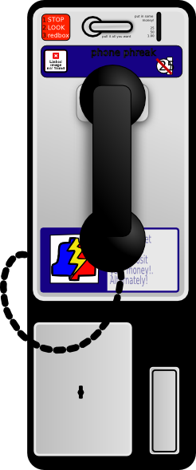
Communication Tips
Maintain a household landline
Call-forward your home phone number to your mobile phone number
Use the Internet to communicate
If no mobile phone, carry a prepaid phone card
Pay phones (if you can find one) don’t rely on electricity or mobile networks

Slide 38
Check On LEARNING
1. Which of the following should be in your communications plan?
Contact info for all family and important outside contacts
Planned meeting places if you get separated
Contact information for the local mayor’s office
Medical and insurance information
2. When communicating during a disaster, which is better to use, text or phone? _________________
3. In a communications plan, “ICE” stands for:
I_______________________
C_______________________
E_______________________
4. T / F Though losing its popularity and convenience in daily life, having a landline telephone during emergencies is an asset.

