Slide 1
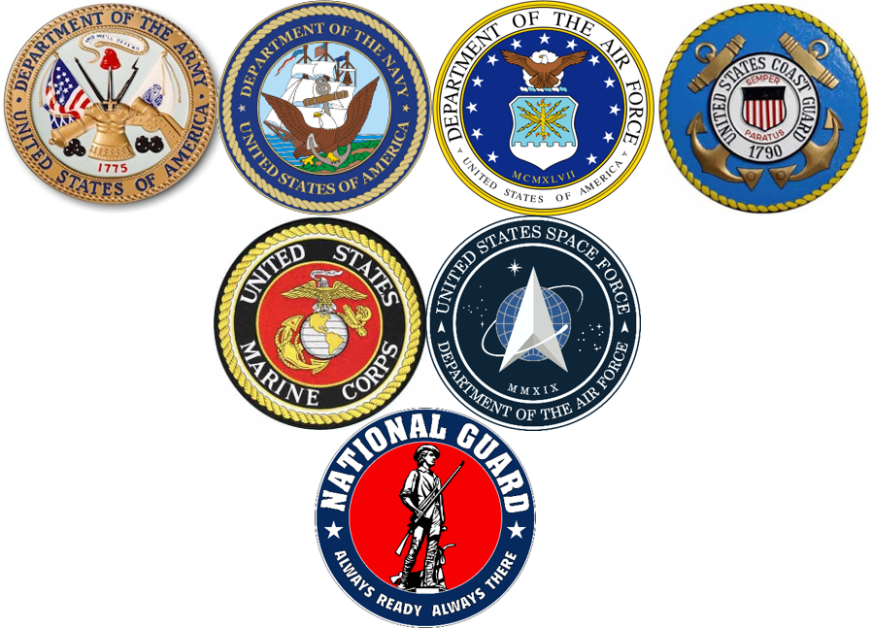
California Cadet Corps Curriculum on Military Knowledge
“To Deter War & Protect Our Freedoms”
M9/B: Trends in the US Military

Slide 2
Agenda
B1. Soldier Care, Diversity, & Equal Opportunity Programs
B2. Special Operations Forces
B3. Technology
B4. The Draft
B5. Deployments
B6. Reintegration Problems

Slide 3
SOLDIER CARE, DIVERSITY, & EQUAL OPPORTUNITY
B1. Explain how Soldier Care, Diversity, and Equal Opportunity programs in the US Military tie the armed services to the community.

Slide 4
Trends in the US Military
OBJECTIVES
Cadets gain an appreciation for the far-reaching trends, policies, and programs embraced by the US Military that have contributed to our national identity.
Plan of Action:
Explain how Soldier Care, Diversity and Equal Opportunity programs in the US Military tie the armed services to the community.
Explain the role Special Operations Forces have played in the wars of the early Twenty-first Century
Explain how technology in warfighting has changed both the nature of war and the warriors
Explain how the Draft functions in the United States and why it still exists
Explain how the armed services manage deployments, and the ramifications of those policies
Explain the reintegration problems military personnel have returning from deployments or combat, and how they affect the military member, their family, their community, and the military services
Essential Question: In what ways does the US Military, through Soldier Care Programs, lead the way in the fair treatment of its employees?

Slide 5
Soldier Care
Empower soldiers to be as good at their jobs as they can possibly be
Well qualified soldiers will survive longer
Good for the soldier, good for the mission
Soldier care includes challenging training, ensuring timely promotions & schools, performance improvement counseling, assistance in solving family issues and making family ready for a soldier’s deployment

Slide 6
Definition of Diversity
The different attributes, experiences and backgrounds of our Soldiers, Civilians and Family Members that further enhance our global capabilities and contribute to an adaptive, culturally astute Army.

Slide 7
The Army’s Diversity Vision
The national leader in embracing the strengths of diverse people in an inclusive environment . . investing in and managing talent, valuing individuals and developing culturally astute Soldiers and Civilians who enhance our communities and are prepared for the human dimension of leadership and global engagements.

Slide 8
Equal Opportunity
Equal Opportunity is the larger program that includes diversity. Equal Opportunity, or EO, is a military-wide program that provides guidelines, regulations, and processes that govern daily treatment of soldiers and Army Civilians. Equal Opportunity is grounded in US and state laws, and is embraced by the military as the right of every servicemember and civilian employee for fair treatment.

Slide 9
Goals of EO Program
Provide EO for military personnel and family members, both on and off post and within the limits of the laws of localities, states, and host nations.
Create and sustain effective units by eliminating discriminatory behaviors or practices that undermine teamwork, mutual respect, loyalty, and shared sacrifice of the men and Women of America's Army.

Slide 10
EO Philosophy
EO philosophy is based on fairness, justice, and equity. Commanders are responsible for sustaining a positive EO climate within their units.

Slide 11
EO Policy
The U.S. Army will provide EO and fair treatment for military personnel and family members without regard to race, color, religion, gender, sexual orientation, or national origin, and provide an environment free of unlawful discrimination and offensive behavior. This policy-
Applies both on and off post, during duty and non-duty hours.
Applies to working, living, and recreational environments (including both on and off-post housing).

Slide 12
Ethnic Observances
EO/special ethnic observances are conducted to enhance cross-cultural awareness among all soldiers, civilian employees, and their families. These observances recognize the achievements and contributions made by members of specific racial, ethnic, gender groups in our society. The observances should promote understanding, teamwork, harmony, pride, and spirit among all groups not just within the specific group being honored.

Slide 13
Ethnic Observances
January
February
March
April
May
June
August
September
November
Martin Luther King Jr Celebration
Nat’l African American/Black History
Women’s History Month
Holocaust Days of Remembrance
Asian American Pacific Islander Heritage
LGBT Pride Month
Women’s Equality Day Celebration
Nat’l Hispanic Heritage Month
Nat’l American Indian Heritage Month

Slide 14
EO can be your Job
Military Occupational Specialty
NCOs/Officers train at the Defense Equal Opportunity Management Institute (DEOMI)
Work in EO positions as their primary job at battalion & higher
Can also be an additional duty in lower level units (companies)
Equates to EEO in the civilian workforce

Slide 15
EO Complaints
EO isn’t just an educational program
Commanders and EO Offices receive complaints from soldiers and employees who feel they’ve been treated unfairly
Investigations by impartial leaders
Very serious – can end a career

Slide 16
Check on Learning
What is the focus of Soldier Care?
The Military isn’t a civilian business. Explain why Diversity & EO pertain within our nation’s military units.
3. Name 3 of the Ethnic Observances.

Slide 17
SPECIAL OPERATIONS FORCES
B2. Explain the role Special Operations Forces have played in the wars of the early Twenty-First Century.

Slide 18
Trends in the US Military
OBJECTIVES
Cadets gain an appreciation for the far-reaching trends, policies, and programs embraced by the US Military that have contributed to our national identity.
Plan of Action:
Explain how Soldier Care, Diversity and Equal Opportunity programs in the US Military tie the armed services to the community.
Explain the role Special Operations Forces have played in the wars of the early Twenty-first Century
Explain how technology in warfighting has changed both the nature of war and the warriors
Explain how the Draft functions in the United States and why it still exists
Explain how the armed services manage deployments, and the ramifications of those policies
Explain the reintegration problems military personnel have returning from deployments or combat, and how they affect the military member, their family, their community, and the military services
Essential Question: Why have Special Operations Forces become the force of choice for military operations, and how has the military made up for numbers of SOF needed for the mission?

Slide 19
Special Operations Forces
US Military’s “commandos”
Army Rangers
Army Special Forces (green berets)
Army’s Delta Force
Navy SEALs
Marine Raiders
Marine Recon
Air Force Spec Ops
(PJ, Combat Controllers)

Slide 20
Special Operations Forces
Originated during World War II
British Army developed concept
US SOF
Ranger
Office of Strategic Services (OSS)
Marine Raiders
Various provisional units with SOF missions

Slide 21
SOF Missions
Sabotage
Demolition
Support to Counterinsurgency
Security Force Assistance
Reconnaissance & Surveillance (Intelligence)
Combat Diving
Elite Offensive Operations
Counterterrorism
Hostage Rescue

Slide 22
Why Now
SOF have been used extensively in military operations since 2001
Force of choice in Counterinsurgency and Counterterrorism operations
Major Special Forces mission is training local military and security forces
Elite small team attack forces is another major strength of SOF
These are the missions we’ve been doing in Afghanistan, Iraq, and Syria

Slide 23
Why Now
The missions in Iraq and Afghanistan have been so extensive, we’ve had to use conventional forces to do most of them
US Army combat brigades training the Iraqi & Afghan military
Military Police training the Iraqi & Afghan Police & security forces
SOF forces focus on training Iraqi & Afghan SOF forces and conducting elite combat missions

Slide 24
Check on Learning
Name three of the current US Military special operations forces
Name three SOF missions.
Why have SOF forces been used so extensively in Iraq & Afghanistan?

Slide 25
TECHNOLOGY
B3. Explain how technology in warfighting has changed both the nature of war and the warriors

Slide 26
Trends in the US Military
OBJECTIVES
Cadets gain an appreciation for the far-reaching trends, policies, and programs embraced by the US Military that have contributed to our national identity.
Plan of Action:
Explain how Soldier Care, Diversity and Equal Opportunity programs in the US Military tie the armed services to the community.
Explain the role Special Operations Forces have played in the wars of the early Twenty-first Century
Explain how technology in warfighting has changed both the nature of war and the warriors
Explain how the Draft functions in the United States and why it still exists
Explain how the armed services manage deployments, and the ramifications of those policies
Explain the reintegration problems military personnel have returning from deployments or combat, and how they affect the military member, their family, their community, and the military services
Essential Question: What types of technology have influenced changes in the nature of war?

Slide 27
Technology
Changes the nature of warfare
Historical Technology Innovations
Guns (over spears, arrows, swords)
Machineguns
Balloons
Airplanes
Tanks
Submarines
Radar
Helicopters
Computers
Nuclear warfare
Missiles

Slide 28
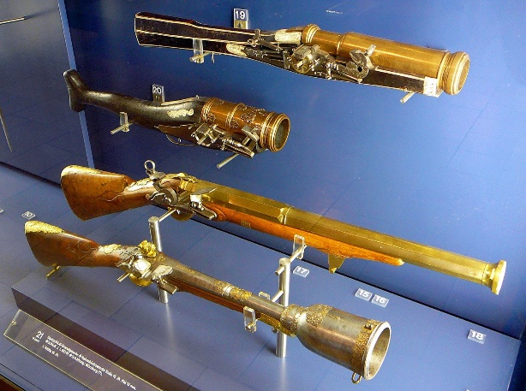
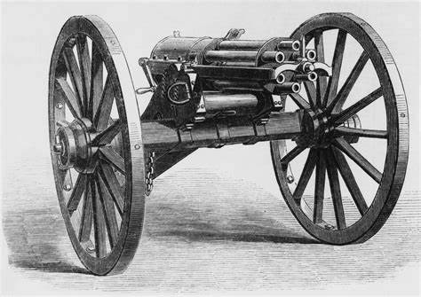
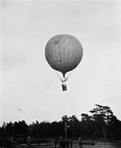
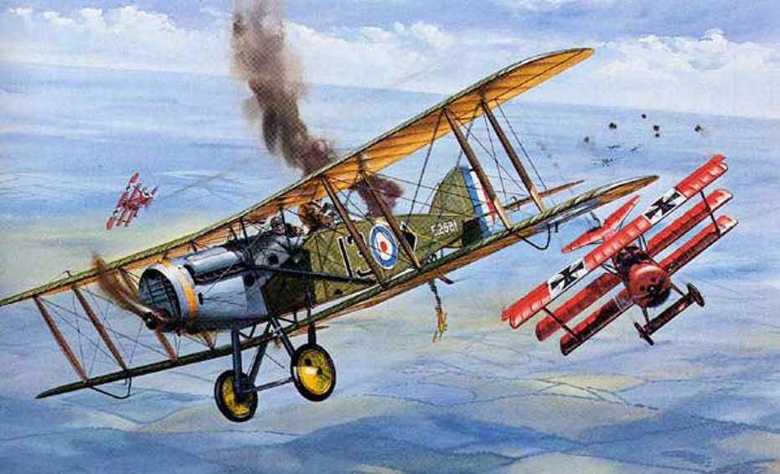
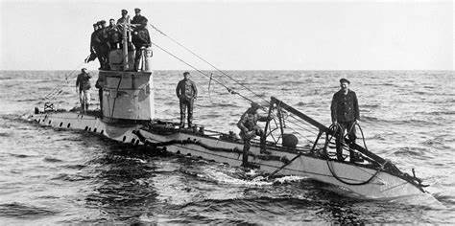
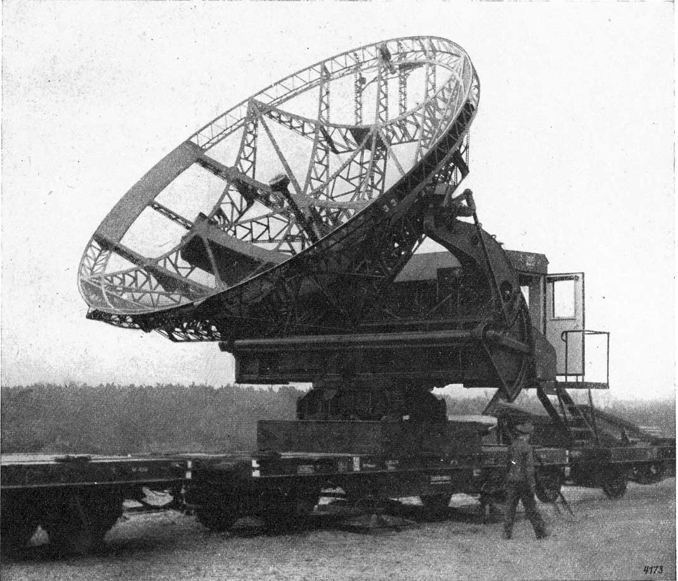
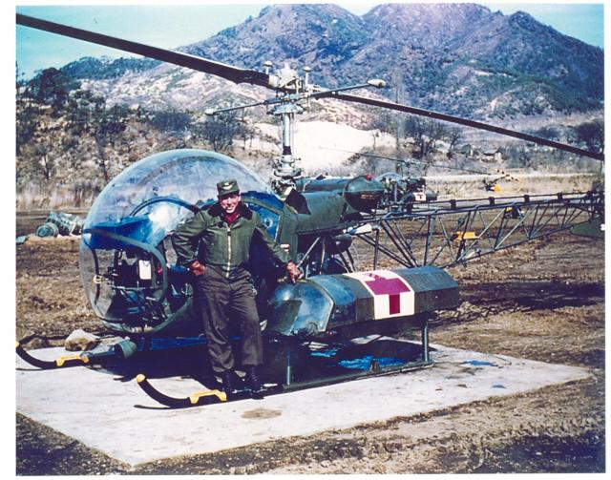
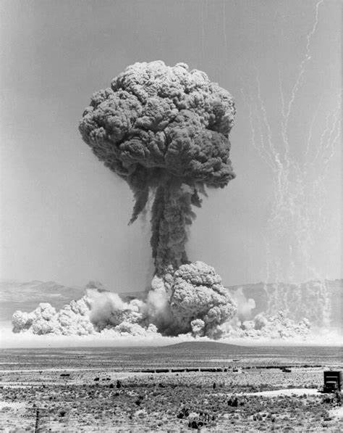
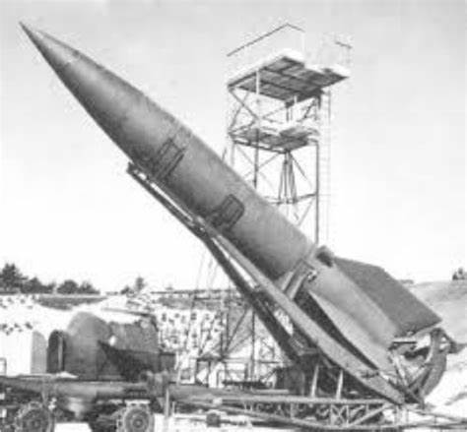

Slide 29
Modern Innovations
GPS
Tracking Terrorist Funding
IEDs
Counter-IEDs
Unmanned aerial vehicles
Prosthetic devices
Robotics

Slide 30
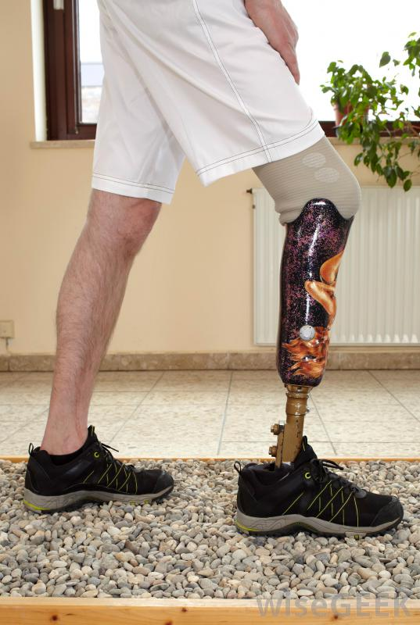
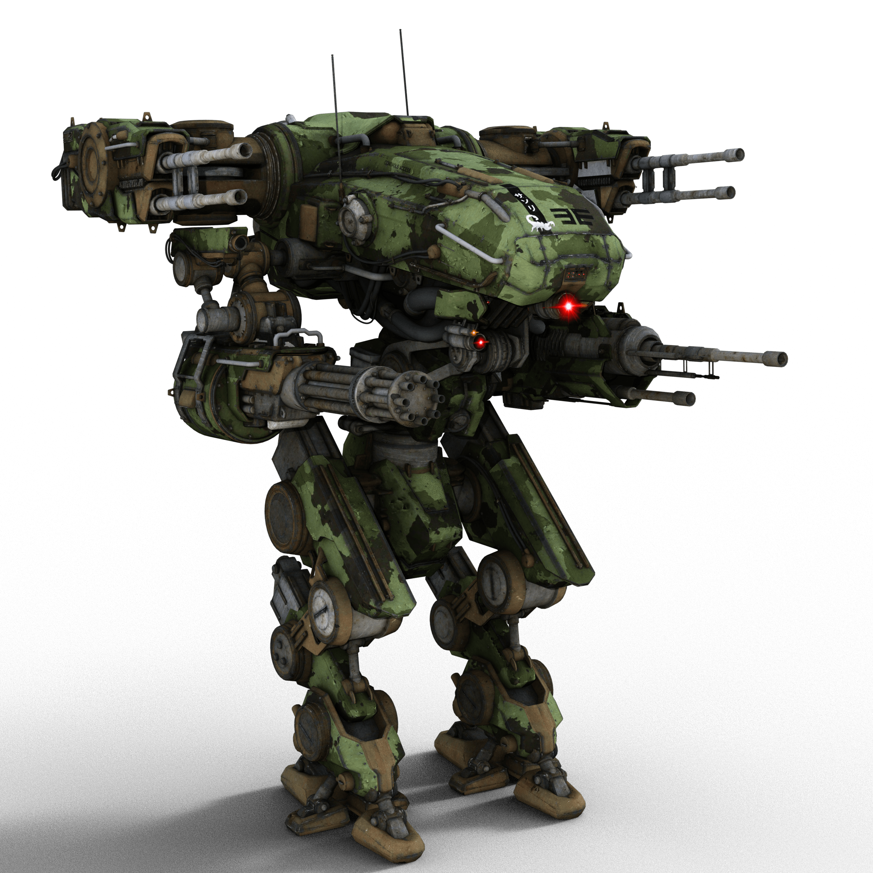
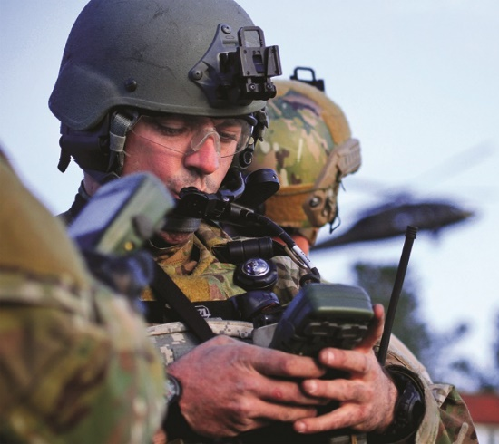
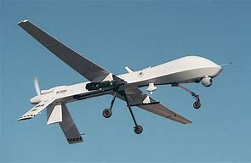
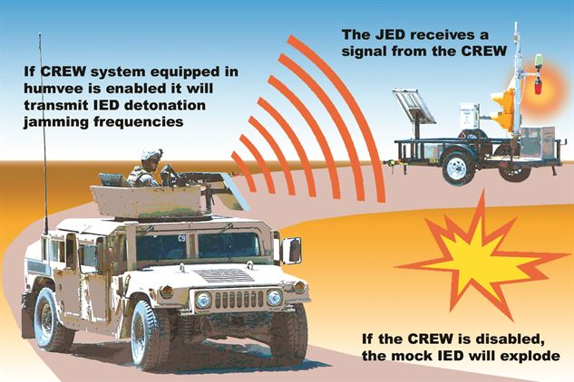
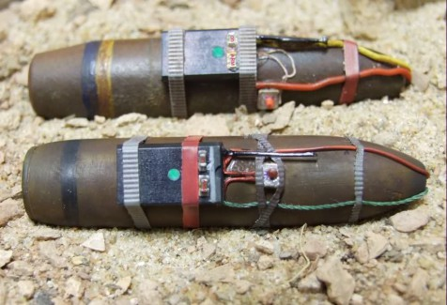

Slide 31
Check on Learning
Name five historical technological innovations that changed warfare.
Name five current (past 20 years) innovations that are changing warfare

Slide 32
THE DRAFT
B4. Explain how the Draft functions in the United States and why it still exists

Slide 33
Trends in the US Military
OBJECTIVES
Cadets gain an appreciation for the far-reaching trends, policies, and programs embraced by the US Military that have contributed to our national identity.
Plan of Action:
Explain how Soldier Care, Diversity and Equal Opportunity programs in the US Military tie the armed services to the community.
Explain the role Special Operations Forces have played in the wars of the early Twenty-first Century
Explain how technology in warfighting has changed both the nature of war and the warriors
Explain how the Draft functions in the United States and why it still exists
Explain how the armed services manage deployments, and the ramifications of those policies
Explain the reintegration problems military personnel have returning from deployments or combat, and how they affect the military member, their family, their community, and the military services
Essential Question: Why do we have a Selective Service System, and how is it changing to keep up with the times?

Slide 34
What’s a Draft?
Draft = Conscription
The compulsory enrollment of persons especially for military service
When a country uses a draft, that means that young adults are required to join the military for a specified time (often 2 years), then be available to be called back up if needed.

Slide 35
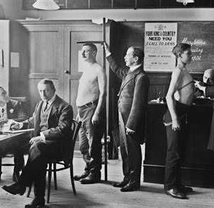
History of US Draft
The draft is covered by the Selective Services Act
The United States has used the draft in five wartime periods:
Revolutionary War
Civil War
World War I
World War II
Korean War thru Vietnam Wars

Slide 36
Who is Drafted?
Depends on the needs of the country/Army
Usually has been men ages 18-25
Has been to age 45 (Rev War) or 35 (Civil War)
The US has never (yet) drafted women
There has been movement in Congress to add women to the US draft

Slide 37
Pros & Cons of a Draft
Pros
Cons
Better cross section of society – higher intelligence, more diversity
Lower personnel costs
Personnel strength across the Army
Lower morale
Higher discipline problems
Lower pay (pay not used as an incentive to join)
Unpopular to citizenry
Soldiers are in the service for a shorter time, so don’t gain a lot of experience

Slide 38
Check on Learning
How many times has the US activated the draft? Name three.
What are the ages of eligibility for the draft in the current system?
Name a pro and a con of the draft.

Slide 39
DEPLOYMENTS
B5. Explain how the armed services manage deployments, and the ramifications of those policies

Slide 40
Trends in the US Military
OBJECTIVES
Cadets gain an appreciation for the far-reaching trends, policies, and programs embraced by the US Military that have contributed to our national identity.
Plan of Action:
Explain how Soldier Care, Diversity and Equal Opportunity programs in the US Military tie the armed services to the community.
Explain the role Special Operations Forces have played in the wars of the early Twenty-first Century
Explain how technology in warfighting has changed both the nature of war and the warriors
Explain how the Draft functions in the United States and why it still exists
Explain how the armed services manage deployments, and the ramifications of those policies
Explain the reintegration problems military personnel have returning from deployments or combat, and how they affect the military member, their family, their community, and the military services
Essential Question: What problems does a high operational tempo of deployments cause the military, the soldier, and the family?

Slide 41
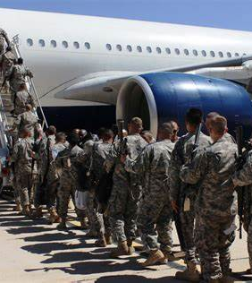
Mobilization & Deployment
Any movement of personnel or equipment to another place for military action (training or combat)
Mobilization is the process of placing military reservists on active duty for a period of time.
Active forces deploy; Reserve forces mobilize then deploy

Slide 42
Post 9/11 Deployment
World War II vs Vietnam vs Iraq
Time deployed vs time home – cycle
High OPTEMPO units
Effect on families
Reduction in time deployed
Special Operations Forces

Slide 43
Deployment Bottom Line
Deployment should be predictable (in a long-term conflict)
Lots of lead time if the cycle is working
Depends on your skills/career field
Some deploy a lot more than others
Deployments are the top priority – that’s where the resources go

Slide 44
Check on Learning
What’s the difference between deployment and mobilization?
What type of units deploy the most?
After 2011, were soldier more or less likely to deploy?

Slide 45
REINTEGRATION PROBLEMS
B6. Explain the reintegration problems military personnel have returning from deployments or combat, and how they affect the military member, their family, their community, and the military services

Slide 46
Trends in the US Military
OBJECTIVES
Cadets gain an appreciation for the far-reaching trends, policies, and programs embraced by the US Military that have contributed to our national identity.
Plan of Action:
Explain how Soldier Care, Diversity and Equal Opportunity programs in the US Military tie the armed services to the community.
Explain the role Special Operations Forces have played in the wars of the early Twenty-first Century
Explain how technology in warfighting has changed both the nature of war and the warriors
Explain how the Draft functions in the United States and why it still exists
Explain how the armed services manage deployments, and the ramifications of those policies
Explain the reintegration problems military personnel have returning from deployments or combat, and how they affect the military member, their family, their community, and the military services
Essential Question: What are the major issues with reintegration of soldiers after combat service?

Slide 47
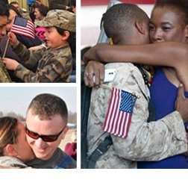
Reintegration
The process of integrating soldiers back into society
When soldiers return from a deployment, the military puts them through a process that helps them get used to their ‘normal’, either as an active duty soldier or reservist
This includes wellness counseling and helps families and soldiers understand and deal with the outcomes of their forced separatoin

Slide 48
Deployment Issues
Some issues related to deployment can be:
Post-Traumatic Stress Disorder (PTSD)
Family dynamics
Employment issues
Marriage or relationship issues
Kids
Money

Slide 49
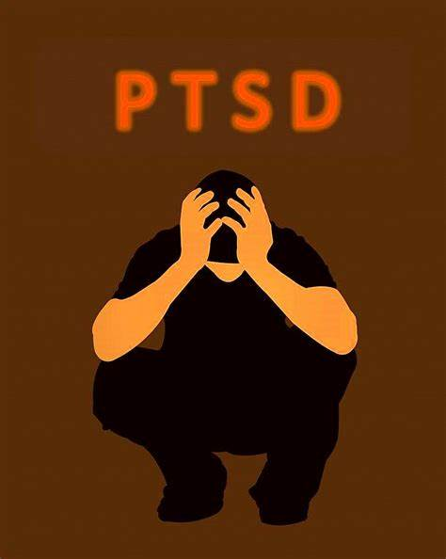
PTSD
Common at low levels
Medical Professionals can usually help
Major cases can last a long time if not addressed and treated
Most cases are simple to deal with

Slide 50
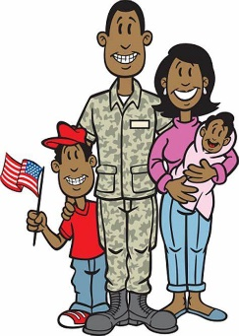
Family Dynamics
When the soldier is gone, the family develops new ways to get things done
Reintegrating soldier interrupts ‘new’ processes
Level of freedom for spouse – hard to ‘go back’

Slide 51
Employment Issues
Laws require employers to give Reservists back their job, or one similar, with no reduction in pay or tenure
Harder for small business to absorb the loss and return of an employee
ESGR helps employers understand their responsibilities and requirements

Slide 52
Relationship Issues
A relationship that had issues before the deployment will not improve with the deployment process
May be a temporary ‘honey-moon’, but problems will return
Relationships that happened during the deployment must be addressed

Slide 53
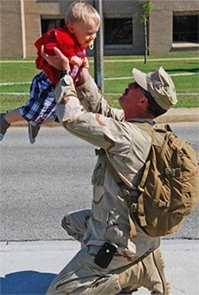
Kids
6-12+ months is a long time for a parent to be separated from their child
Response depends on the age of the child
Child can act with remoteness, or clinginess
Older kids can push the parents, trying to gain freedoms from supervision
Soldiers don’t acknowledge gains that have happened in family dynamics
Spouse used to being in charge

Slide 54
Money
No less a problem in deployments than any other time
Reservists may make less money from military
Control of funds – power within marriage
Soldier wants to treat themselves with large purchases

Slide 55
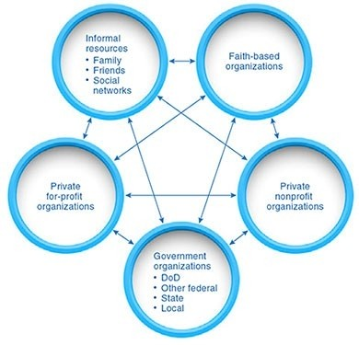
Resources Available

Slide 56
Family Readiness Groups
Group of people related to or interested in a military unit, especially one deploying
Shared experience
Source of assistance
Plans activities
Welcomes families to a military unit
Funded by military

Slide 57
Family Readiness Groups
For Reserve & National Guard Units, family readiness is equally important during mobilization:
Families aren’t oriented to the military
Families are spread out – not concentrated on or near a military base
May not have any experience with military support capabilities
No friends/neighbors sharing deployment experience

Slide 58
Preparation
Prior to a unit’s redeployment, the military offers training and guidance to soldiers and families on reintegration
After redeployment, more training of soldiers and families together to educate about and help with issues

Slide 59
Check on Learning
Name and discuss two issues that often arise during the reintegration of soldiers returning from deployment
What recourses are available to help soldiers and families work through reintegration issues?

