Slide 1
Curriculum on Military Knowledge
C. Regulations that Guide Us
“Earn it. Achieve it. Wear it.”
24 July 2020

Slide 2
Agenda
C1. Personnel Regulations
C2. Operations (S3) Regulations
C3. Logistics: CR 4-2, State Property
C4. CR 3-21.5 Drill & Ceremonies
Note: When reviewing each of the regulations listed in this Section, cadets should acquire and review the regulation itself in addition to the curriculum text and slides

Slide 3
Personnel Regulations
Objectives:
Use CR 1 to properly prepare a memo or letter
Identify the major requirements from CR 1-9 to establish a new Cadet Corps unit
Identify the specifications for flags and guidons per CR 1-12

Slide 4
Correspondence
Keep your writing style clear and to the point
Use the right format – this includes all the details outlined in CR 1 on spacing, what’s capitalized, style of the date, etc.
You show your professionalism by what you put in your correspondence
Attention to Detail is very important!
Cc as appropriate to keep the chain of command informed

Slide 5
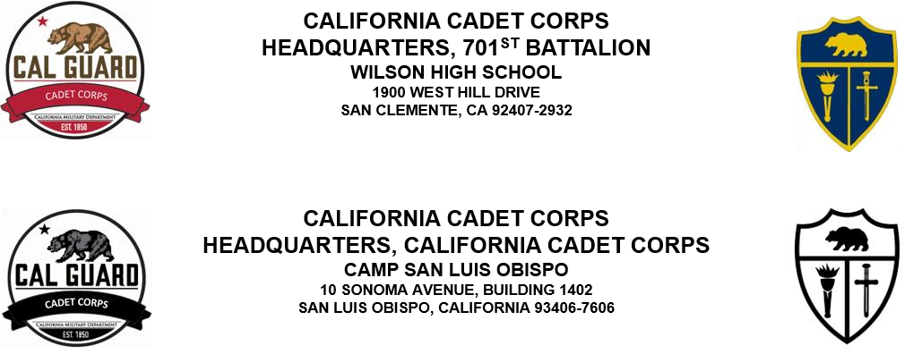
Letterhead
CR 1, para 5-1f and Figure 5-1
Both logos, if used, either color or black
Use Cal Guard CACC logo; CACC or Bde/Bn logo
Size of fonts per para 5-1f

Slide 6
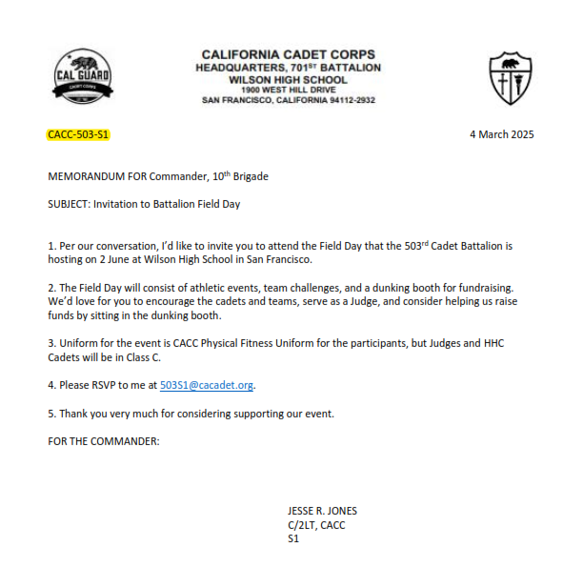
Office Symbols
Stands for your Position instead of your name
Explained in CR 1, para 5-1k
CACC-405-CR is the Bn Cdr, 405th Bn
CACC-405-S6 is the S6 for the 405th Bn
CACC-097-C-1-PL is the Platoon Leader, 1st Plt, C Co, 97th Bn
HQ CACC-XO is the Executive Officer of CACC
CACC-503-S1 is the S1 of the 503rd Bn

Slide 7
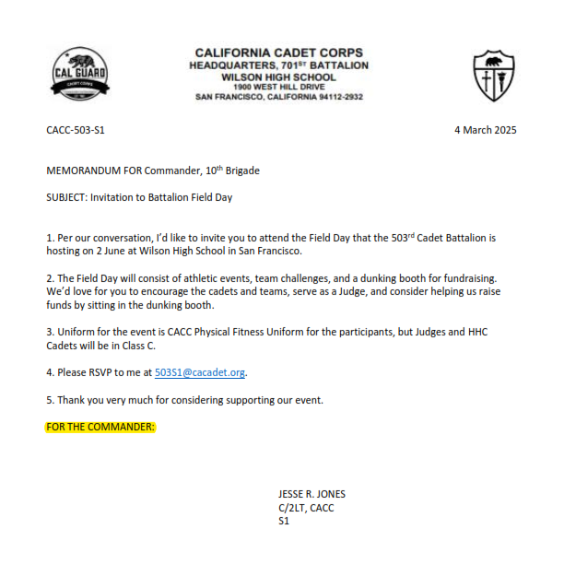
Authority Line
Shows under whose authority the correspondence is being written
If the memo is yours alone, don’t use one
If it’s unit business, use
FOR THE COMMANDER: or
FOR THE COMMANDANT: or
FOR THE PRINCIPAL:
Inserted two spaces under the last text line

Slide 8
Signature Block
Cadet:
JOHNNY K. DETT
C/SSG, CACC
Platoon Sergeant
Commandant:
JOHNNY P. JONES
1LT, CACC
Assistant Commandant of Cadets
Ensure you use correct abbreviations for rank!
Inserted 5 lines below the Authority Line or last line of text
Left side of signature block starts at center of page

Slide 9
CACC Correspondence
CR 1 is very specific about the types of correspondence, what you use when, and what it’s supposed to look like. See Chapter 5, CR 1
Type of Correspondence | Use for:
Letter | For communicating with civilians outside the CACC (parents, school district officials, civic & government entities)
Memorandum | For communicating with CACC or military members or offices. Includes Memorandum for Record (MFR), Memorandum of Agreement (MOA), or Memorandum of Understanding (MOU)
Information Bulletin | Published announcements put out on a regular basis. HQ CACC publishes monthly Info Bulletins to convey information to CACC members
Circular or WARNORD | Gives directions and information about a specific event or operation (i.e. Drill Competition, XTC, Leadership Conference). May be in a Circular or WARNORD format.
Letter of Instruction | Communicates policy, directives or instructions

Slide 10
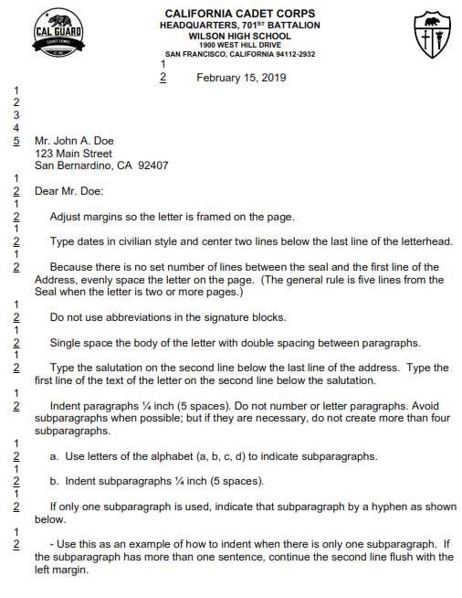
Letter
Letterhead
Date
Address
Salutation
Paragraphs / Indentation
Authority Line
Signature Block
Enclosures/Attachments

Slide 11
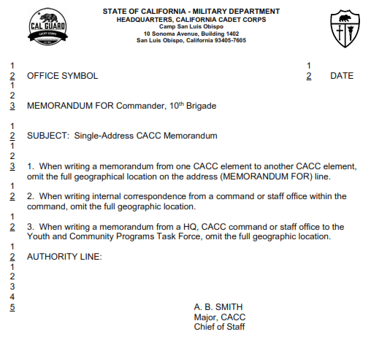
Memorandum
Letterhead
Office Symbol
Date
MEMORANDUM FOR
SUBJECT
Paragraphs / Indentation
Authority Line
Signature Block
Enclosures/Attachments
Note: If you have multiple addressees, or there are more than one page in the memo, check out the rules for how to do that.

Slide 12
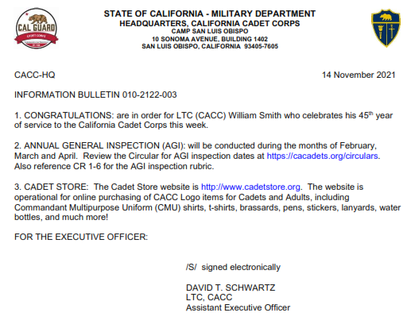
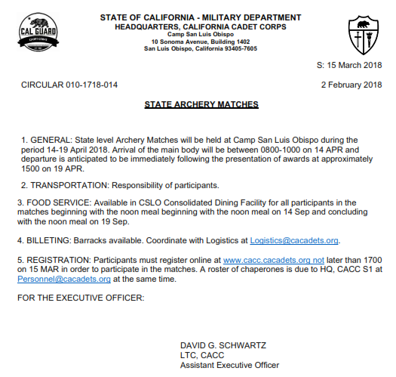
Info Bulletin, Circular, LOI
Mostly issued by HQ CACC, but brigades & battalions can issue them too
Formatted mostly like a Memorandum

Slide 13
Warning Order
^{CACC-16th Bde}
^{3 SEP 2016}
^{WARNING ORDER 2016-2017-01}
^{1. SITUATION:}
a. Name of Event/Operation: 16th Bde Fall Bivouac b. Dates: 4-6 NOV 2016
c. Start and End Times: Friday 4 NOV 16 at 1830 hrs/Sunday 6 NOV at 1500 hrs d. Location: California State Park (meet at Campsite 17)
e. Units participating: 16th Bde
f. Participation Requirements: All 16th Bde cadets in good standing with parental and commandant
^{permission may attend}
g. Training events planned: Land Nav, Archery, Guard Duty, Field Training h. Uniform is Class C
2. MISSION: 16th Brigade gathers at its annual bivouac at California State Park 4-6 NOV 2016 to conduct field and adventure training in a field environment.
^{3. EXECUTION:}
a. Commander’s Intent: 16th Brigade will conduct its annual bivouac in a safe and fun manner, while
challenging cadets to learn new skills and meet cadets from all schools within the brigade. Cadets will learn to live and work in a field environment, and participate in friendly competition between units.
b. Concept of Operations: The bivouac will focus on three training events: Land Nav, Archery, and Guard Duty. All cadets will compete in the Land Nav and Archery events, which will go toward an overall Honor Unit. All cadets will receive classes on Guard Duty and will perform a shift of Guard Duty to reinforce their General Orders and teach responsibility. All units from the brigade will participate, and
we will conduct a morale activity that will bring the cadets from different schools together in a friendly environment.
c. Goals: (these may or may not be included in the WARNORD)
Format and example are in CR 3-14
Used as part of the Cadet Activity Planning Process (CAPP) to disseminate information about upcoming events
May be followed by an Operations Plan or Order
Follows a specific format, just like other correspondence

Slide 14
CR 1-9 Establishing a CACC Unit
Principal & School Board Approval
No JROTC program on campus
High Schools must be WASC accredited
ID the Commandant
Enough Cadets
Letter of Interest
Cooperative Agreement
Activation Order

Slide 15
CR 1-12 CACC Organizational Colors & Guidons
Flags will either be four-foot four-inch hoist by five-foot 6-inch fly OR three-foot hoist by 4-foot fly. CACC organizational colors should never be displayed or carried with National or State Colors that are larger in dimension.

Slide 16
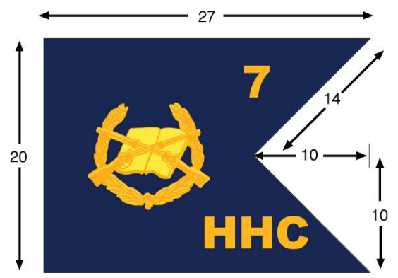
CR 1-12 CACC Organizational Colors & Guidons

Slide 17
Check on Learning
Is this letterhead authorized?
What’s wrong with this Signature Block?
JOHNNY K. DETT
C/SSGT, CACC
Logistics NCO
To write officially to the Cadet Corps XO, would you use a letter format or a memorandum format?
Where do you find the format for a Warning Order?

Slide 18
Operations (S-3) Regulations
Describe the Cadet Corps Curriculum system of Core Instructional Groups, Strands, Sections, and Lessons. Given a topic, find it within the list of lessons
List the Leadership Training Schools as described in CR 3-1
List the Field Training conducted within the CA Cadet Corps per CR 3-2
Describe the CA Cadet Corps Summer Encampment program per CR 3-3
Describe the Individual Major Awards (IMA) program per CR 3-4
List the divisions and events within the CA Cadet Corps Drill Competition program per CR 3-8
Describe the Fitnessgram as implemented by the California Cadet Corps in CR 3-12
Describe the Marksmanship Training and Competition program as described in CR 3-17
Describe the three chains of command identified in CR 3-22 for use within the CA Cadet Corps
Use CR 3-22 to determine promotion eligibility of a cadet in a staff position in battalion, brigade, or state level units

Slide 19
CR 3 Training
Structure of CACC Curriculum
4 Core Instructional Groups
Military Subjects, Citizenship, Leadership, Wellness
Sections & Lessons
Content Standards
Flexible System of Curriculum (1-7 years of study)
Training Schedules & Lesson Plans
Cadet Corps Knowledge & Basic Facts

Slide 20
CR 3-1 Leadership Training Schools
CR 3-1 presents the various training schools that CACC offers, at battalion, brigade, and state level. This includes:
Leadership Schools (Basic, Intermediate, Advanced)
NCO Schools (Basic & Advanced)
Officer Candidate School (OCS)
Specialized Training Schools
Drill Academy
Command & Staff School
Commandant training courses

Slide 21
CR 3-2 Field
CR 3-2 presents the various training schools that CACC offers, at battalion, brigade, and state level. This includes:
Bivouacs
Adventure Training
Mountain Search & Rescue Training
Survival Training

Slide 22
CR 3-3 Summer Encampment
CR 3-3 outlines the summer encampment program
Provides basic guidelines for encampments
Actual encampments will vary based on leaders, situation, budget
Purpose & Goals for programs that may be offered
Application process

Slide 23
CR 3-4 Individual Major Awards
IMA Program has existed for decades
Competition between cadets at battalion, brigade, and state levels
Major changes in 2019 and 2020
Awards in high school, middle school, and elementary school categories
Overall category winners:
Senior Division: Stilwell Saber
Junior Division: Forbes Trophy
Grizzly Division: Jerry Brown Trophy
Competition between cadets in various areas related to the Cadet Corps curriculum

Slide 24
Core IMA Events
In years when in-person competitions aren’t possible, the core IMA events are:
Interview Board
Oral Presentation
Uniform Inspection
Written Exam

Slide 25
CR 3-8 Competitive Drill
Junior & Senior Divisions for
drill & color guard
Squad & Platoon levels
Armed and Unarmed Drill
Color Guard
Exhibition Drill (with or without arms)
Individual Drill Down – Armed & Unarmed
Grizzly, Junior, & Senior Divisions

Slide 26
CR 3-12 Physical Fitness
Physical Conditioning & Fitness Testing
Fitnessgram (with adjustments)
Mile Run, Curl Up, Push Up, Trunk Lift, Sit & Reach, and the Shoulder Stretch
Army Style Physical Training
Extended Rectangular Formation
Positions
Process
Preparation & Recovery Drills
Running, Circuits, and Other PT

Slide 27
CR 3-17 Marksmanship Program
The Cadet Corps has a long history of quality marksmanship training and competition
CR 3-17 gives the standards and curriculum for marksmanship training and individual rifle qualification
Use of National Rifle Association (NRA) and Civilian Marksmanship Program (CMP) standards and practices
CACC Marksmanship Competitions
State Rifle Team or Air Rifle Team guidelines

Slide 28
CR 3-22 CACC Organization
Defines the structure of Cadet Corps units
Defines common terms for CACC
Defines the 3 chains of command
Cadet
School
Advisor/Mentor (Commandant)
Structure & purpose of brigade & 10th Corps
Duties & responsibilities of leadership roles

Slide 29
Check on Learning
What are the 4 core instructional groups in the CACC Curriculum?
Name four of the six types of cadet leadership courses covered in CR 3-1.
What are the 4 core IMA events?
Name 5 types of Advanced Training in the CACC Summer Encampment program.
What are the 3 chains of command in CACC?

Slide 30
Logistics (S-4) Regulation 4-2
Using CR 4-2, describe the security required for state equipment stored at schools

Slide 31
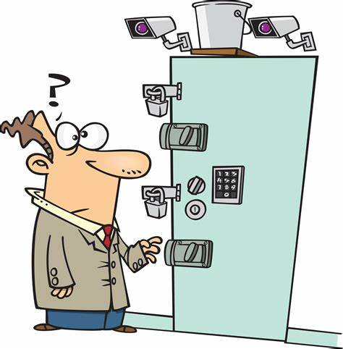
CR 4-2 State Property
Supplies should be stored in locked cabinets
CR 4-2 describes how we care for and safeguard state property issued to Cadet Corps units
Minimum security standards to store property
Extra security for working (able to fire) weapons
Prevention of pilferage/theft, deterioration, and loss
Pilferage is likely from Cadets, of small items
Theft is likely from outside elements seeking value

Slide 32
Storing & Safeguarding Supplies
Small arms will be protected by triple locks
Arms racks will be secured to the floor or wall
Bolts will be secured separately from rifles
Schools can possess up to 5000 rounds of ammo
Keys and combinations will be controlled
If working weapons are stored, the school should make the local police aware of that

Slide 33
Check on Learning
What subtopic of logistics is covered in CR 4-2?
If a school has working weapons, what should they do to enhance security?
Name 3 things that proper security prevents.

Slide 34
CR 3-21.5 Drill & Ceremonies
Use CR 3-21.5 to determine standards for performing Drill and Ceremonies at individual, squad, platoon, company, or battalion level
Use CR 3-21.5 to determine standards for rifle drill, manual of the guidon, and color guard drill
Use CR 3-21.5 to properly plan a review ceremony at battalion or brigade level

Slide 35
CR 3-21.5 Drill & Ceremonies
Refined from Army Technical Circular 3-21.5
Establishes standards for drill movements and command of drill units
Learn the drill for the next level you up from your position (start with Individual Drill, then Squad, etc. If you’re marching a Platoon, you need to know Company drill)
Become an expert at your level of drill
Constantly refer to CR 3-21.5
Preview the reg before you teach a movement

Slide 36
CR 3-21.5 Drill & Ceremonies
CR 3-21.5 mostly uses the text from TC 3-21.5
Where necessary, the movements are explained differently, in ways (hopefully) cadets will understand better
Standards are adjusted to cadet requirements
24-inch and 12-inch steps
Smaller units
Photos are of CACC cadets, not soldiers

Slide 37
Practical Exercise #1
You have been assigned to teach the drill movement Column Right March (while marching) to your platoon tomorrow.
Without looking at the CR 3-21.5, write down all the details of this movement you can think of.
Do you think that’s pretty complete? Great!
Now go to CR 3-21.5, paragraphs 4-7 and 5-11. Read through each paragraph carefully, and add to your list.
Once you’re done, compare it to our list on the next page (don’t peek!).

Slide 38
Answer to Practical Exercise #1
Column Right, March (while marching)
Command given while marching forward in Column formation. (Can’t be given marching inverted)
Preparatory Command: Column Right (given on right foot)
Command of Execution: March (also on right foot)
Right Squad (base file):
Squad Leader takes one additional step with the left foot, pivots 90 degrees to the right on the ball of the left foot, continues marching in the new direction, taking up the Half Step
Each subsequent cadet marches to the point where the squad leader pivoted, and pivots in the same place
Pin your arms to your side when executing the 90-degree pivot (not in manual, but tradition)
Once all the other squads have come abreast of the base squad, cadets step out with a 24-inch step without command
Continued on Next Slide

Slide 39
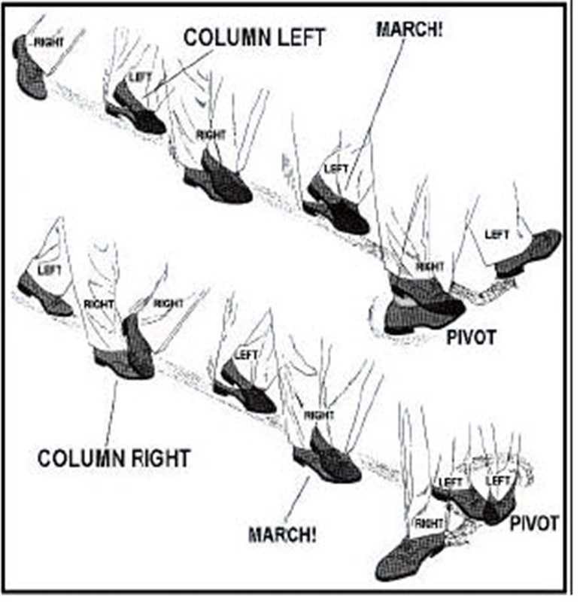
Answer to Practical Exercise #1
All Other Squads:
Squad leader takes one additional step with the left foot, pivots 45 degrees to the right, continues marching, and arcs around to the right, maintaining dress and interval, until you’ve caught up to the squad leaders to your right, then take up the Half Step
Once all squad leaders are abreast, they automatically resume 24-inch steps without command
Each subsequent cadet in each squad marches to the point where their squad leader pivoted, and they execute the same movements as the squad leader (pivot, arc, half step, 24-inch step)

Slide 40
Practical Exercise #2
You have been assigned to teach the manual of arms movement Present Arms from Order Arms, and back to Order Arms, to your platoon tomorrow.
Without looking at the CR 3-21.5, write down all the details of this movement you can think of.
Do you think that’s pretty complete? Great!
Now go to CR 3-21.5, paragraph 2-5. Read through each paragraph carefully, and add to your list.
Once you’re done, compare it to our list on the next page (don’t peek!).

Slide 41
Answer to Practical Exercise #2
Present Arms from Order Arms:
Command is given while at Order Arms with the rifle
Preparatory Command: Present
Command of Execution: Arms
From Order Arms, Present Arms is a three-count movement.
At the command of execution Arms
Grasp the rifle with the right hand and raise the rifle diagonally across the body, keeping the right elbow down alongside the rifle (without strain).
With the left hand, simultaneously grasp the rifle at the balance (grasping the wood stock right above the receiver) so that the rifle is about 4 inches (a fist) from the body.
On count two, regrasp the rifle at the small of the stock with the right hand. Hold the rifle diagonally across the body, about 4 inches from the body, the right forearm horizontal, and the elbows close to the sides (this is Port Arms)
Continued on Next Slide

Slide 42
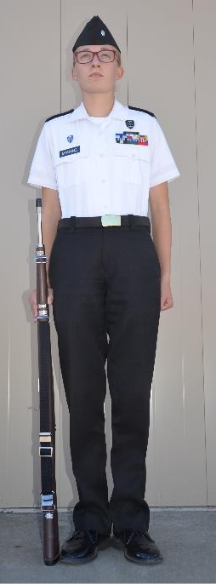
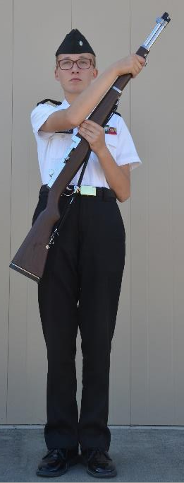
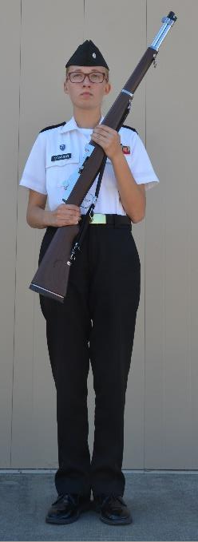
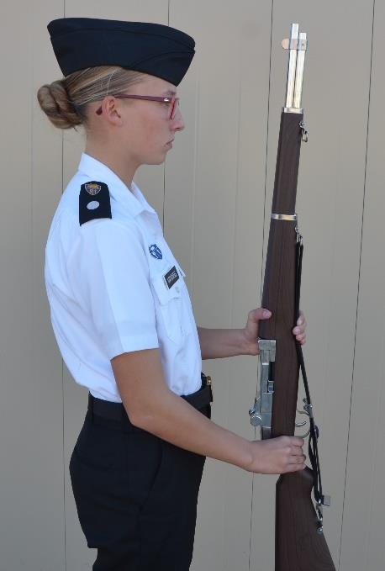
Answer to Practical Exercise #2
On count three, twist the rifle with the right hand so that the sights are to the rear, and move the rifle to a vertical position about 4 inches in front of and centered on the body. Lower the rifle until the left forearm is horizontal; keep the elbows at the sides. Keep the left thumb wrapped around the rifle and touching the right side of the handguard right above the receiver. Incline the barrel slightly backward to ensure the weapon is vertical.
Continued on Next Slide

Slide 43
Answer to Practical Exercise #1
Order Arms from Present Arms:
Command is given while at Present Arms with the rifle
Preparatory Command: Order
Command of Execution: Arms
From Present Arms, Order Arms is a four-count movement.
At the command of execution Arms
Twist the rifle in the grasp of the right hand, returning to the position of Port Arms. Control the rifle with the right hand as you reposition the rifle with the sling within the palm’s grasp with the left hand
On count two, move the right hand up and across the body and firmly grasp the rifle on
the upper stock (handguard) without moving the rifle, and keep the right elbow aligned alongside the rifle.
On count three, move the left hand from the balance and lower the rifle to the right side until it is about 1 inch from the marching surface next to your right foot. Guide the rifle to the side by placing the index finger of the left hand at the top of the rifle near the stacking swivel, fingers and thumb extended and joined, palm to the rear.
On count four, move the left hand sharply to the left side, gently lower the rifle to the ground next to your right foot, and resume the position of Order Arms.
Continued on Next Slide

Slide 44
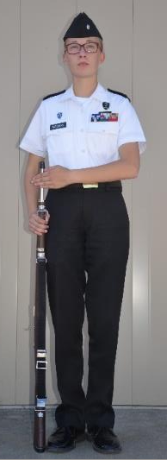
Answer to Practical Exercise #2

Slide 45
Check on Learning
If you’re a Platoon Sergeant, what level of drill should you be competent in?
If scheduled to teach a drill command during a drill class/practice, what should your first step be in preparing for your instruction?
What size steps does CR 3-21.5 call for?

