Slide 1
Curriculum on Military Knowledge
B. Cadet Staff Regulations
“Earn it. Achieve it. Wear it.”
22 September 2020

Slide 2
Agenda
B1. Personnel (S-1) Regulations
B2. Safety (S-2) Regulations
B3. Operations (S-3) Regulations
B4. Logistics Regulations
B5. Civic, Public & Military Affairs Regulations

Slide 3
Personnel Regulations
Objectives:
Use CR 1 to properly prepare a Strength and Activities Report
Use CR 1 to prepare orders and permanent orders
Use CR 1 to prepare and maintain Cadet Service Records and Personnel Files
Use CR 1 to prepare and maintain unit files in accordance with the Master Files Index
Use CR 1-6 to prepare for an Annual General Inspection

Slide 4
Personnel Regulations
OBJECTIVES​
Cadet Leaders are able to identify where to get information about the standards required to do a staff job, S1 through S6.
​
Plan of Action​
Use CR 1 to properly prepare a Strength and Activities Report
Use CR 1 to prepare orders and permanent orders
Use CR 1 to prepare and maintain Cadet Service Records and Personnel Files
Use CR 1 to prepare and maintain unit files in accordance with the Master Files Index
Use CR 1-6 to prepare for an Annual General Inspection
​
Essential Question: How do Cadet Regulations help us properly do the S1 – S6 staff jobs at a cadet battalion?

Slide 5
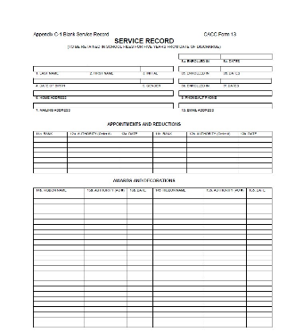
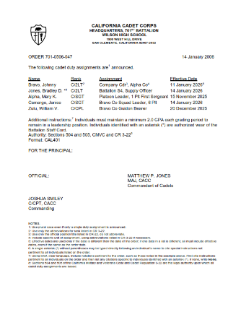
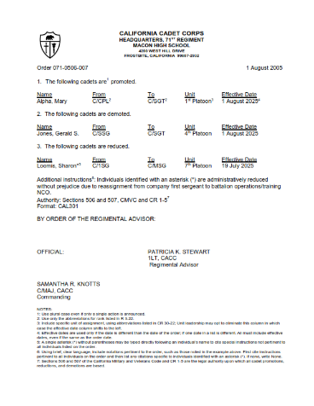
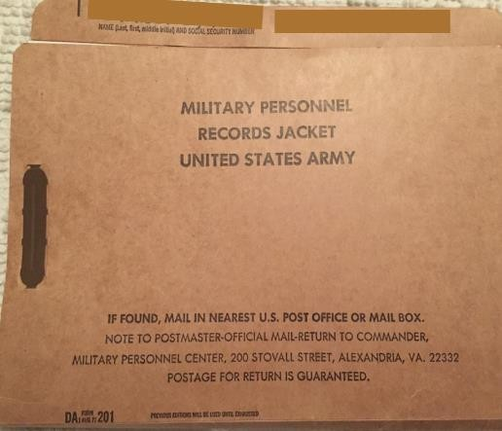
CR 1: General Administration
is a regulation that gives everyone in the Cadet Corps, Commandants and Cadets alike, the standards and formats for administrative and personnel functions. It covers:
Strength and Activity Reporting
Preparation of Orders and Permanent Orders
Cadet Service Records and Personnel Files
Preparing and Managing Correspondence (covered in Lesson C)
File Management
These are what make your promotions and awards “official”!

Slide 6
Strength & Activity Report
Tells the HQ CACC and Military Department how many cadets are in each unit, their ranks, and what activities they’re doing.
Due every month by the 10th, updated as of the 1st.
Done online in Commandant Tools.
Once you populate your database, it’s just the click of a mouse!

Slide 7
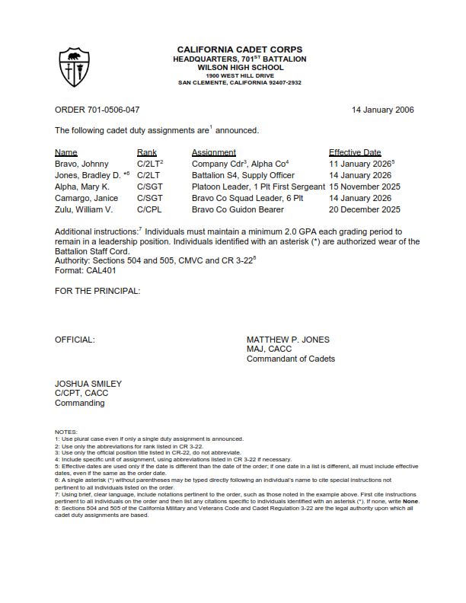
Orders & Permanent Orders
Orders are the written and oral means by which instructions are transmitted to cadets, units, or personnel. There are two types:
Orders: Appointments, promotions, reductions, demotions, and assignment of cadets or commandants
Permanent Orders: The award of ribbons, medals, badges, bars, decorations, accouterments, and unit awards identified in CR 1-1 and CR 1-7.
Specific formats are required – they’re in CR 1

Slide 8
Cadet Service Records
CACC Form 13 (covered in Lesson M1A)
Cadet’s permanent record, also called 201 file
Reflects the career progression while in CACC
CR 1 tells the S1 how to enter data properly on the Form 13
Other records (orders, rosters, PTA checklists, etc.) are kept with the Form 13 in the Personnel File

Slide 9
Files
Units must maintain certain files
They must be organized per CR 1, Chapter 7 & Appendix C
They’re an official record of what the unit has done
They’re checked during the Annual General Inspection
They may be kept electronically, but must be accessible and per the reg

Slide 10
Files
See the Master Index in Appendix C
List of all required files
By Staff Area & Subject
Many will be empty for your unit
Keep a copy of everything you do as a staff member and put it in the right file
Review before the AGI and ensure required documents are filed where they’re supposed to be
i.e. A copy of every Training Schedule for the past year

Slide 11
CR 1-6 AGI
CR 1-6 gives us the standards by which we grade CACC units at the AGI
Cadet Commanders should set goals and plan their unit activities based on CR 1-6 requirements
Cadet Staff should plan and execute their jobs based on what CR 1-6 requires

Slide 12
CR 1-6
The Inspection Program
The Rubric (standards)
The Report form
Recommended briefing slides for the staff
CR 1-6 tells you what to expect during the AGI. By going through it, you can plan and prepare by having all the questions answered before the inspection, while you can still fix things!

Slide 13
Sample from the Rubric
This is Requirement #5. The Cadet Sergeant Major is responsible for answering this requirement.
For each level of grade, Superior thru Unsatisfactory, it describes what the unit must have done.
The unit must provide proof/evidence of completion (i.e. a Roster of cadets who participated in each parade the unit has marched in)

Slide 14
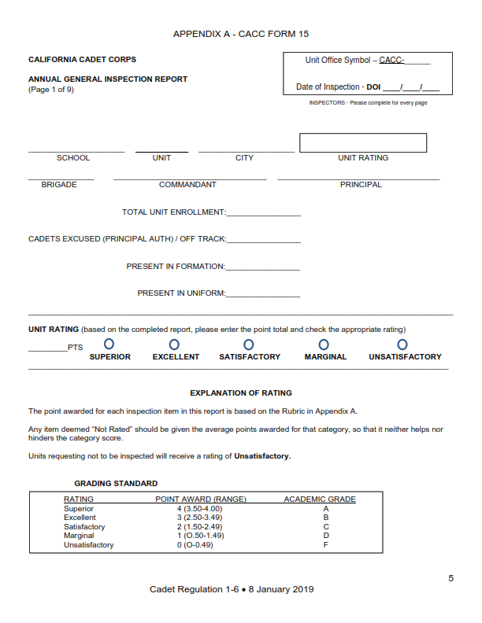
Form 15 – AGI Report

Slide 15
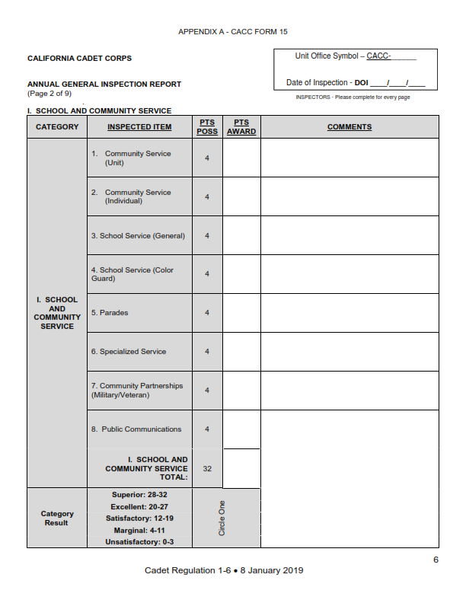
Form 15 – AGI Report

Slide 16
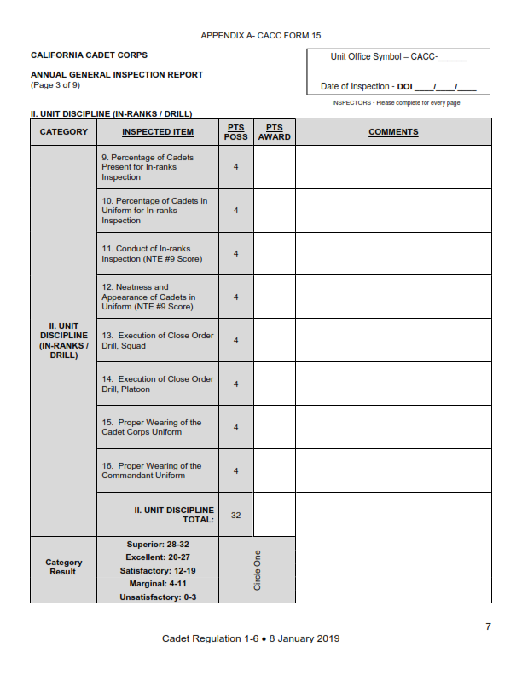
Form 15 – AGI Report

Slide 17
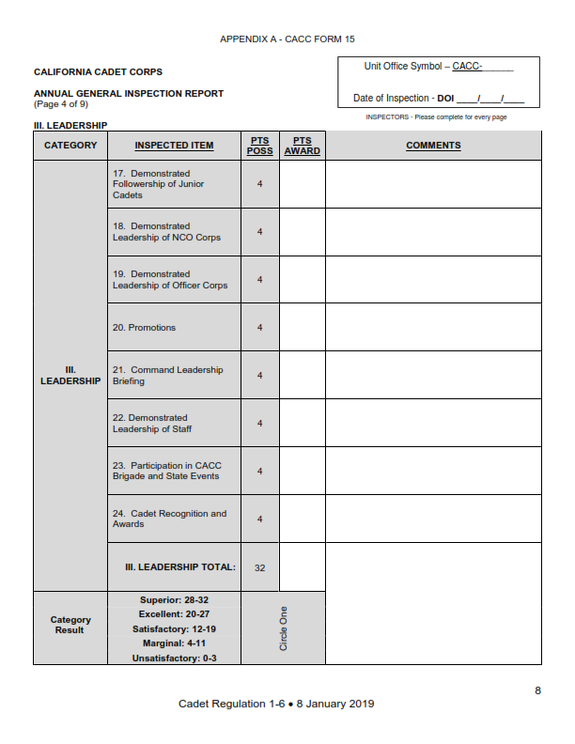
Form 15 – AGI Report

Slide 18
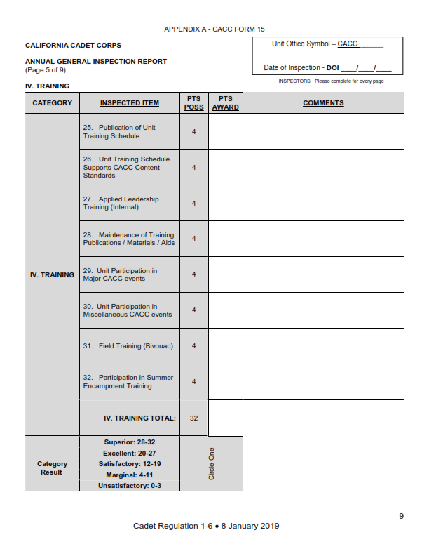
Form 15 – AGI Report

Slide 19
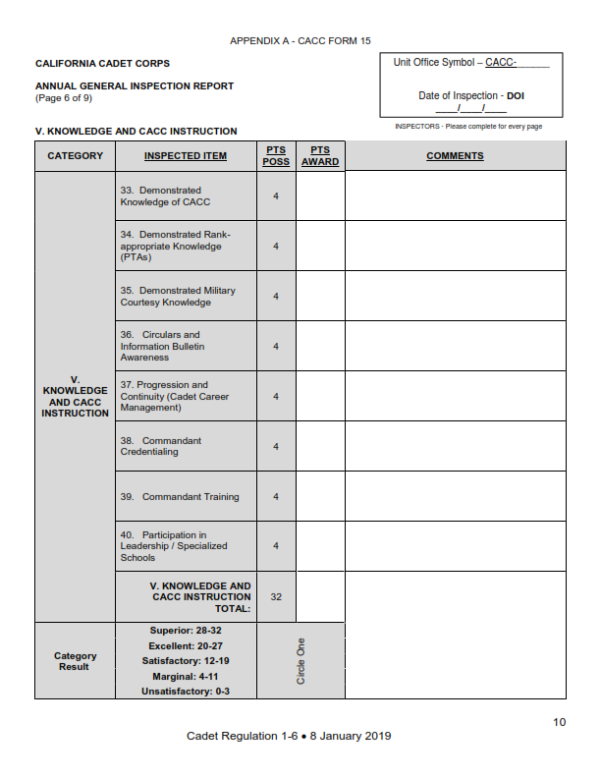
Form 15 – AGI Report

Slide 20
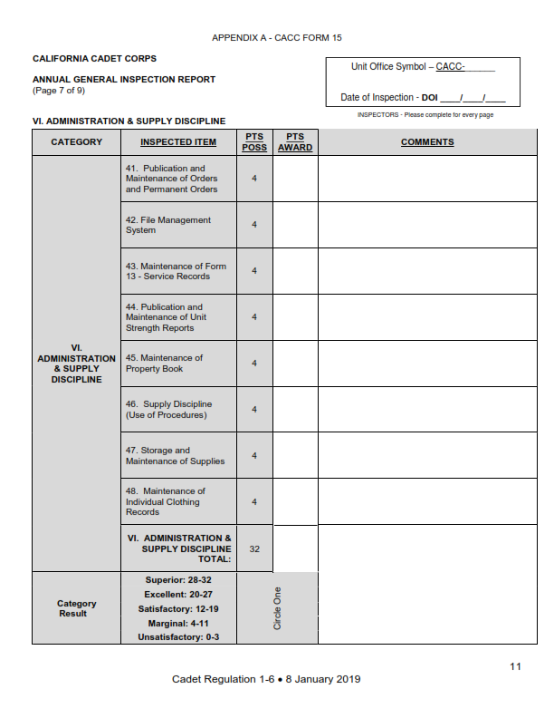
Form 15 – AGI Report

Slide 21
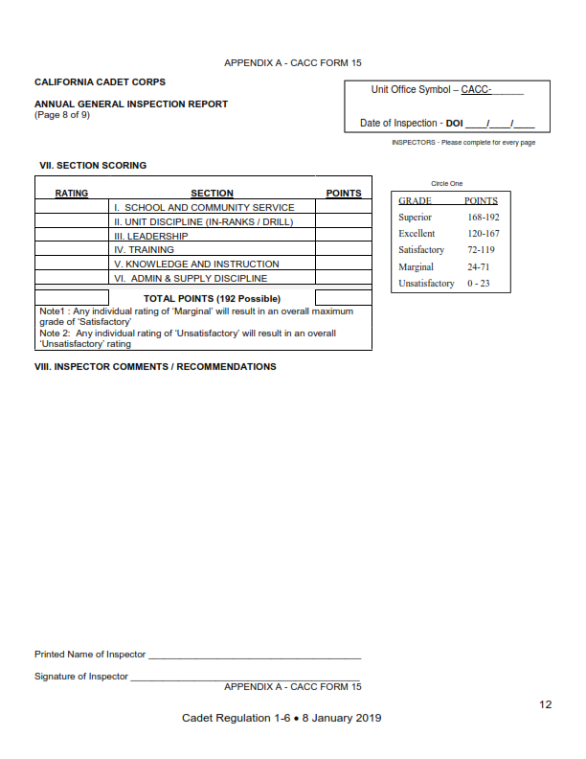
Form 15 – AGI Report

Slide 22
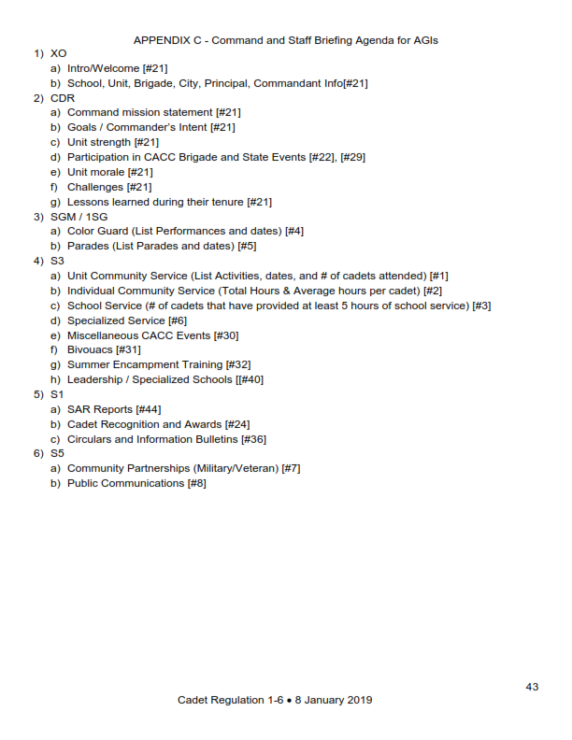
Command & Staff Briefing

Slide 23
Check on Learning
What regulation tells you about the Strength & Activity Report?
Of the actions listed, which goes into an order, and which into a permanent order?
A promotion
The award of a ribbon
An appointment to a staff job
The award of an Honor Cadet badge
Eligibility to wear the red beret
Where are the standards for each area inspected during the AGI found?
How do you know what to put in your Command and Staff Briefing for the AGI?

Slide 24
Safety (S-2) Regulations
Use CR 2-1 to oversee the Unit Safety Program and prepare/implement Risk Management Worksheets for cadet activities
Identify the 3 CACC Environmental Principles
Identify the rules and standards from CR 2-1 that apply to Cadets and Commandants regarding Cadet Protection

Slide 25
Safety Regulations
OBJECTIVES​
Cadet Leaders are able to identify where to get information about the standards required to do a staff job, S1 through S6.
​
Plan of Action​
Use CR 2-1 to oversee the Unit Safety Program and prepare/implement Risk Management Worksheets for cadet activities
Identify the 3 CACC Environmental Principles
Identify the rules and standards from CR 2-1 that apply to Cadets and Commandants regarding Cadet Protection
​
Essential Question: How does CR 2-1 define the Risk Management process, describe environmental concerns, and establish rules that protect our cadets?

Slide 26
CR 2-1 Safety, Risk Management, Environmental & Cadet Protection
CR 2-1 covers a LOT of material, all SAFETY related
We need to identify hazards
We need to mitigate hazards through planning & safety implementation
We need to be good STEWARDS of our environment
We need to protect our CADETS from harm

Slide 27
Risk Management Process
(1) Identify hazards
(2) Assess hazards to determine risks
(3) Develop controls and make risk decisions
(4) Implement controls
(5) Supervise and Evaluate
Once we know what the potential hazards are, we figure out ways to reduce those risks to a reasonable level through ‘controls.’ We ensure leaders and cadets know the controls – the safety rules – and follow them. And we evaluate how it went, and how we can do better next time.

Slide 28
Assessing a Hazard
Probability and Severity of Hazard
Determine how likely the hazard might happen
Determine how severe the result will be
Put that on the chart to determine the risk

Slide 29
Risk Assessment Chart
PROBABILITY→ SEVERITY↓ | FREQUENT | LIKELY | OCCASIONAL | SELDOM | UNLIKELY
CATASTROPHIC (death/serious injury and/or environmental damage) | Extremely High | Extremely High | High | High | Moderate
CRITICAL (extensive injuries and/or environmental damage) | Extremely High | High | High | Moderate | Low
MARGINAL (minor injury/illness/environmental damage) | High | Moderate | Moderate | Low | Low
NEGLIGIBLE (first aid, very minor loss) | Moderate | Low | Low | Low | Low

Slide 30
Risk Management Example
Running the Paintball Course
Hazard (there may be many – you do this for each one): Putting an eye out with a direct hit
Probability: Seldom
Severity: Critical
Risk Level: Moderate
(when I started this, I thought the risk would be High; examine my answers; do you agree?)

Slide 31
Risk Mitigation
Hazard: Putting an eye out with a paintball round
Control Measures:
Wear protective eyewear/helmet
Safety briefing – don’t aim at other cadets’ heads
Training – aiming with the paintball gun
Outcome:
Probability goes to Unlikely, Severity stays at Critical
This reduces the risk to Low
Supervision:
Range and Safety Officers
Cadet chain of command
Operate in Teams in the Paintball Course
Evaluation:
Review –
Did anyone get hit in the eye? Did anyone get hit in the head? Where were the hits?
Use this information for training before the next course

Slide 32
Environmental Principles
Principle #1. Cadets will always leave an area better than when it was found.
Principle #2. Cadet Corps leadership will be familiar with applicable local, state, and national policies regarding environmental impact and fully comply with those policies.
Principle #3. Cadet Corps activities will strive to mitigate any negative impact on the environment and will, whenever possible, avoid such impact.

Slide 33
Cadet Protection
Commitment to Safety
Proximity of Supervisor - always near
Semi-Private Discussions – not alone w/cadet
Transportation – At least 3 in vehicle
In the Field – Rule of Three
No Favoritism / No Gifts
Social Media approved by S5
No cadets in Adult quarters/tent/
room

Slide 34
Cadet Protection
Segregation by Gender(overnight)
Reasonable Accommodation for Sexual Orientation or Transgender Cadets
Personal Care Time – private
Cadet Supervisors
Confidentiality w/medical/health info
Training intensity appropriate for situation
Train adults & cadets on rules

Slide 35
Check on Learning
List the 5 steps in the Risk Management Process.
Name one of the 3 CACC environmental principles.
Name 3 CACC Cadet Protection Rules.

Slide 36
Operations (S-3) Regulations
Use CR 3 to prepare a Lesson Plan
Use CR 3 to prepare a Unit Training Schedule
Use CR 3-14 and the Cadet Activity Planning Process (CAPP) to plan a unit activity

Slide 37
Operations Regulations
OBJECTIVES​
Cadet Leaders are able to identify where to get information about the standards required to do a staff job, S1 through S6.
​
Plan of Action​
Use CR 3 to prepare a Lesson Plan
Use CR 3 to prepare a Unit Training Schedule
Use CR 3-14 and the Cadet Activity Planning Process (CAPP) to plan a unit activity
​
Essential Question: What are the requirements outlined in cadet regulations for planning cadet training and activities?

Slide 38
CR 3 Training
The CACC Training Concept
Applied Leadership
Flexible, with recommended subjects per semester
CACC Curriculum Design
4 Instructional Groups, 33 Strands, >600 Lessons
4 Content Standards
A-G Requirements, CTE
Lesson Planning template
CACC Knowledge & Basic Facts
Training Schedule template

Slide 39
Training Schedules
CALIFORNIA CADET CORPS TRAINING SCHEDULE
UNIT: _____504th Bn_______________________ |  |  |  |  | DATES: ___20-25 AUG 2018___________________
DATE/TIME | WHO | WHAT | WHERE | TRAINER | UNIFORM | NOTES | CACC STD/ STRAND/LESSON
8/20/2018 Pds 2/3/4 | 1st Yr | Class: CACC History & Organization | CR 201 | C/SFC Jones | None |  | Std 1a. M5/A1 & A4
8/20/2018 Pds 2/3/4 | 2d Yr | Class: Teaching Drill | Drill Pad | C/1SG Diaz | None | Bring TC 3-21.5 | Std 1z. M7/A1 & A2
8/20/2018 Pds 2/3/4 | Sr Cdts | Self-Study: Leadership Styles | CR 202 | C/MAJ Scanlon | None |  | Std 3h. L4/A1-4
8/21/2018 Pds 2/3/4 | ALL | D&C: Ind Drill | Drill Pad | Sqd Ldrs | None | Fall In, Attn, Facing | Std 1aa. M3/B
8/22/2018 Pds 2/3/4 | ALL | Uniform Issue | CR 201 | C/2LT Smith | None | Class B & C
8/23/2018 Pds 2/3/4 | 1st Yr | Class: Class B Uniform | CR 201 | C/2LT Smith | None |  | Std 1f. M2/A
8/23/2018 Pds 2/3/4 | 2 & 3d Yr | Practice: Teaching Drill | Drill Pad | C/1SG Diaz | None | Individual Drill Movements | Std 1aa. M3/B
8/24/2018 Pds 2/3/4 | ALL | PT: Extended Rectangular Formation | Field | C/1SG Diaz | None | PT Clothes | Std 4c. W3/B2
8/25/2018 Pds 2/3/4 | ALL | D&C: Ind Drill | Drill Pad | Sqd Ldrs | None | Facing, DRD/Cover/ Open Ranks | Std 1aa. M3/B
NOTES: Staff Requirements: S1 start Personnel Files; S3 finalize Training Schedules & File Lesson Plans; S4 Issue Uniforms; S5 Market to get late registering students into CACC.
APPROVAL
Initial/Date: Cdt Tng Off: ____________________ Cdt Cdr: ____________________ Commandant: _________________________
CACC Form 23 (Jul 2018) Previous editions are obsolete

Slide 40
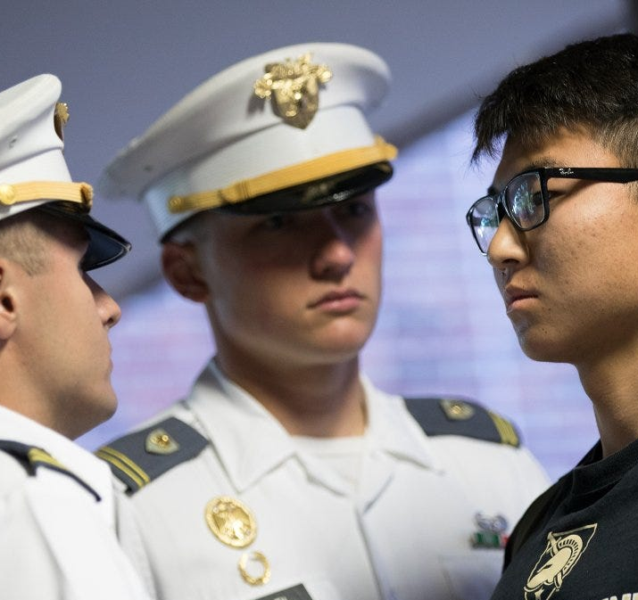
CACC Knowledge “Memory Work”
Knowledge that is expected of a successful Cadet
The CACC Mission, Goals (Cadet Code), and Objectives
The CACC Core Values, Honor Code, Definition of Leadership, & Leader’s Code
CACC History and General Orders
CACC Chain of Command

Slide 41
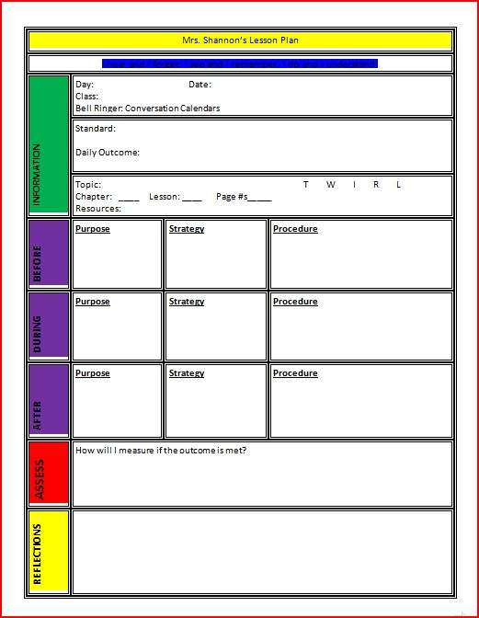
Lesson Planning Appendix C, CR 3
Step 1: Decide what you want your cadets to know and be able to do at the end of your instruction.
Step 2: Decide how you will know your cadets have learned what you taught. Select the method(s) you will use to ASSESS their understanding, knowledge, and skill
Step 3: Write out the steps you will use to get the cadets to learn the material you are presenting so they are successful on the assessment. Organize the information in a logical way.
Step 4: Gather the materials you need for the class. What materials will you need for the class?
Step 5: After the class: What went well in your class and what would you do differently next time to make the class better?

Slide 42
CR 3-14 Cadet Activity Planning
The Cadet Activity Planning Process:
Step 1: Envision the Activity
Step 2: Initial Planning
Step 3: WARNORD/
Marketing/Staff Selection
Step 4: Detailed Planning
Step 5: Support Planning
Step 6: Preparation
Step 7: Execution
Step 8: Assessment

Slide 43
Check on Learning
What are the 8 pieces of information for each event on the CACC Training Schedule?
T/F: A cadet is expected to be able to list the 6 Objectives of the California Cadet Corps
What regulation covers the Cadet Activity Planning Process?

Slide 44
Logistics (S-4) Regulations
Use CR 4-1 to prepare and maintain an Individual Clothing Record, CACC Form 100
Use CR 4-1 to prepare and maintain a Unit Property Book
Use the CACC Website to prepare supply requisitions using the online forms

Slide 45
Logistics Regulations
OBJECTIVES​
Cadet Leaders are able to identify where to get information about the standards required to do a staff job, S1 through S6.
​
Plan of Action​
Use CR 4-1 to prepare and maintain an Individual Clothing Record, CACC Form 100
Use CR 4-1 to prepare and maintain a Unit Property Book
Use the CACC Website to prepare supply requisitions using the online forms
​
Essential Question: How do the requirements of CR 4-1 and 4-2 protect Cadet Corps supplies and equipment?

Slide 46
CR 4-1 Supply Management
Managing supplies is all about Accountability
Equipment at a unit belongs to the State of California, and it’s a leader’s job to ensure it stays in the unit
We use the Individual Clothing Record and Hand Receipts to maintain Accountability
This ensures we know where all the equipment that we hand out is, so we can get it back

Slide 47
2 Types of Property
State Controlled
Quick Service Items
Must be accounted for
Weapons
Uniform Items
CPR Mannequins
Compasses
Color Guard Equipment
Anything costing >$100 that was issued by CACC
Low Cost Items
Rank Insignia
Ribbons & Medals
Attachments & Badges
These SHOULD be controlled so that they aren’t pilfered or taken by unauthorized people
Some property must be accounted for but does not need to be collected back. Uniform items like hats or PT T-Shirts & Shorts, because they touch the skin, are expendable

Slide 48
Clothing Record
Maintained on every cadet who has been issued uniform items
Every time you issue or receive a uniform item, it’s annotated on the Form 100 & signed in or out
Issued # for each item is carried over to the next column. The latest column lists everything the cadet has signed for
Sizes & Ranks are entered in pencil

Slide 49
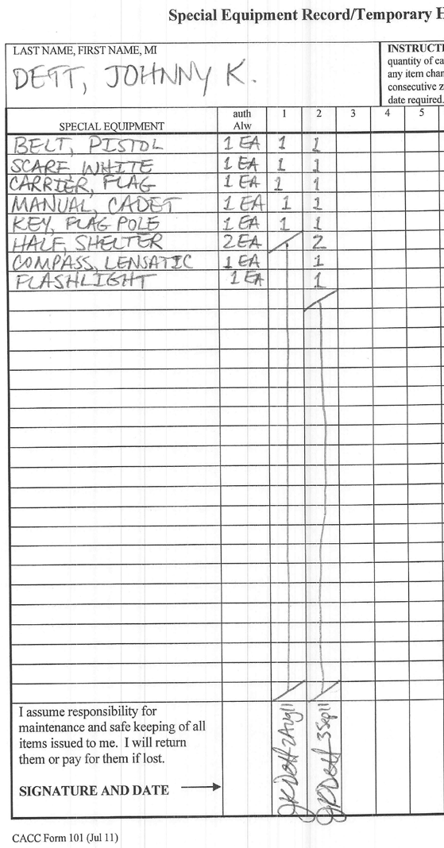
Hand Receipts CACC Form 101
Accounts for all property you have issued out other than uniform items
Every Time you issue equipment, have the received sign a hand receipt
Exception: if the cadet will use the equipment in class under your supervision, you can assume responsibility for its accountability. The Instructor should sign a hand receipt for all items, collect them at the end of training, and turn them in
Once turned in, the hand receipt is destroyed

Slide 50
Property Book
The legal record of the state-controlled items that a unit has been issued.
CACC Form 104 (electronic)
Lists what you should have on hand
Received or Purchased
Issued Out (accounted for by Forms 100 & 101)
You must have CACC Form 100’s & 101’s for the items issued out
Must conduct formal inventories and document them to show you have the equipment
If equipment is lost, you must complete a Report of Survey to show the loss; then you can remove it off your Property Book

Slide 51
Requisitions
CACC Website
Headquarters
S-4
Uniform Requisitions
Note: HQ CACC does not always have all uniform items on hand, nor do they always have people able to pull and ship the items. Communicate with your chain of command about what you need and whether you can get it.

Slide 52
Check on Learning
What is managing supplies “all about”?
What are the two types of property, and what’s the difference?
What should you ALWAYS do when issuing property to someone?
Where are the forms for requisitioning uniform items?

Slide 53
Civic, Public, & Military affairs Regulations
15. Use CR 5-1 to manage Civic, Public, and Military Affairs for a CACC unit.

Slide 54
Civic, Public, & Military Affairs Regulations
OBJECTIVES​
Cadet Leaders are able to identify where to get information about the standards required to do a staff job, S1 through S6.
​
Plan of Action​
Use CR 5-1 to manage Civic, Public, and Military Affairs for a CACC unit.
​
Essential Question: How do we publicize the activities of the California Cadet Corps in a positive, responsible manner?

Slide 55
CR 5-1 Civic, Public, & Military (CPM) Affairs
CPM Activity Rules:
No discrimination
No religion or partisan politics
No endorsement of private ventures
Fostering of public service, patriotism, national security, national heritage = okay
School/Community Service = great
We can’t be individually paid for our service
Your support to charities of your choice is fine
No participation (as CACC) in protests or demonstrations

Slide 56
Outreach
Every effort will be made by units, regiments, brigades, and the HQ, CACC to promote positive relationships with civic entities, including but not limited to:
city council members
mayors
city departments/agencies
school board members
school district officials
county supervisors
county government offices/agencies
the state assembly
the state senate
The California Department of Education and California State Board of Education
The Governor, Lieutenant Governor, and other elected statewide officials
Other State of California departments/agencies

Slide 57
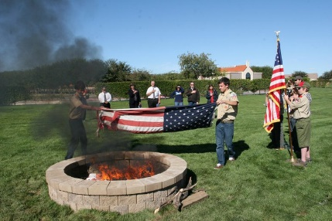
Role of the S5
Invite dignitaries to CACC events
Request proclamations for 5 April
Seek membership in civic organizations
Outreach to local parades, events
Conduct a Flag Disposition Ceremony
Promote Color Guard & Flag Details
Publish CACC newsletters & web pages
Outreach to fraternal organizations
Create media with photos & video

Slide 58
Check on Learning
Which of the following is acceptable under CPM rules?
CACC cadets, as a group, participate in a BLM demonstration
CACC cadets hold a prayer service at the end of practice
Cadets on a Color Guard receive $25 each for presenting the colors at a function
A CACC cadet attends a BLM demonstration with their family
Name 5 political officials (by position) the S5 could outreach to gain support for the program.
Name 4 roles the S5 can perform

